Slide 1


from cots to kids
range overview
i-Deal
our entry level range
core options
fibre
fibre & spring
top cover
kidtex eco 80 Supersoft
hypo allergenic
wipe clean cover
one sleeping surface
bottom cover
kidtex non woven
ESSENTIALS
our entry+ range
core options
fibre
fibre & spring
top cover
kidtex eco 100
hypo allergenic
ultrasonic quilting
wipe clean cover
one sleeping surface
bottom cover
kidtex non woven
KIDTEX
our good range
core options
orthopaedic foam
foam & spring
top cover
kidtex plus
hypo allergenic
ultrasonic quilting
wipe clean cover
reversible mattress
two sleeping surfaces
bottom cover
kidtex non woven
VENTIFLOW
our better range
core options
orthopaedic foam
foam & pocket spring
dual core with coir
top cover
breathex airflow plus
hypo allergenic
knitted design
removable and washable
reversible mattress
two sleeping surfaces
bottom cover
supersoft permex plus
hypo allergenic
TOTAL CAIR
our best range
core options
orthopaedic hygiena core
top cover
aerobliss
antimicrobial
viroblock treatment
knitted swirl design
removable and washable
reversible mattress
two sleeping surfaces
four comfort options
bottom cover
polka sonic
hypo allergenic
quilted dot design

Slide 2

Bebeluca Range Pg1
Item code | Item | Desc/Dims | Pack Size
Moses Basket Mattresses
BBLKEVAL01 | i-Deal Fibre Moses Basket Mattress | 74x28x2.5 | 6
BBLKE01 | Essentials Fibre Moses Basket Mattress | 74x28x4 | 6
BBLKEP01 | Essentials Premium Fibre Moses Basket Mattress | 74x28x4 | 6
BBLK01 | KIDTEX Small Foam Moses Basket Mattress | 65x27x2 | 6
BBLK02 | KIDTEX Foam Moses Basket Mattress | 75x28x3 | 6
BBLKP02 | VENTIFLOW Foam Moses Basket Mattress | 75x28x3 | 6
Crib Mattresses
BBLKEVAL03 | i-Deal Fibre Crib Mattress | 89x38x2.5 | 6
BBLKEVAL03BED | i-Deal Fibre Crib Mattress (Bedside) | 89x50x2.5 | 6
BBLKE03 | Essentials Fibre Crib Mattress | 89x38x4 | 6
BBLKEP03 | Essentials Premium Fibre Crib Mattress | 89x38x4 | 6
BBLK03 | KIDTEX Foam Crib Mattress | 88.5x39.5x3 | 6
BBLK134 | KIDTEX Short Crib Mattress | 80x50x3 | 6
BBLKP03 | VENTIFLOW Foam Crib Mattress | 88.5x39.5x3 | 6
BBLKP03BED | VENTIFLOW Foam Crib Mattress (Bedside) | 83x50x3 | 6
Pram Mattresses
BBLK04 | KIDTEX Foam Square End Pram Mattress | 73x35x3 | 6
BBLK05 | KIDTEX Foam Round End Pram Mattress | 73x35x3 | 6
Travel Mattresses
BBLK09 | KIDTEX Folding Travel Cot Mattress | 96x54x2.5 | 5
BBLKP11 | VENTIFLOW Folding Travel Cot Mattress | 96x54x2.5 | 5
BBLK10 | KIDTEX Travel Cot Thick Mattress | 93x64x6 | 4
BBLKP10 | VENTIFLOW Thick Travel Cot Mattress | 93x64x6 | 4
BBLK21 | KIDTEX Large Travel Cot Thick Mattress | 98x69x6 | 4

Slide 3
Bebeluca Range Pg2
Item code | Item | Desc/Dims | Pack Size
Cot & Cotbed Mattresses
BBLKEVAL065 | i-Deal Fibre Cot Mattress | 120x60x5 | 2
BBLKEVAL085 | i-Deal Fibre Cotbed Mattress | 140x60x5 | 2
BBLKEVAL068 | i-Deal Fibre Cot Mattress | 120x60x8 | 2
BBLKEVAL088 | i-Deal Fibre Cotbed Mattress | 120x60x8 | 2
BBLKE06 | Essentials Fibre Cot Mattress | 120x60x8 | 2
BBLKE08 | Essentials Fibre Cotbed Mattress | 140x70x8 | 2
BBLKEP06 | Essentials Premium Fibre Cot Mattress | 120x60x10 | 2
BBLKEP08 | Essentials Premium Fibre Cotbed Mattress | 140x70x10 | 2
BBLK06 | KIDTEX Foam Cot Mattress | 120x60x8 | 2
BBLK08 | KIDTEX Foam Cot Bed Mattress | 140x70x10 | 2
BBLKEVAL11 | i-Deal Fibre Spring Cot Mattress | 120x60x10 | 2
BBLKEVAL13 | i-Deal Fibre Spring Cotbed Mattress | 140x70x10 | 2
BBLKE11 | Essentials Fibre Spring Cot Mattress | 120x60x10 | 2
BBLKE13 | Essentials Fibre Spring Cotbed Mattress | 140x70x10 | 2
BBLK11 | KIDTEX Spring Cot Mattress | 120x60x10 | 2
BBLK13 | KIDTEX Spring Cotbed Mattress | 140x70x10 | 2
BBLKP14 | VENTIFLOW Spring Cot Mattress | 120x60x10 | 2
BBLKP16 | VENTIFLOW Spring Cot Bed Mattress | 140x70x10 | 2
BBLKP04 | VENTIFLOW Pocket Spring Cot Mattress | 120x60x10 | 2
BBLKP05 | VENTIFLOW Pocket Spring Cot Bed Mattress | 140x70x10 | 2
BBLKP31 | VENTIFLOW Dual Core Cot Mattress | 120x60x10 | 2
BBLKP32 | VENTIFLOW Dual Core Cot Bed Mattress | 140x70x10 | 2
BBLKVB120 | Total Cair HygienaCore Cot Mattress with Viroblock | 120x60x10 | 2
BBLKVB140 | Total Cair HygienaCore Cotbed Mattress with Viroblock | 140x70x10 | 2
Special Purchases / Closeout
BBLK31 | KIDTEX ECOmfort Spring CotBed Mattress | 140x70x10 | 2
BBLKP600 | SUPERIOR Pocket Spring Cot Bed Mattress (M&P Cover) | 140x70x10 | 2

Slide 4
Bebeluca Range – pg3
Item code | Item | Desc/Dims | Pack Size
PVC Changing Mats - Medium
BEBEMAT42 | Beige Polka Dot Change Mat Meduim | 70x40x3.5 | 10
BEBEMAT105 | Grey Stars Change Mat Medium | 70x40x3.5 | 10
BEBEMAT104 | Pink Button Change Mat Medium | 70x40x3.5 | 10
BEBEMAT125 | Blue Button Change Mat Medium | 70x40x3.5 | 10
BEBEMAT34 | Blue Gingham Change Mat Medium | 70x40x3.5 | 10
BEBEMAT35 | Pink Gingham Change Mat Medium | 70x40x3.5 | 10
BEBEMAT112 | Pink Pastel Hearts Change Mat Medium | 70x40x3.5 | 10
BEBEMAT113 | Blue Pastel Stars Change Mat Medium | 70x40x3.5 | 10
BEBEMAT36 | G Goes Free Change Mat Medium | 70x40x3.5 | 10
BEBEMAT37 | Rising Stars Change Mat Medium | 70x40x3.5 | 10
BEBEMAT38 | Duck ‘n’ Bearz Change Mat Medium | 70x40x3.5 | 10
BEBEMAT39 | Pads ‘n’ Paws Change Mat Medium | 70x40x3.5 | 10
BEBEMAT40 | Over The Moon (G) Change Mat Medium | 70x40x3.5 | 10
BEBEMAT41 | Over The Moon (P) Change Mat Medium | 70x40x3.5 | 10
BEBEMAT43 | Blowin Bubbles Change Mat Medium | 70x40x3.5 | 10
BEBEMAT44 | Jollie Olliphant Change Mat Medium | 70x40x3.5 | 10
BEBEMAT45 | Big World (P) Change Mat Medium | 70x40x3.5 | 10
BEBEMAT46 | Big World (B) Change Mat Medium | 70x40x3.5 | 10
BEBEMAT47 | Bamboo Baby Change Mat Medium | 70x40x3.5 | 10
BEBEMAT48 | Peak A Boo Bear Change Mat Medium | 70x40x3.5 | 10
PVC Changing Mats - Large
BEBEMAT62 | Strawberry Bloom Change Mat Large | 75x45x4 | 5
BEBEMAT99 | Navy Star Change Mat Large | 75x45x4 | 5
BEBEMAT001 | Grey Stars Change Mat Large | 75x45x4 | 5
BEBEMAT77 | Play Time Change Mat Large | 75x45x4 | 5

Slide 5
Bebeluca Range – pg4
Item code | Item | Desc/Dims | Pack Size
NEW Changing Mats - Supersoft Microfibre Washable
BBMAT002 | White Microfibre Change Mat Meduim | 70x40x3.5 | 10
BBMAT003 | White Microfibre Quilted Change Mat Medium | 70x40x3.5 | 10
BBMAT006 | G Goes Free Change Mat Medium | 70x40x3.5 | 10
BBMAT007 | Rising Stars Change Mat Medium | 70x40x3.5 | 10
BBMAT008 | Duck ‘n’ Bearz Change Mat Medium | 70x40x3.5 | 10
BBMAT009 | Pads ‘n’ Paws Change Mat Medium | 70x40x3.5 | 10
BBMAT010 | Over The Moon (G) Change Mat Medium | 70x40x3.5 | 10
BBMAT011 | Over The Moon (P) Change Mat Medium | 70x40x3.5 | 10
BBMAT012 | Blowin Bubbles Change Mat Medium | 70x40x3.5 | 10
BBMAT013 | Jollie Olliphant Change Mat Medium | 70x40x3.5 | 10
BBMAT014 | Big World (P) Change Mat Medium | 70x40x3.5 | 10
BBMAT015 | Big World (B) Change Mat Medium | 70x40x3.5 | 10
BBMAT016 | Bamboo Baby Change Mat Medium | 70x40x3.5 | 10
BBMAT017 | Peak A Boo Bear Change Mat Medium | 70x40x3.5 | 10
BBMAT004 | White Microfibre Change Mat Large | 75x45x4 | 5
BBMAT005 | White Microfibre Quilted Change Mat Large | 75x45x4 | 5
BBMAT018 | G Goes Free Change Mat Large | 75x45x4 | 5
BBMAT019 | Rising Stars Change Mat Large | 75x45x4 | 5
BBMAT020 | Duck ‘n’ Bearz Change Mat Large | 75x45x4 | 5
BBMAT021 | Pads ‘n’ Paws Change Mat Large | 75x45x4 | 5
BBMAT022 | Over The Moon (G) Change Mat Large | 75x45x4 | 5
BBMAT023 | Over The Moon (P) Change Mat Large | 75x45x4 | 5
BBMAT024 | Blowin Bubbles Change Mat Large | 75x45x4 | 5
BBMAT025 | Jollie Olliphant Change Mat Large | 75x45x4 | 5
BBMAT026 | Big World (P) Change Mat Large | 75x45x4 | 5
BBMAT027 | Big World (B) Change Mat Large | 75x45x4 | 5
BBMAT028 | Bamboo Baby Change Mat Large | 75x45x4 | 5
BBMAT029 | Peak A Boo Bear Change Mat Large | 75x45x4 | 5

Slide 6

i-Deal Range
The NEW i-Deal range has been designed to help you compete in an increasingly challenging marketplace where price and value of offering are key to your customers.
This new range features FibReTM technology, and takes the fight to your competition but with the expected quality and credibility from Bebeluca
New Item Code | Item | Desc/Dims | Pack Size
Moses Basket Mattresses
BBLKEVAL01 | i-Deal Fibre Moses Basket Mattress | 74x28x2.5 | 6
Crib Mattresses
BBLKEVAL03 | i-Deal Fibre Crib Mattress | 89x38x2.5 | 6
BBLKEVAL03BED | i-Deal Fibre Crib Mattress (Bedside) | 89x50x2.5 | 6
Cot & Cotbed Mattresses
BBLKEVAL065 | i-Deal Fibre Cot Mattress | 120x60x5 | 2
BBLKEVAL085 | i-Deal Fibre Cotbed Mattress | 140x60x5 | 2
BBLKEVAL068 | i-Deal Fibre Cot Mattress | 120x60x8 | 2
BBLKEVAL088 | i-Deal Fibre Cotbed Mattress | 120x60x8 | 2
BBLKEVAL11 | i-Deal Fibre Spring Cot Mattress | 120x60x10 | 2
BBLKEVAL13 | i-Deal Fibre Spring Cotbed Mattress | 140x70x10 | 2
SEE NEXT PAGES FOR MATTRESS DETAILS

Slide 7
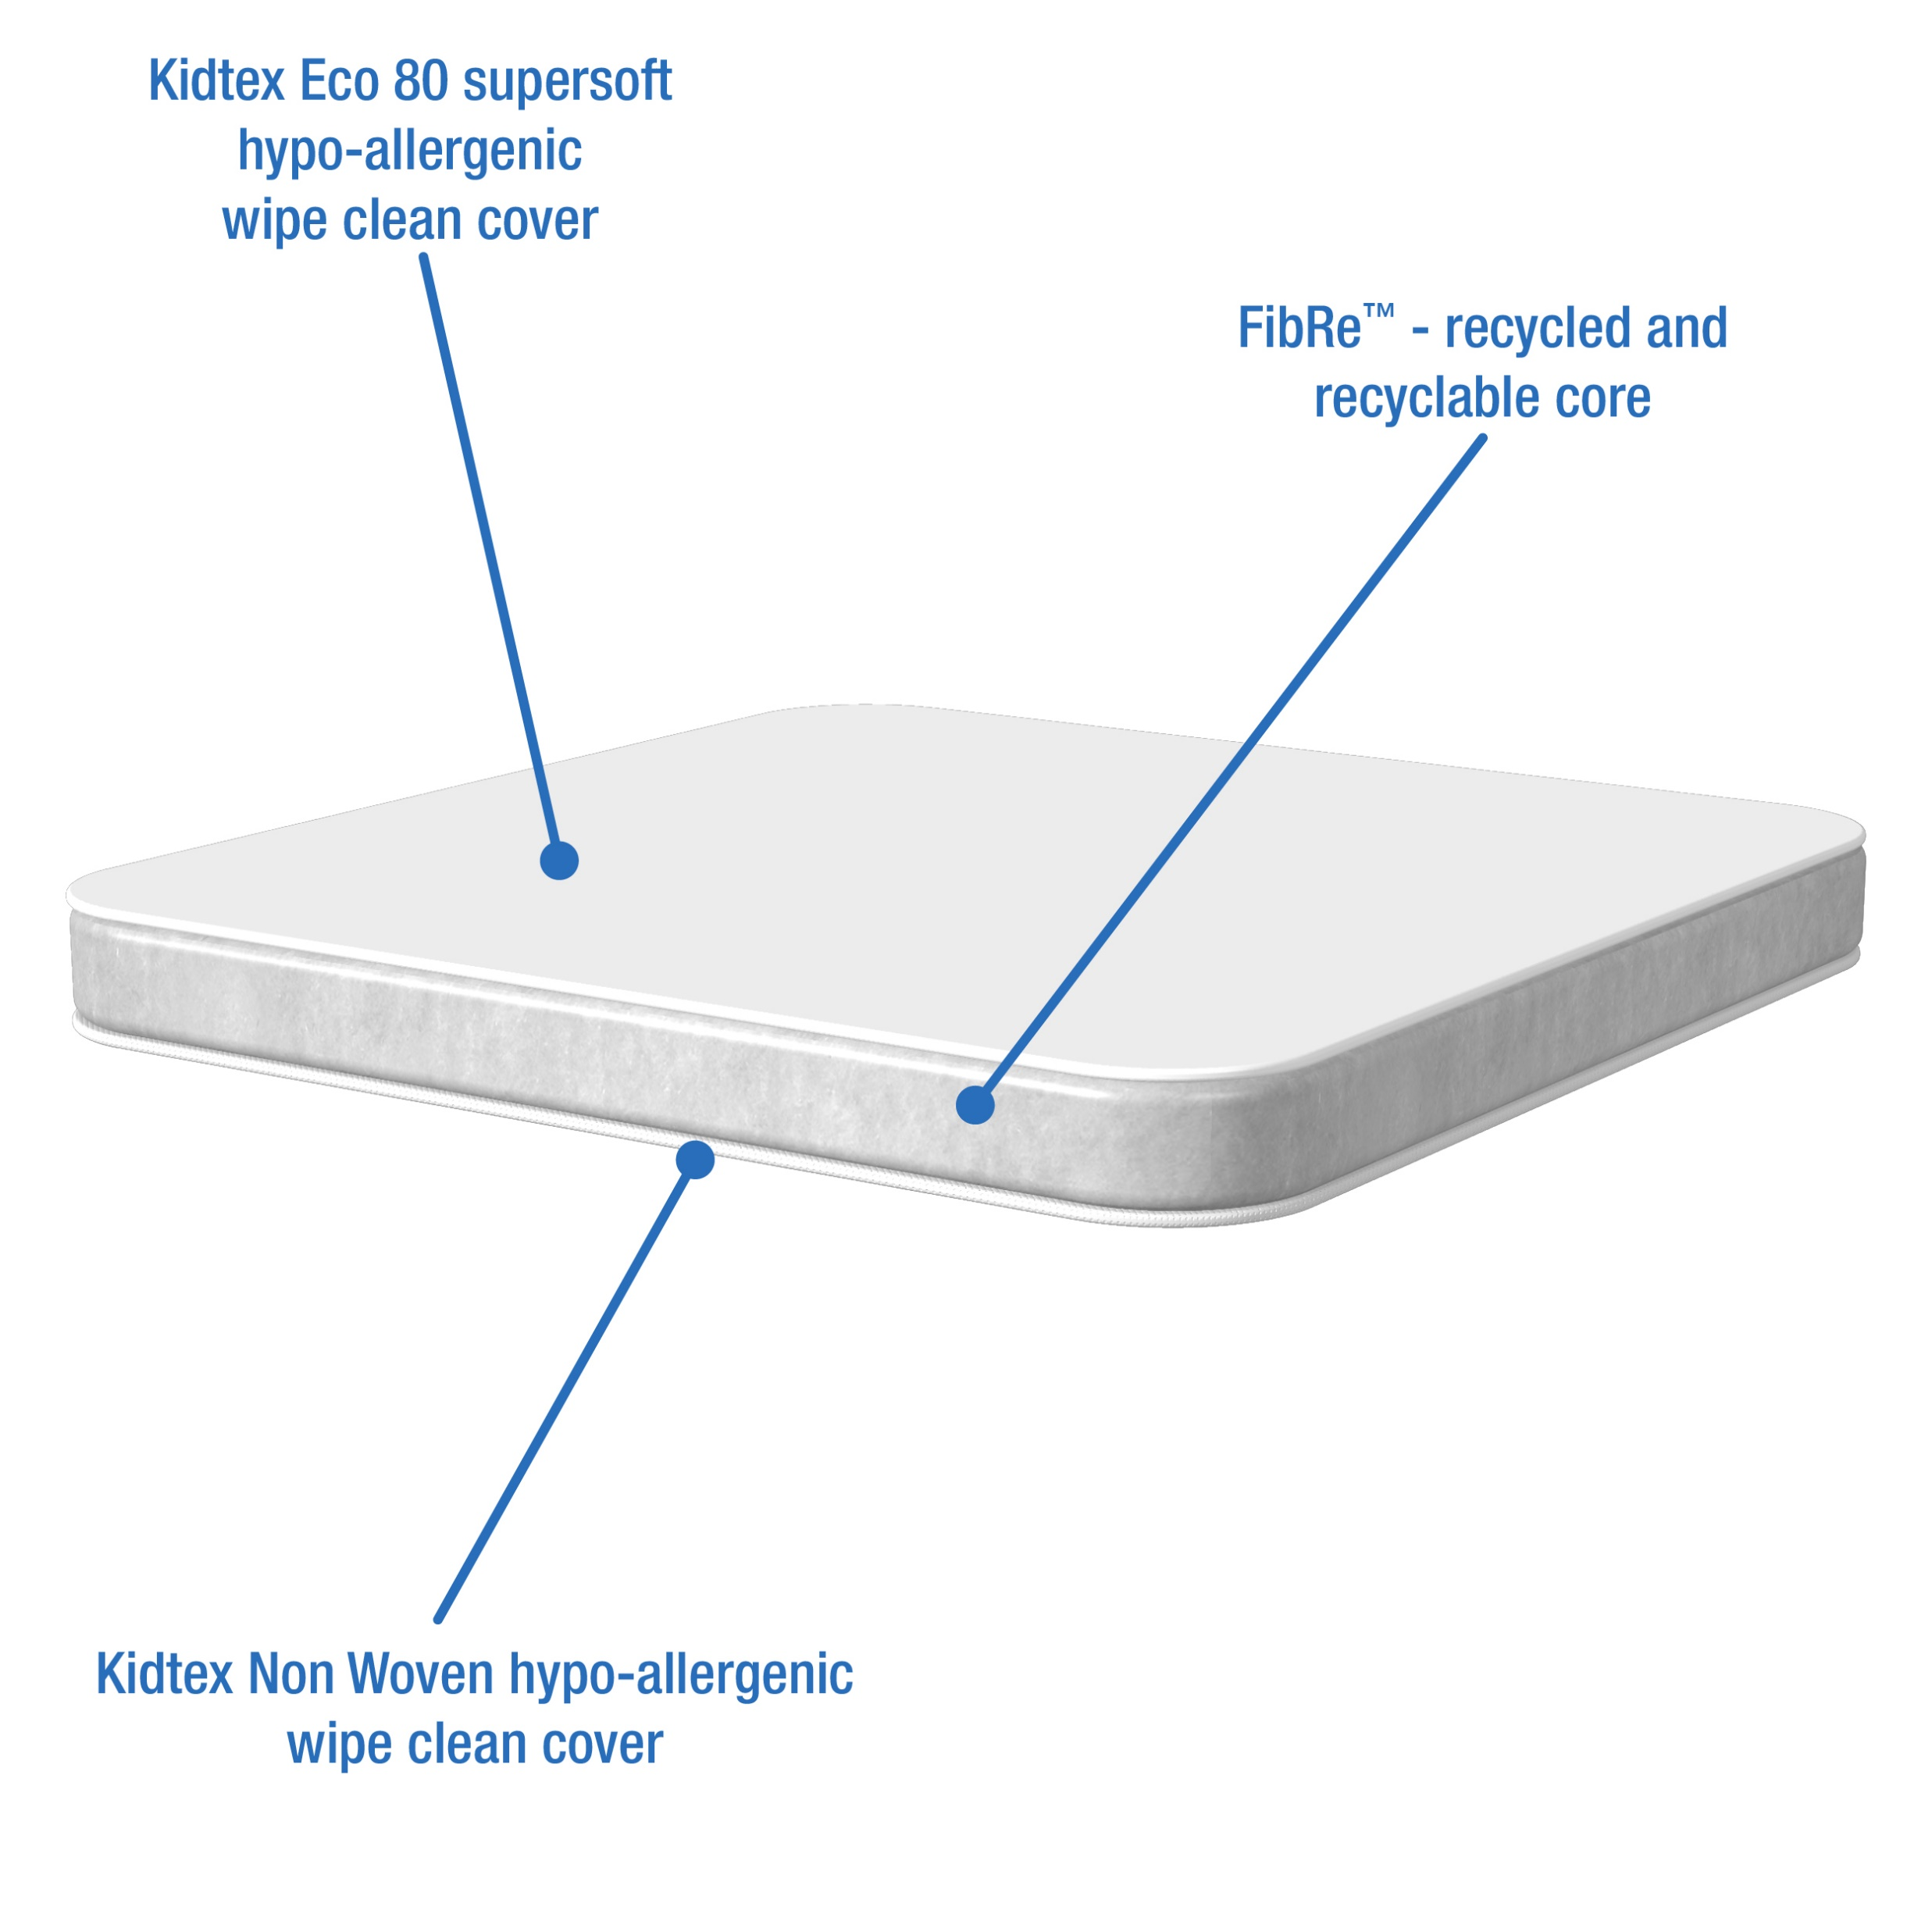
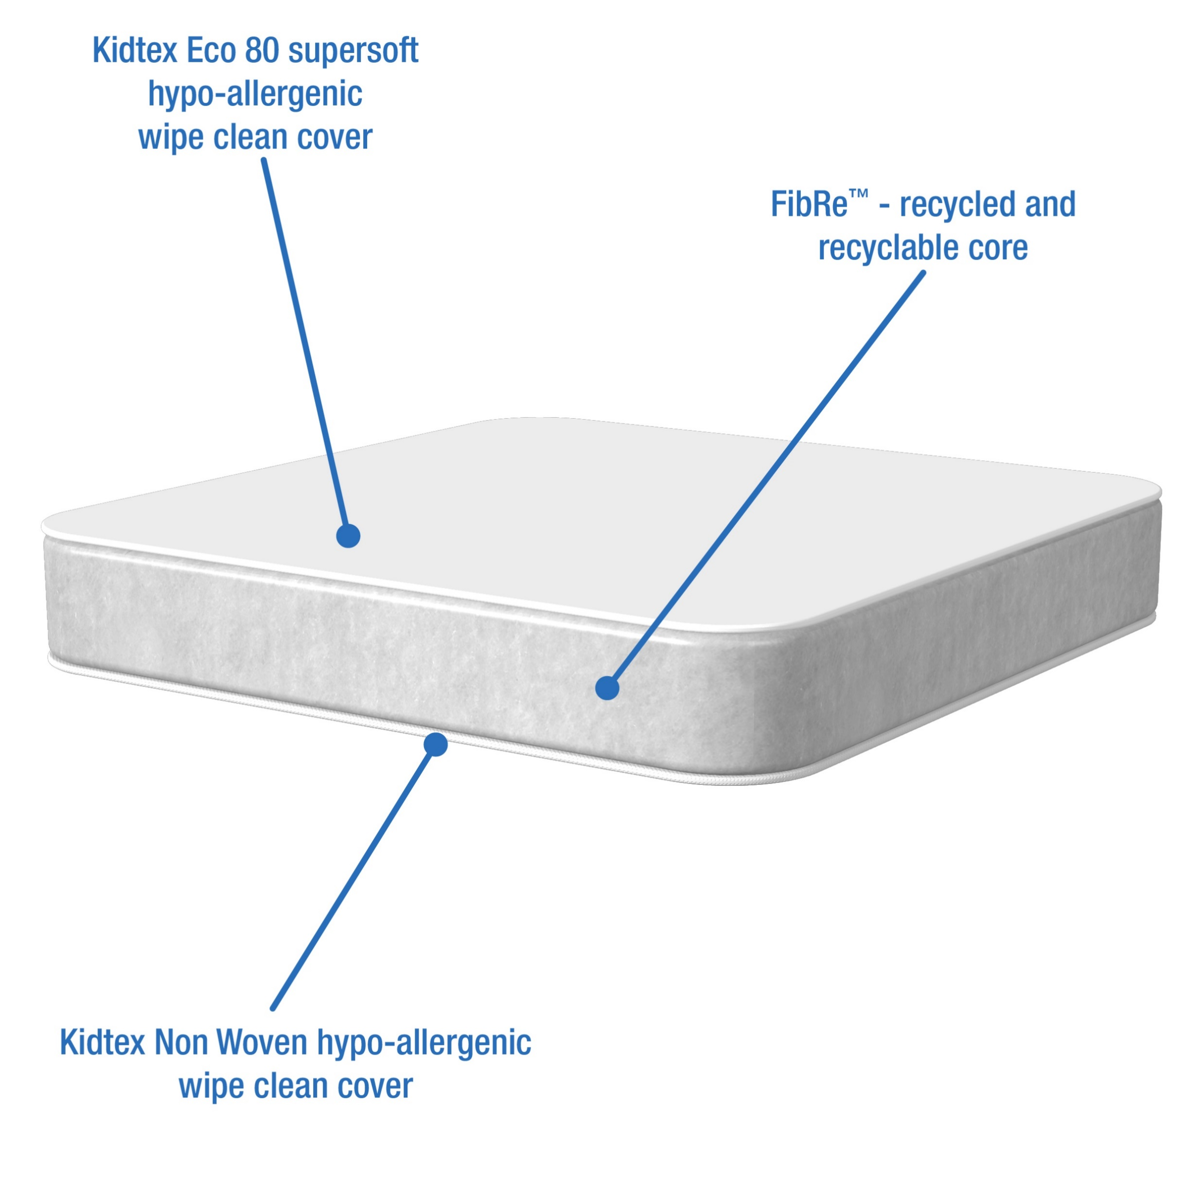
i-Deal Range
The NEW i-Deal range has been designed to help you compete in an increasingly challenging marketplace where price and value of offering are key to your customers.
This new range features FibReTM technology, and takes the fight to your competition but with the expected quality and credibility from Bebeluca
i-Deal Fibre – Wipe Clean Cover
A mattress offering ideal comfort and support for your baby.
The PVC free Kidtex Eco 80 Supersoft hypo-allergenic wipe clean mattress cover helps to maintain temperature and comfort for the correct sleeping environment for your child and features a micropore cover which enhances breathability and air circulation for your child.
The wipe clean cover keeps the mattress interior fresh and clean, reducing the causes of allergies….perfect when potty training or when your child has a little accident
The FibReTM used in the inner core has the correct balance between density and firmness to provide ideal spinal support and comfort for your child, and is free from any PVC or plasticisers, being manufactured from recycled fibre ensuring kindness to both your baby and the environment.
Easily maintained mattress with non removeable cover which can be sponged/wiped clean with a mild detergent and air dried
The correct choice of mattress will provide a healthier and safer sleeping environment; provide a better nights sleep for your child, and peace of mind for you, the parent.
Crib and Moses - Suitable from birth to 12 months (approx.)
Cot and Cotbed – Suitable from birth to 2 years (approx.)
This product is fully tested and complies with the relevant UK safety regulations - BS EN 16890, BS 1877-10, BS 7177 and EN 71.

Slide 8
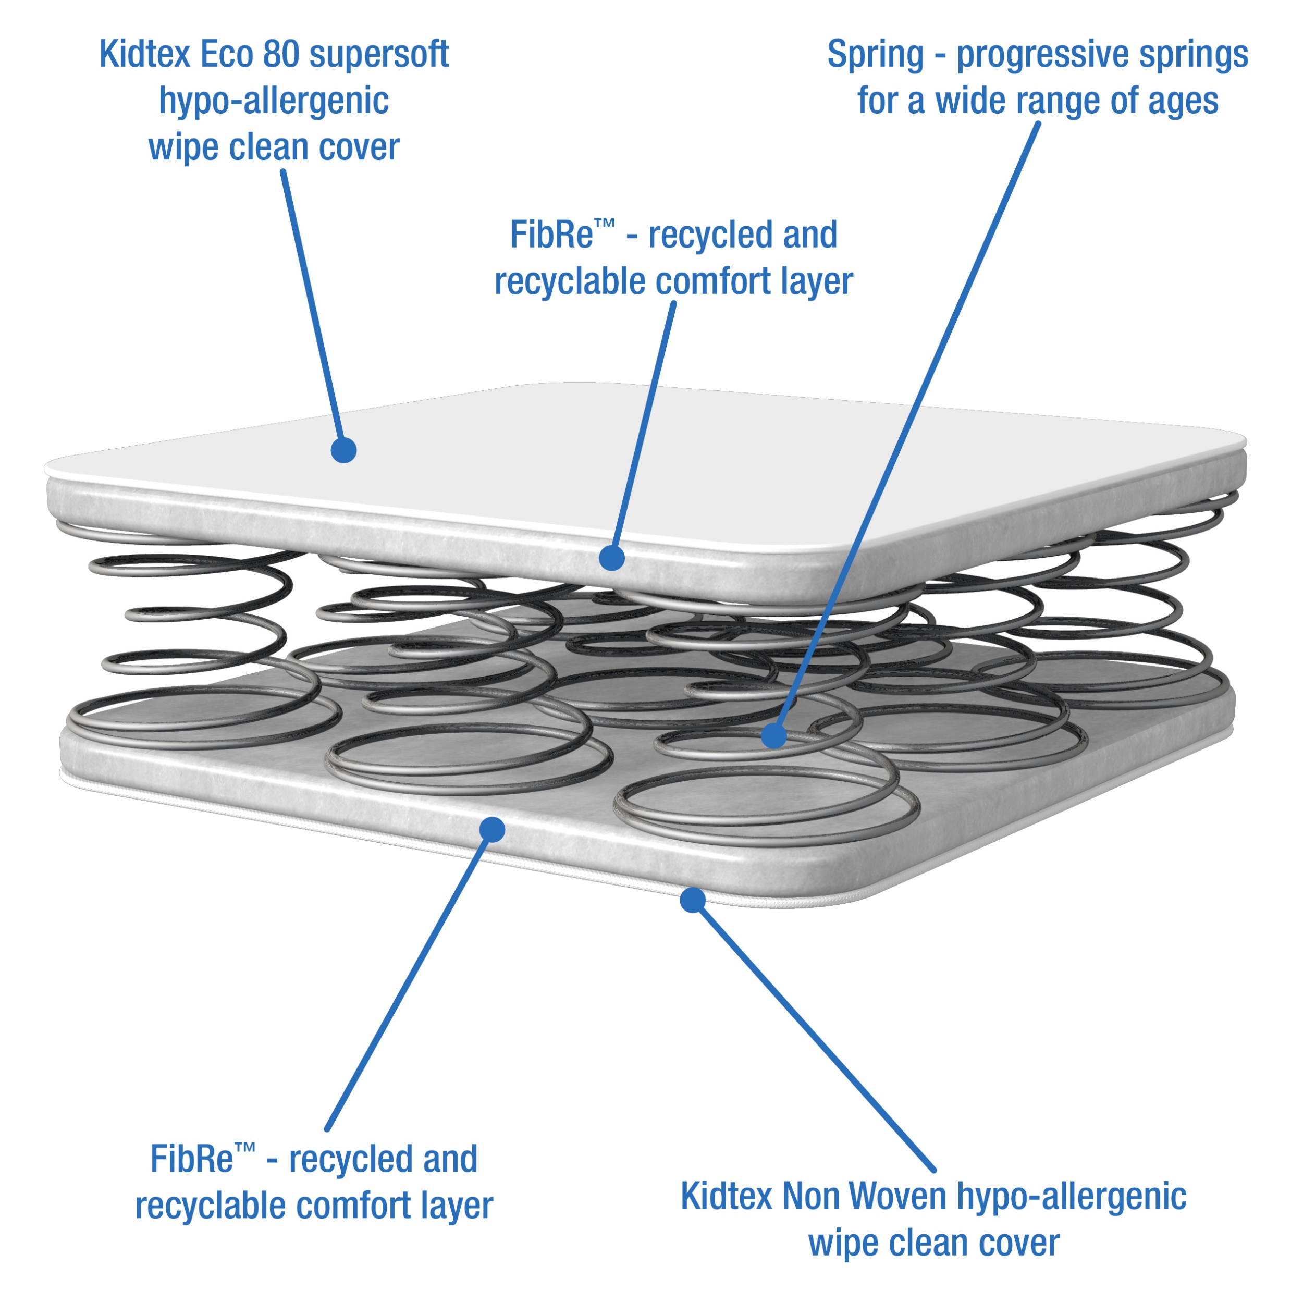
i-Deal Range
The NEW i-Deal range has been designed to help you compete in an increasingly challenging marketplace where price and value of offering are key to your customers.
This new range features FibReTM technology, and takes the fight to your competition but with the expected quality and credibility from Bebeluca
i-Deal Spring Fibre – Wipe Clean Cover
BBLKEVAL11 and BBLKEVAL13 ONLY
A mattress offering ideal comfort and support for your baby.
The PVC free Kidtex Eco 80 Supersoft hypo-allergenic wipe clean mattress cover helps to maintain temperature and comfort for the correct sleeping environment for your child and features a micropore cover which enhances breathability and air circulation for your child.
The wipe clean cover keeps the mattress interior fresh and clean, reducing the causes of allergies….perfect when potty training or when your child has a little accident
The springs used in the inner core of this Spring mattress are linked double cone orthopaedic springs giving excellent spinal support and comfort
Easily maintained mattress with non removeable cover which can be sponged/wiped clean with a mild detergent and air dried
The correct choice of mattress will provide a healthier and safer sleeping environment; provide a better nights sleep for your child, and peace of mind for you, the parent.
Cot and Cotbed – Suitable from birth to 4 years (approx.)
This product is fully tested and complies with the relevant UK safety regulations - BS EN 16890, BS 1877-10, BS 7177 and EN 71.

Slide 9
Essentials Range
The NEW Essentials range has been designed to help you compete in an increasingly challenging marketplace where price, specification and value of offering are key to your customers.
This new range features FibReTM technology, quilted covers and with the expected quality and credibility from Bebeluca
New Item Code | Item | Desc/Dims | Pack Size
Moses Basket Mattresses
BBLKE01 | Essentials Fibre Moses Basket Mattress | 74x28x3 | 6
BBLKEP01 | Essentials Premium Fibre Moses Basket Mattress | 74x28x3 | 6
Crib Mattresses
BBLKE03 | Essentials Fibre Crib Mattress | 89x38x3 | 6
BBLKEP03 | Essentials Premium Fibre Crib Mattress | 89x38x3 | 6
Cot & Cotbed Mattresses
BBLKE06 | Essentials Fibre Cot Mattress | 120x60x8 | 2
BBLKE08 | Essentials Fibre Cotbed Mattress | 140x70x8 | 2
BBLKEP06 | Essentials Premium Fibre Cot Mattress* | 120x60x10 | 2
BBLKEP08 | Essentials Premium Fibre Cotbed Mattress* | 140x70x10 | 2
BBLKE11 | Essentials Fibre Spring Cot Mattress | 120x60x10 | 2
BBLKE13 | Essentials Fibre Spring Cotbed Mattress | 140x70x10 | 2
SEE NEXT PAGES FOR MATTRESS DETAILS

Slide 10
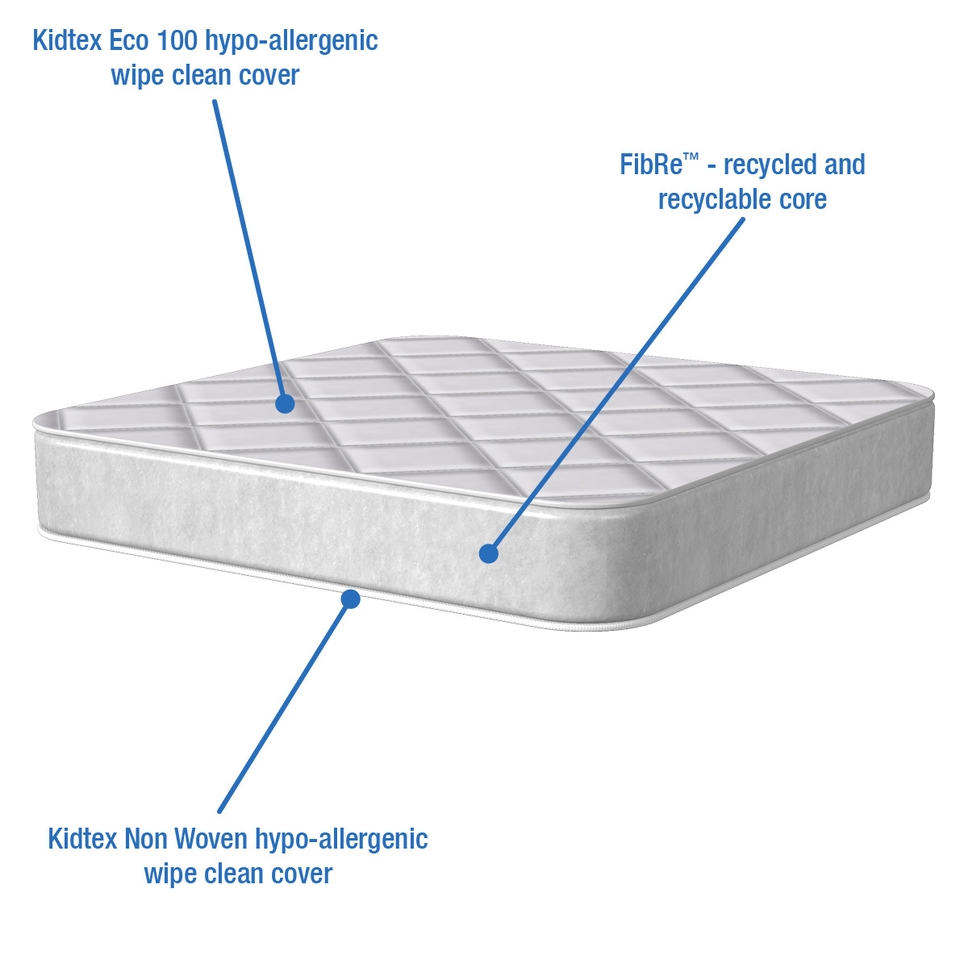
Essentials Range
The NEW Essentials range has been designed to help you compete in an increasingly challenging marketplace where price, specification and value of offering are key to your customers.
This new range features FibReTM technology, quilted covers and with the expected quality and credibility from Bebeluca
Essentials Fibre – Wipe Clean Cover
A mattress offering essential comfort and support for your baby.
The PVC free Kidtex Eco 100 hypo-allergenic wipe clean quilted mattress cover helps to maintain temperature and comfort for the correct sleeping environment for your child and features a micropore cover which enhances breathability and air circulation for your child.
The wipe clean cover keeps the mattress interior fresh and clean, reducing the causes of allergies….perfect when potty training or when your child has a little accident
The FibReTM used in the inner core has the correct balance between density and firmness to provide ideal spinal support and comfort for your child, and is free from any PVC or plasticisers, being manufactured from recycled fibre ensuring kindness to both your baby and the environment.
Easily maintained mattress with non removeable cover which can be sponged/wiped clean with a mild detergent and air dried
The correct choice of mattress will provide a healthier and safer sleeping environment; provide a better nights sleep for your child, and peace of mind for you, the parent.
Crib and Moses - Suitable from birth to 12 months (approx.)
Cot and Cotbed – Suitable from birth to 2 years (approx.)
This product is fully tested and complies with the relevant UK safety regulations - BS EN 16890, BS 1877-10, BS 7177 and EN 71.

Slide 11
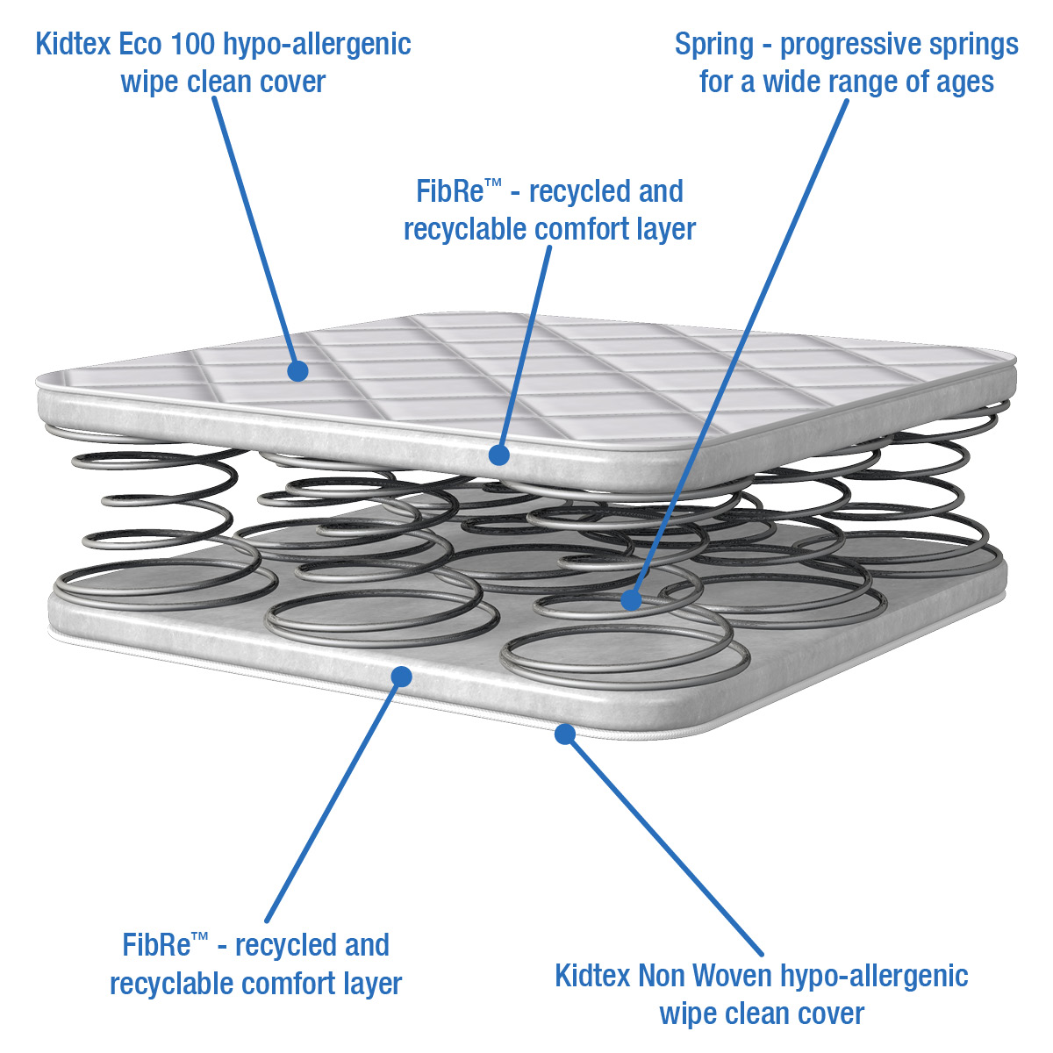
  Essentials Range
The NEW Essentials range has been designed to help you compete in an increasingly challenging marketplace where price, specification and value of offering are key to your customers.
This new range features FibReTM technology, quilted covers and with the expected quality and credibility from Bebeluca
Essentials Spring Fibre – Wipe Clean Cover
BBLKE11 and BBLKE13 ONLY
A mattress offering essential comfort and support for your baby.
The PVC free Kidtex Eco 100 hypo-allergenic wipe clean quilted mattress cover helps to maintain temperature and comfort for the correct sleeping environment for your child and features a micropore cover which enhances breathability and air circulation for your child.
The wipe clean cover keeps the mattress interior fresh and clean, reducing the causes of allergies….perfect when potty training or when your child has a little accident
The springs used in the inner core of this Spring mattress are linked double cone orthopaedic springs giving excellent spinal support and comfort
Easily maintained mattress with non removeable cover which can be sponged/wiped clean with a mild detergent and air dried
The correct choice of mattress will provide a healthier and safer sleeping environment; provide a better nights sleep for your child, and peace of mind for you, the parent.
Cot and Cotbed – Suitable from birth to 4 years (approx.)
This product is fully tested and complies with the relevant UK safety regulations - BS EN 16890, BS 1877-10, BS 7177 and EN 71.

Slide 12
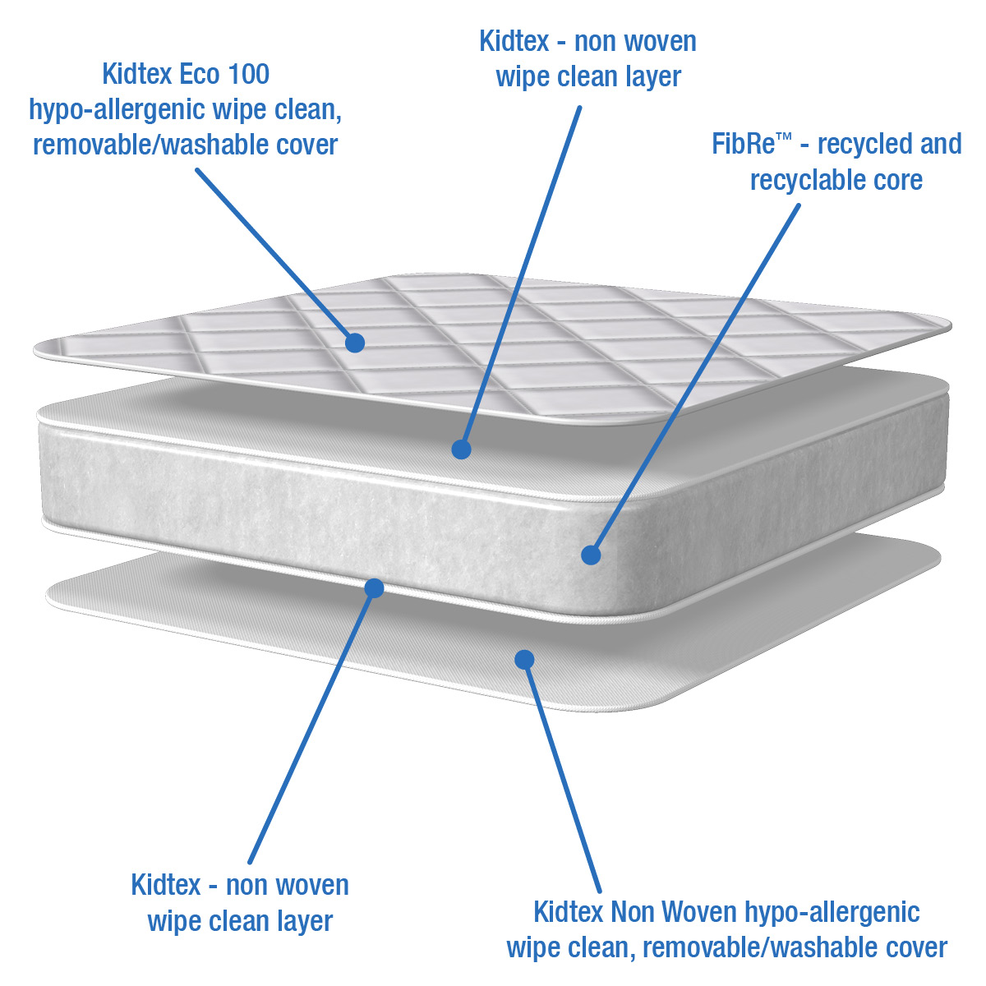
Essentials Premium Range
The NEW Essentials Premium range has a removable/washable cover and has been designed with great value in mind to help you compete in an increasingly challenging marketplace where price, specification and value of offering are key to your customers.
This new range features FibReTM technology, quilted covers and with the expected quality and credibility from Bebeluca
Essentials Premium Fibre – Removable/Washable Cover
A premium Fibre mattress offering uncompromising comfort and support for your baby.
The PVC free Kidtex Eco 100 hypo-allergenic wipe clean, removable/washable quilted mattress cover maintains temperature and comfort for the optimum sleeping environment for your child and features a removable cover, which enhances breathability and air circulation for your child.
The inner cover features a Kidtex Non Woven wipe clean layer made from vapour permeable yet water repellent fabric, helping to protect the comfortable high resilience foam core…perfect when potty training or when your child has a little accident.
The FibReTM used in the inner core has the correct balance between density and firmness to provide optimum spinal support and comfort for your child, and is free from any PVC or plasticisers, being manufactured from recycled fibre ensuring kindness to both your baby and the environment.
The outer cover can be easily removed for washing at 60 degrees C in accordance with the care label, killing dust-mites, a common cause of allergies
The correct choice of mattress will provide a healthier and safer sleeping environment; provide a better nights sleep for your child, and peace of mind for you, the parent.
Crib and Moses - Suitable from birth to 12 months (approx.)
Cot and Cotbed – Suitable from birth to 2 years (approx.)
This product is fully tested and complies with the relevant UK safety regulations - BS EN 16890, BS 1877-10, BS 7177 and EN 71.

Slide 13
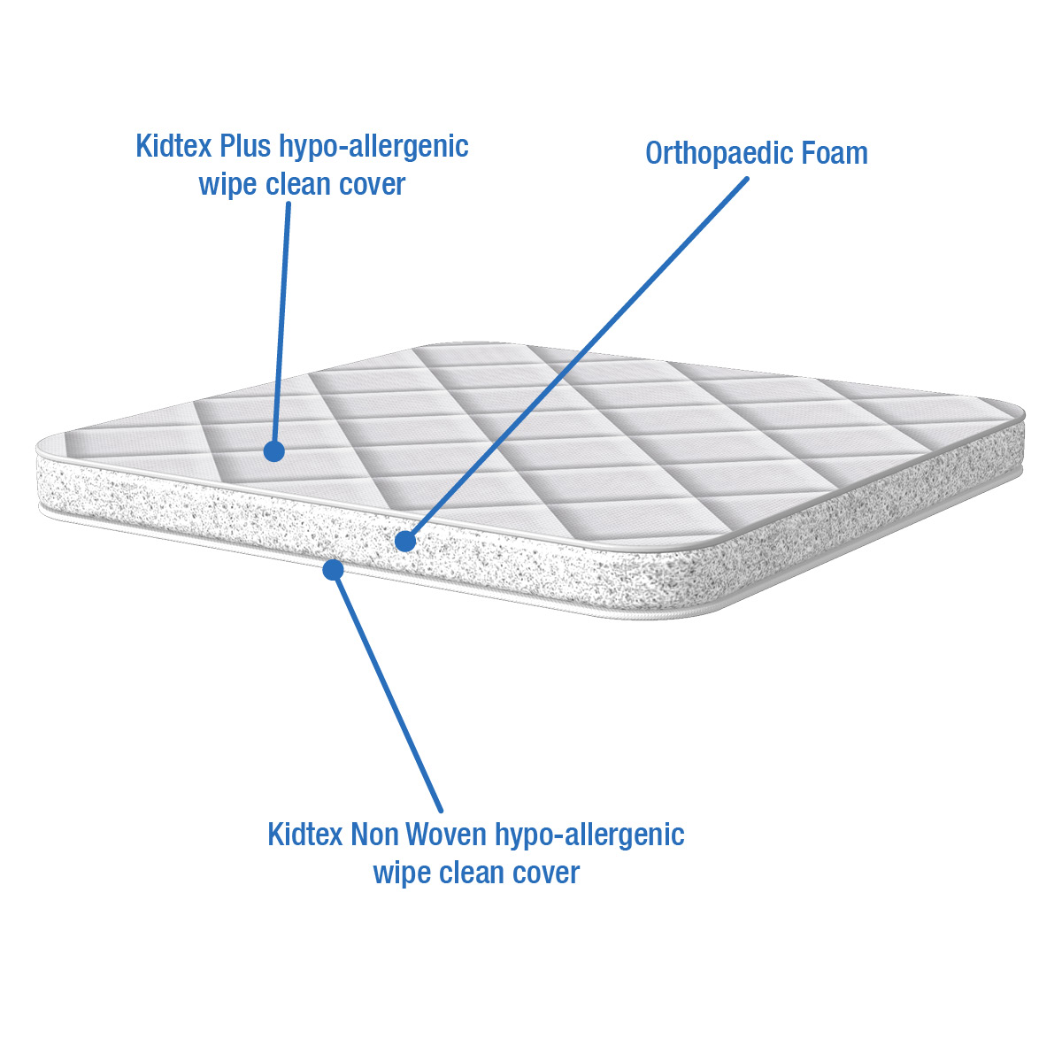
KIDTEX Range (Crib, Moses Basket & Pram Mattresses)
New Item Code | Old Item Code | Item | Desc/Dims | Pack Size
Moses Basket Mattresses
BBLK01 | Kidtex01 | KIDTEX Small Foam Moses Basket Mattress | 65x27x2 | 6
BBLK02 | Kidtex02 | KIDTEX Foam Moses Basket Mattress | 75x28x3 | 6
Crib Mattresses
BBLK03 | Kidtex03 | KIDTEX Foam Crib Mattress | 88.5x39.5x3 | 6
BBLK134 | Kidtex134 | KIDTEX Short Crib Mattress | 80x50x3 | 6
Pram Mattresses
BBLK04 | Kidtex04 | KIDTEX Foam Square End Pram Mattress | 73x35x3 | 6
BBLK05 | Kidtex05 | KIDTEX Foam Round End Pram Mattress | 73x35x3 | 6
A premium mattress offering uncompromising comfort and support for your baby.
The fully reversible Kidtex Plus hypo-allergenic wipe clean quilted mattress cover maintains temperature and comfort for the optimum sleeping environment, and features micropores, which enhance breathability and air circulation for your child. It also keeps the mattress interior fresh and clean, reducing the causes of allergies.
Although often considered the economic choice, a quality foam core is a durable comfortable option and has been carefully selected with a density and firmness ensuring the correct balance between comfort and support. The foam used in the inner core is orthopaedic dent resistant foam giving spinal support and comfort and does not contain any PVC or plasticisers, ensuring kindness to both the environment and your baby.
The correct choice of mattress will provide a healthier and safer sleeping environment; provide a better nights sleep for your child, and peace of mind for you, the parent.
Easily maintained mattress with non removeable cover which can be sponged/wiped clean with a mild detergent and air dried….perfect when potty training or when your child has a little accident
Suitable from birth to 12 months (approx.)
This product is fully tested and complies with the relevant UK safety regulations - BS EN 16890, BS 1877-10, BS 7177 and EN 71.

Slide 14
KIDTEX Range (Travel Cot Mattresses)
New Item Code | Old Item Code | Item | Desc/Dims | Pack Size
Travel Mattresses
BBLK09 | Kidtex09 | KIDTEX Folding Travel Cot Mattress | 96x54x2.5 | 5
BBLK10 | Kidtex10 | KIDTEX Travel Cot Thick Mattress | 93x64x6 | 4
BBLK21 | Kidtex21 | KIDTEX Large Travel Cot Thick Mattress | 98x69x6 | 4
A premium travel cot mattress offering uncompromising comfort and support for your baby at home and away.
The fully reversible Kidtex Plus hypo-allergenic wipe clean quilted mattress cover maintains temperature and comfort for the optimum sleeping environment, and features micropores, which enhance breathability and air circulation for your child. It also keeps the mattress interior fresh and clean, reducing the causes of allergies.
Although often considered the economic choice, a quality foam core is a durable comfortable option and has been carefully selected with a density and firmness ensuring the correct balance between comfort and support. The foam used in the inner core is orthopaedic dent resistant foam giving spinal support and comfort and does not contain any PVC or plasticisers, ensuring kindness to both the environment and your baby.
The correct choice of mattress will provide a healthier and safer sleeping environment; provide a better nights sleep for your child, and peace of mind for you, the parent.
Easily maintained mattress with non removeable cover which can be sponged/wiped clean with a mild detergent and air dried….perfect when potty training or when your child has a little accident
Suitable from birth to 4 years (approx.)
This product is fully tested and complies with the relevant UK safety regulations - BS EN 16890, BS 1877-10, BS 7177 and EN 71.

Slide 15
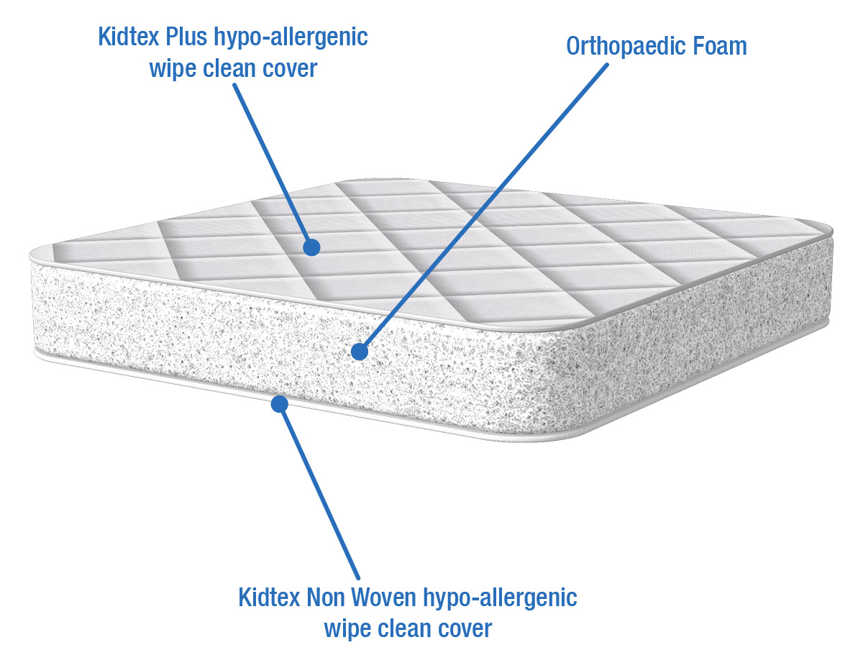
KIDTEX Range (Foam Cot & Cotbed Mattresses)
New Item Code | Old Item Code | Item | Desc/Dims | Pack Size
Cot & Cotbed Mattresses
BBLK06 | Kidtex06 | KIDTEX Foam Cot Mattress | 120x60x8 | 2
BBLK08 | Kidtex08 | KIDTEX Foam Cot Bed Mattress | 140x70x10 | 2
A premium cot and cotbed mattress offering uncompromising comfort and support for your baby.
The fully reversible Kidtex Plus hypo-allergenic wipe clean quilted mattress cover maintains temperature and comfort for the optimum sleeping environment, and features micropores, which enhance breathability and air circulation for your child. It also keeps the mattress interior fresh and clean, reducing the causes of allergies.
Although often considered the economic choice, a quality foam core is a durable comfortable option and has been carefully selected with a density and firmness ensuring the correct balance between comfort and support. The foam used in the inner core is orthopaedic dent resistant foam giving spinal support and comfort and does not contain any PVC or plasticisers, ensuring kindness to both the environment and your baby.
The correct choice of mattress will provide a healthier and safer sleeping environment; provide a better nights sleep for your child, and peace of mind for you, the parent.
Easily maintained mattress with non removeable cover which can be sponged/wiped clean with a mild detergent and air dried….perfect when potty training or when your child has a little accident
Suitable from birth to approx. 4 years (cot) and 5 years (cotbed)
This product is fully tested and complies with the relevant UK safety regulations - BS EN 16890, BS 1877-10, BS 7177 and EN 71.

Slide 16
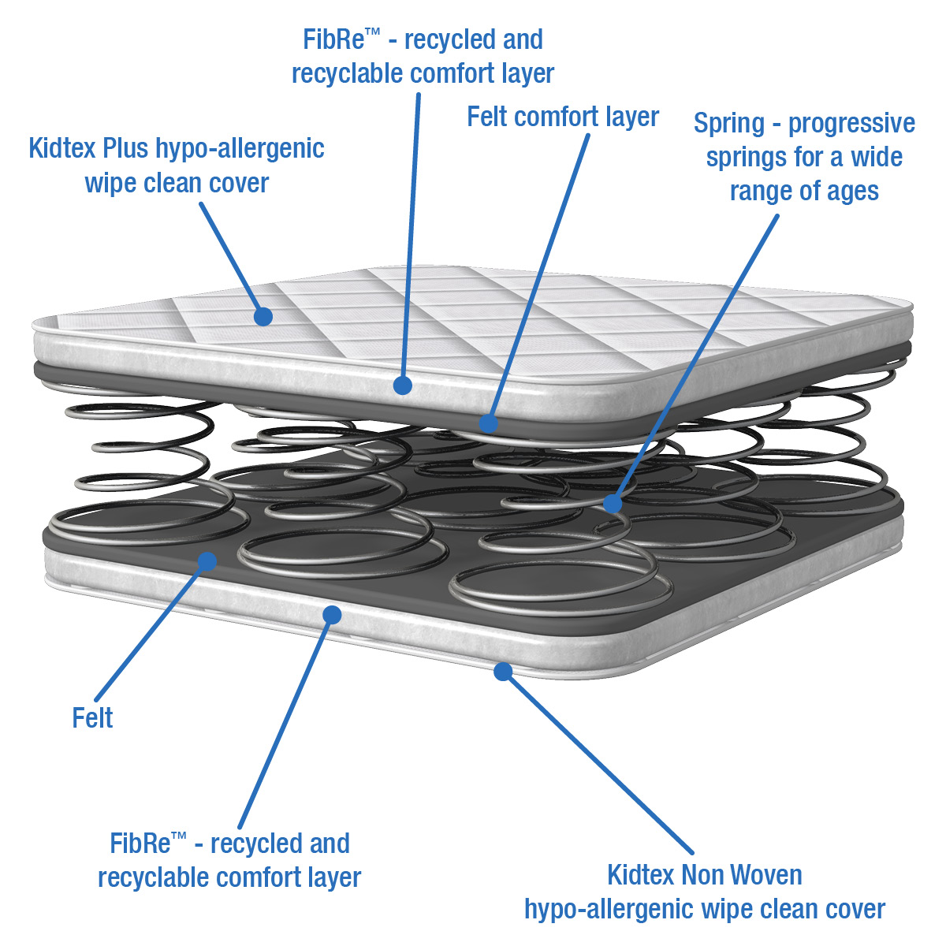
KIDTEX Range (Spring Cot & Cotbed Mattresses)
New Item Code | Old Item Code | Item | Desc/Dims | Pack Size
Cot & Cotbed Mattresses
BBLK11 | Kidtex11 | KIDTEX Spring Cot Mattress | 120x60x10 | 2
BBLK13 | Kidtex13 | KIDTEX Spring Cotbed Mattress | 140x70x10 | 2
A premium Spring mattress offering superior comfort, hygiene and support for your baby and features a fully reversible Kidtex Plus hypo-allergenic wipe clean quilted mattress cover which enhance breathability and air circulation for your child. It also keeps the mattress interior fresh and clean, reducing the causes of allergies.
The quilted fabric envelopes the fully linked double cone spring base that is cocooned in a FibReTM and felt comfort layer. Double cone springs add further support and durability to a mattress and are often the choice for the older child, providing better postural support. Additionally, the space within the spring lattice allows for better airflow helping with temperature regulation of the child.
The springs used in the inner core of this spring mattress are linked double cone orthopaedic springs giving excellent spinal support and comfort.
The correct choice of mattress will provide a healthier and safer sleeping environment; provide a better nights sleep for your child, and peace of mind for you, the parent.
Easily maintained mattress with non removeable cover which can be sponged/wiped clean with a mild detergent and air dried….perfect when potty training or when your child has a little accident
Suitable from birth to approx. 4 years (cot) and 5 years (cotbed)
This product is fully tested and complies with the relevant UK safety regulations - BS EN 16890, BS 1877-10, BS 7177 and EN 71.

Slide 17
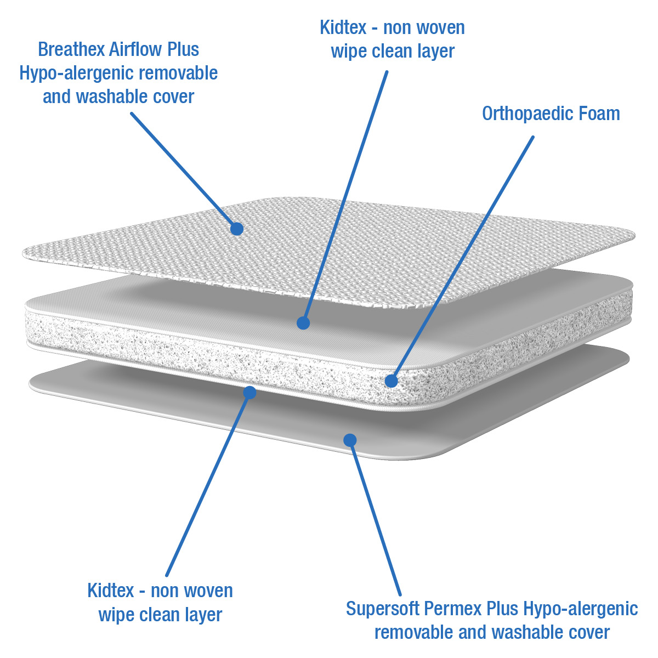
VENTIFLOW Range (Crib & Moses Basket Mattresses)
New Item Code | Old Item Code | Item | Desc/Dims | Pack Size
Moses Basket Mattresses
BBLKP02 | Venti02 | VENTIFLOW Foam Moses Basket Mattress | 75x28x3 | 6
Crib Mattresses
BBLKP03 | Venti03 | VENTIFLOW Foam Crib Mattress | 88.5x39.5x3 | 6
BBLKP03BED |  | VENTIFLOW Foam Crib Mattress (Bedside) | 83x50x3 | 6
An ultimate quality mattress offering superior comfort, support and breathability for all climates.
The fully reversible mattress features a unique 3D Breathex Airflow Plus and Supersoft Permex Plus hypo-allergenic removable and washable cover that promotes air circulation to help prevent overheating and maximise breathability for the sleeping child.
The inner cover features a Kidtex Non Woven wipe clean layer made from vapour permeable yet water repellent fabric, helping to protect the comfortable high resilience foam core…perfect when potty training or when your child has a little accident.
Although often considered the economic choice, a quality foam core is a durable comfortable option and has been carefully selected with a density and firmness ensuring the correct balance between comfort and support. The foam used in the inner core is orthopaedic dent resistant foam giving spinal support and comfort and does not contain any PVC or plasticisers, ensuring kindness to both the environment and your baby.
The base of the cover features Supersoft Permex Plus, which is a hypo-allergenic, PVC-free waterproof fabric that is easy to wipe clean.
The correct choice of mattress will provide a healthier and safer sleeping environment; provide a better nights sleep for your child, and peace of mind for you, the parent.
The outer cover can be easily removed for washing at 60 degrees C in accordance with the care label, killing dust-mites, a common cause of allergies
Suitable from birth to 12 months (approx.)
This product is fully tested and complies with the relevant UK safety regulations - BS EN 16890, BS 1877-10, BS 7177 and EN 71.

Slide 18
VENTIFLOW Range (Travel Cot Mattresses)
New Item Code | Old Item Code | Item | Desc/Dims | Pack Size
Travel Mattresses
BBLKP11 | Venti11 | VENTIFLOW Folding Travel Cot Mattress | 96x54x2.5 | 5
BBLKP10 | Venti10 | VENTIFLOW Thick Travel Cot Mattress | 93x64x6 | 4
An ultimate quality mattress offering superior comfort, support and breathability for all climates.
The fully reversible mattress features a unique 3D Breathex Airflow Plus and Supersoft Permex Plus hypo-allergenic removable and washable cover that promotes air circulation to help prevent overheating and maximise breathability for the sleeping child.
The inner cover features a Kidtex Non Woven wipe clean layer made from vapour permeable yet water repellent fabric, helping to protect the comfortable high resilience foam core…perfect when potty training or when your child has a little accident.
Although often considered the economic choice, a quality foam core is a durable comfortable option and has been carefully selected with a density and firmness ensuring the correct balance between comfort and support. The foam used in the inner core is orthopaedic dent resistant foam giving spinal support and comfort and does not contain any PVC or plasticisers, ensuring kindness to both the environment and your baby.
The base of the cover features Supersoft Permex Plus, which is a hypo-allergenic, PVC-free waterproof fabric that is easy to wipe clean.
The correct choice of mattress will provide a healthier and safer sleeping environment; provide a better nights sleep for your child, and peace of mind for you, the parent.
The outer cover can be easily removed for washing at 60 degrees C in accordance with the care label, killing dust-mites, a common cause of allergies
Suitable from birth to 4 years (approx.)
This product is fully tested and complies with the relevant UK safety regulations - BS EN 16890, BS 1877-10, BS 7177 and EN 71.

Slide 19
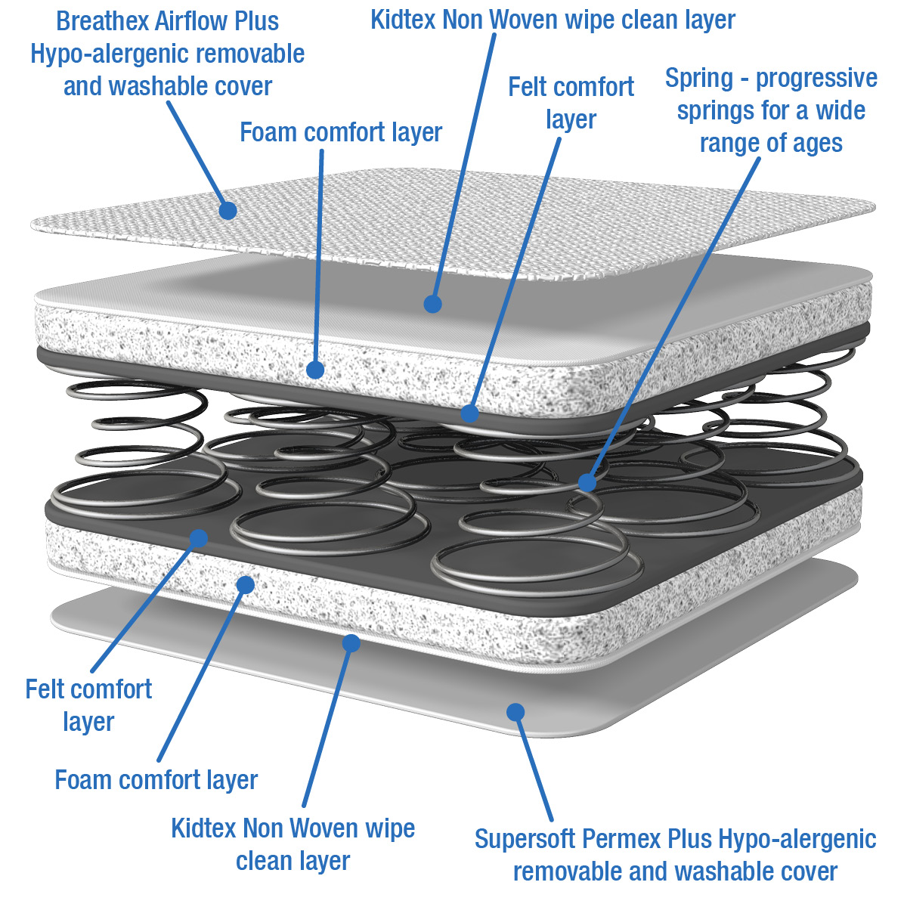
VENTIFLOW Range (Spring Cot & Cotbed Mattresses)
New Item Code | Old Item Code | Item | Desc/Dims | Pack Size
Cot & Cotbed Mattresses
BBLKP14 | Venti14 | VENTIFLOW Spring Cot Mattress | 120x60x10 | 2
BBLKP16 | Venti16 | VENTIFLOW Spring Cot Bed Mattress | 140x70x10 | 2
An ultimate quality Spring mattress offering superior comfort, support and breathability for all climates.
The fully reversible mattress features a unique 3D Breathex Airflow Plus and Supersoft Permex Plus hypo-allergenic removable and washable cover that promotes air circulation to help prevent overheating and maximise breathability for the sleeping child.
The inner cover features a Kidtex Non Woven wipe clean layer made from vapour permeable yet water repellent fabric, helping to protect the comfortable spring core…perfect when potty training or when your child has a little accident.
The springs used in the inner core of this mattress are completely wrapped in a foam and felt comfort layer which is durable and long lasting, providing excellent postural support, and spring mattresses are often the choice for the older child.
The base of the cover features Supersoft Permex Plus, which is a hypo-allergenic, PVC-free waterproof fabric that is easy to wipe clean.
The correct choice of mattress will provide a healthier and safer sleeping environment; provide a better nights sleep for your child, and peace of mind for you, the parent.
The outer cover can be easily removed for washing at 60 degrees C in accordance with the care label, killing dust-mites, a common cause of allergies
Suitable from birth to approx. 4 years (cot) and 5 years (cotbed)
This product is fully tested and complies with the relevant UK safety regulations - BS EN 16890, BS 1877-10, BS 7177 and EN 71.

Slide 20
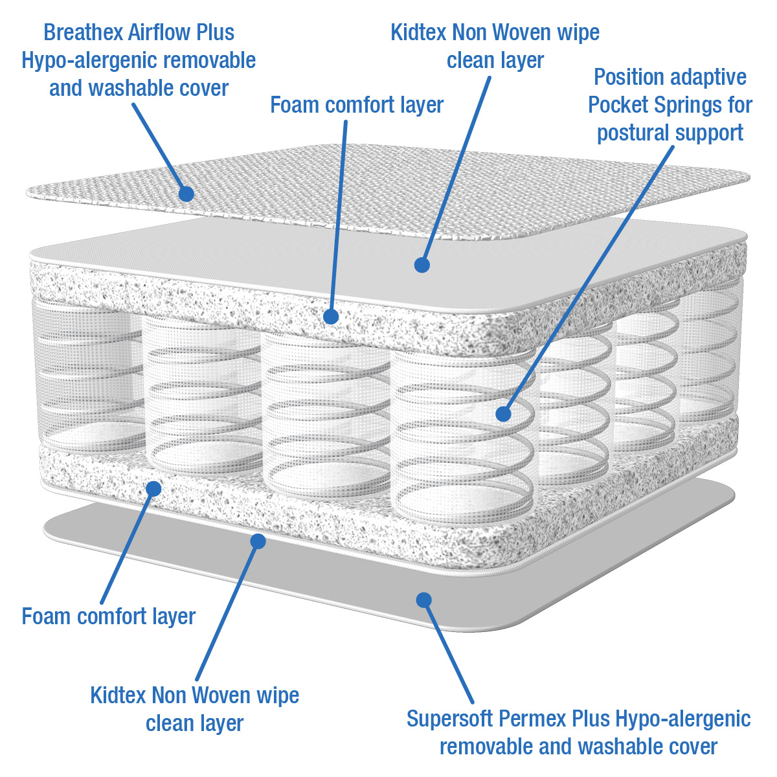
VENTIFLOW Range (Pocket Spring Cot & Cotbed Mattresses)
New Item Code | Old Item Code | Item | Desc/Dims | Pack Size
Cot & Cotbed Mattresses
BBLKP04 | Venti04 | VENTIFLOW Pocket Spring Cot Mattress | 120x60x10 | 2
BBLKP05 | Venti05 | VENTIFLOW Pocket Spring Cot Bed Mattress | 140x70x10 | 2
An ultimate quality Pocket Spring mattress offering superior comfort, support and breathability for all climates.
The fully reversible mattress features a unique 3D Breathex Airflow Plus and Supersoft Permex Plus hypo-allergenic removable and washable cover that promotes air circulation to help prevent overheating and maximise breathability for the sleeping child.
The inner cover features a Kidtex Non Woven wipe clean layer made from vapour permeable yet water repellent fabric, helping to protect the comfortable spring core…perfect when potty training or when your child has a little accident.
The springs used in this Pocket Spring mattress are within individually sewn, self contained micro-pockets which adapt to your child’s precise shape and are completely wrapped in a foam comfort layer. Pocketed springs are often the choice for the older child, providing optimum postural support and the pocketed interior is durable and long lasting.
The base of the cover features Supersoft Permex Plus, which is a hypo-allergenic, PVC-free waterproof fabric that is easy to wipe clean.
The correct choice of mattress will provide a healthier and safer sleeping environment; provide a better nights sleep for your child, and peace of mind for you, the parent.
The outer cover can be easily removed for washing at 60 degrees C in accordance with the care label, killing dust-mites, a common cause of allergies
Suitable from birth to approx. 4 years (cot) and 5 years (cotbed)
This product is fully tested and complies with the relevant UK safety regulations - BS EN 16890, BS 1877-10, BS 7177 and EN 71.

Slide 21
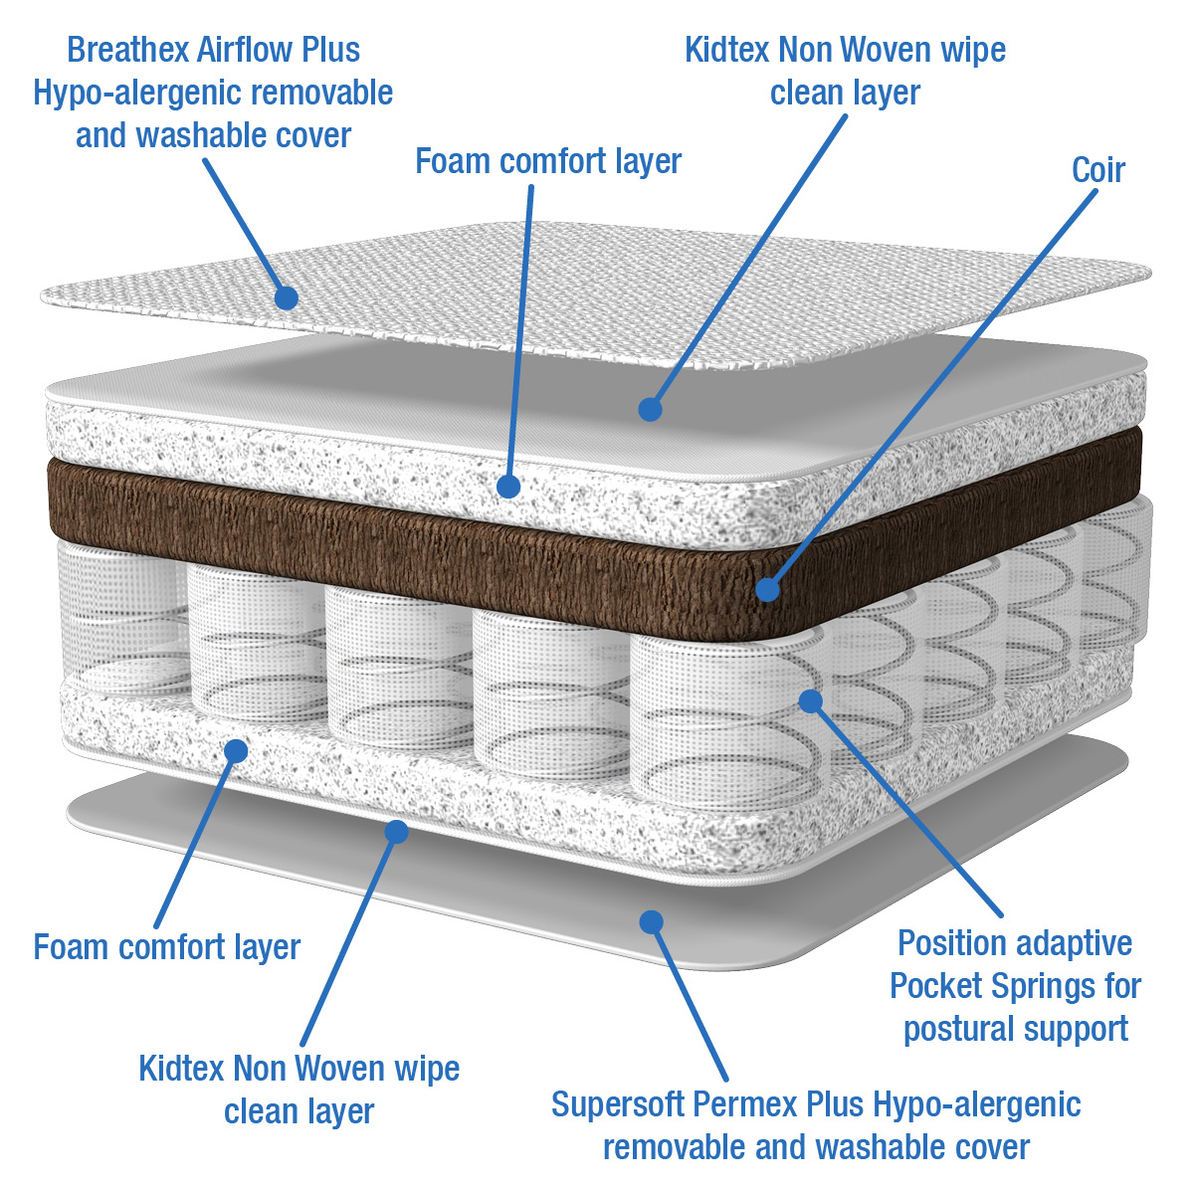
VENTIFLOW Range (Dual Core Cot & Cotbed Mattresses)
New Item Code | Old Item Code | Item | Desc/Dims | Pack Size
Cot & Cotbed Mattresses
BBLKP31 | Venti31 | VENTIFLOW Dual Core Cot Mattress | 120x60x10 | 2
BBLKP32 | Venti32 | VENTIFLOW Dual Core Cot Bed Mattress | 140x70x10 | 2
An ultimate quality Dual Core Pocket Spring mattress offering superior comfort, support and breathability for all climates.
The fully reversible mattress features a unique 3D Breathex Airflow Plus and Supersoft Permex Plus hypo-allergenic removable and washable cover that promotes air circulation to help prevent overheating and maximise breathability for the sleeping child.
The inner cover features a Kidtex Non Woven wipe clean layer made from vapour permeable yet water repellent fabric, helping to protect the comfortable spring core…perfect when potty training or when your child has a little accident.
The springs used in this Pocket Spring mattress are within individually sewn, self contained micro-pockets which adapt to your child’s precise shape, with the added feature of a natural coconut fibre (Coir) sleeping pad on one side of the Pocket Springs for a firmer sleeping surface option. The Dual Core is also completely wrapped in a foam comfort layer. Pocket Springs are often the choice for the older child, providing optimum postural support and the Dual Core interior is durable and long lasting.
The base of the cover features Supersoft Permex Plus, which is a hypo-allergenic, PVC-free waterproof fabric that is easy to wipe clean.
The correct choice of mattress will provide a healthier and safer sleeping environment; provide a better nights sleep for your child, and peace of mind for you, the parent.
The outer cover can be easily removed for washing at 60 degrees C in accordance with the care label, killing dust-mites, a common cause of allergies
Suitable from birth to approx. 4 years (cot) and 6 years (cotbed)
This product is fully tested and complies with the relevant UK safety regulations - BS EN 16890, BS 1877-10, BS 7177 and EN 71.

Slide 22
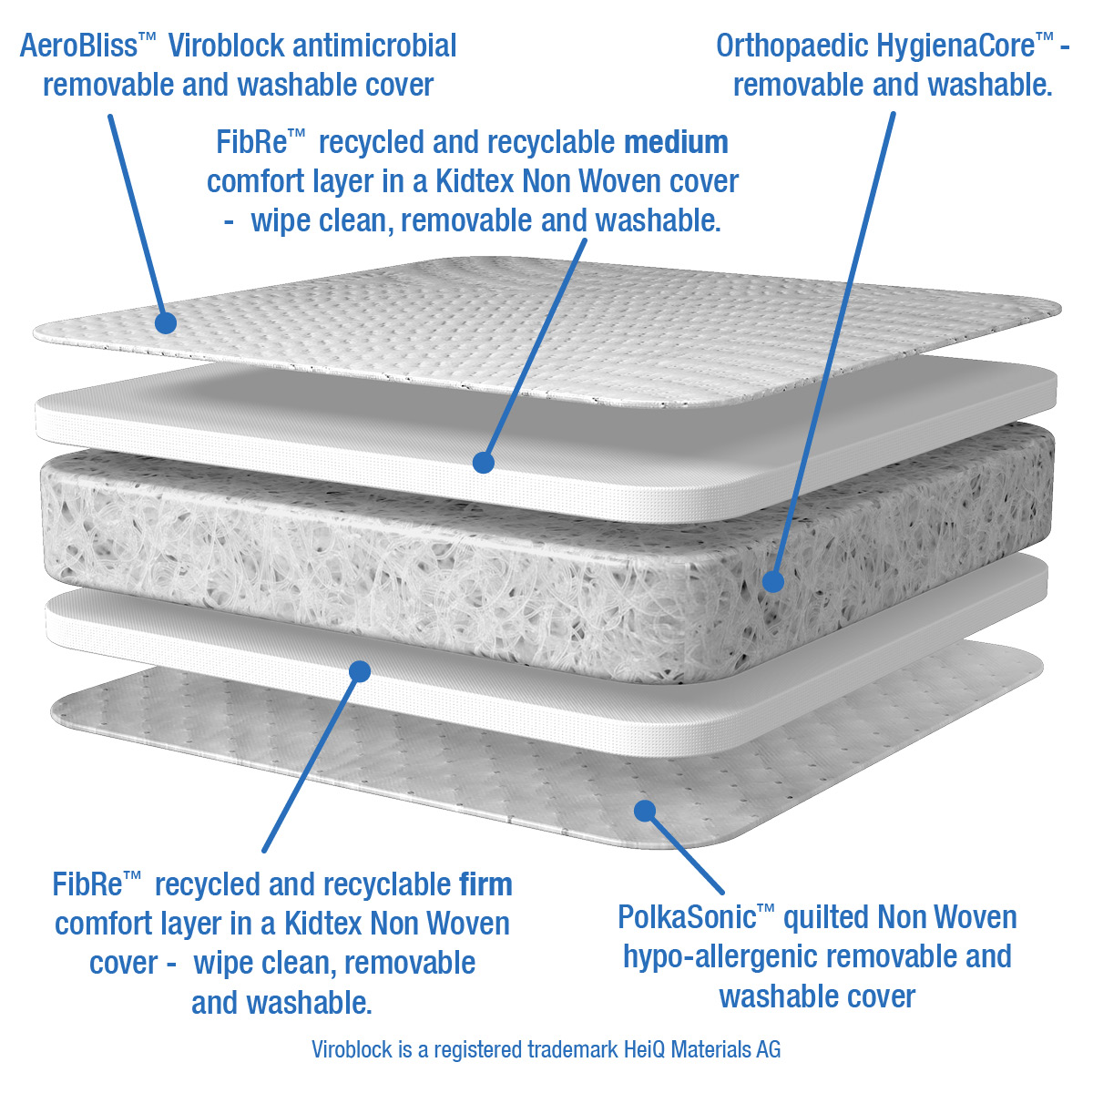
Total Cair HygienaCore Mattress with Viroblock
New Item Code | Old Item Code | Item | Desc/Dims | Pack Size
Cot & Cotbed Mattresses
NEW BBLKVB120 |  | Total Cair HygienaCore Cot Mattress with Viroblock | 120x60x10 | 2
NEW BBLKVB140 |  | Total Cair HygienaCore Cotbed Mattress with Viroblock | 140x70x10 | 2
A Total CairTM mattress which provides unparalleled protection, breathability and comfort for your baby and every part of this mattress, including the core, can be removed for washing & cleaning, providing the ultimate, clean sleeping environment for your baby.
This fully reversible mattress cover features a unique Supersoft AeroBlissTM Viroblock antimicrobial and PolkaSonicTM quilted hypo-allergenic cover which is removable and washable. The cover is treated with Viroblock^{R} which helps provide the ultimate protection from known viruses, bacteria and fungal spores and inactivates all coronaviruses (inc Sars COV2/ COVID19), thus maintaining the mattress cover’s hygiene at all times, helping to protect your baby and keep them safe.
The AeroblissTM top cover allows enhanced airflow and temperature regulation across 100% of the mattress surface and works in harmony with the core HygienaCoreTM to maintain the perfect sleeping environment.
The quality HygienaCoreTM antimicrobial mattress features superior comfort, support, breathability and protection for all climates, promoting air circulation to help prevent overheating and maximise breathability for the sleeping child. It is unique in providing an absolutely consistent support across 100% of the mattress from edge to edge, therefore providing the best possible support for a developing baby wherever they position themselves. Made from partially recycled monofilament continuous strands of PET, it is also kind to the environment and fully recyclable.
The unique inner comfort layers feature a muti-modular system which can be configured specifically to your child’s needs and development and provides 4 options for various mattress sleeping surfaces, including, medium, medium firm, firm and extra firm, providing tailored postural support for your baby as they grow. The inner comfort layers feature a FibReTM recycled and recyclable comfort layer encased in a Kidtex Non Woven wipe clean, removable and washable cover made from vapour permeable yet water repellent fabric….perfect when potty training or when your child has a little accident.
The core used in this HygienaCoreTM antimicrobial mattress can be removed, washed and air dried for an ultimate clean.
The base of the cover features PolkaSonicTM quilted hypo-allergenic fabric which is removable and washable.
The correct choice of mattress will provide a healthier and safer sleeping environment; provide a better nights sleep for your child, and peace of mind for you, the parent.
The outer cover, and inner layers can be easily removed for washing at 60 degrees C in accordance with the care label, killing dust-mites, a common cause of allergies. The inner HygienaCoreTM core can be removed, washed and air dried to create a totally fresh mattress throughout.
  Suitable from birth to 6 years (approx)
  This product is fully tested and complies with the relevant UK safety regulations - BS EN 16890 A2021, BS 1877-10, BS 7177 and EN 71.

Slide 23

Total Cair HygienaCore Mattress with Viroblock - Credentials
New Item Code | Old Item Code | Item | Desc/Dims | Pack Size
Cot & Cotbed Mattresses
NEW BBLKVB120 |  | Total Cair HygienaCore Cot Mattress with Viroblock | 120x60x10 | 2
NEW BBLKVB140 |  | Total Cair HygienaCore Cotbed Mattress with Viroblock | 140x70x10 | 2
HeiQ Viroblock NPJ03 is an intelligent Swiss textile technology that is added to the fabric during the final stage of the textile manufacturing process. Fully antimicrobial including SARS-COV-2 (COVID19)
HeiQ Viroblock NPJ03 has been tested effective 99.99% against SARS-CoV-2, the COVID-19 causing virus
Residual virus infectivity tested according to a modified ISO 20743, rapid antiviral effect demonstrated within 2-5 minutes
Tested according to ISO 18184 as strong antiviral and ISO 20743 as strong antibacterial against enveloped viruses and bacteria
HeiQ Viroblock Technology was developed in 2013. The medical class antimicrobial performance was unchanged after 7 years of shelf-life
HeiQ won the prestigious Swiss Technology Award 2020 for HeiQ Viroblock
OEKOTEX® tested, ZDHC and bluesign® ecologically homologized
Treated textile articles are compliant with EU BPR
For washable fabrics: Lasts at least 30 gentle washes at 60°C (140°F) ((ISO 6330 6G)
Provides a germ resistant surface
Patent pending antiviral and antibacterial technology
      HeiQ Viroblock are registered trademarks of HeiQ Materials AG
      https://heiq.com/products/functional-textile-technologies/heiq-viroblock/

Slide 24

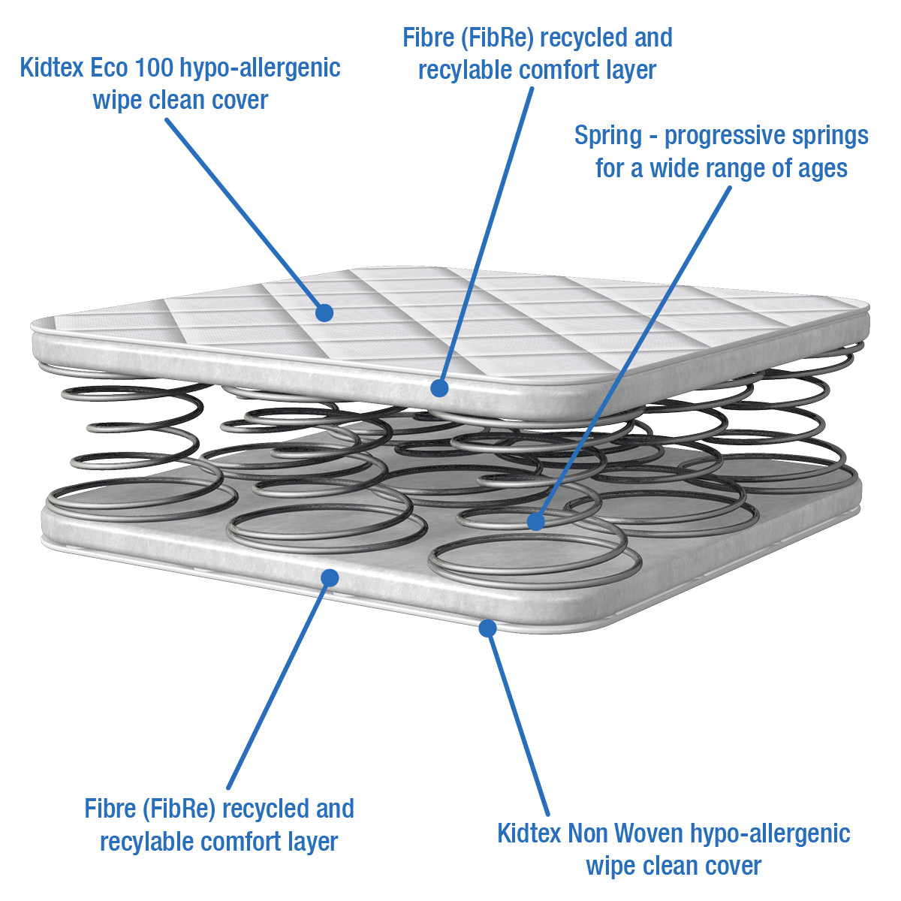
KIDTEX Spring Mattress
DEALS….DEALS….DEALS
New Item Code | Item | Desc/Dims | Pack Size
Special Purchase
NEW BBLK31 | KIDTEX ECOmfort Spring CotBed Mattress | 140x70x10 | 2
BBLK31
(KIDTEX31)
Spring Cotbed Mattress
Based on the very successful KIDTEX range, this Spring cotbed mattress has been designed to offer a value product within the Kidex stable for promotional opportunities. A highly competitive price with much improved environmental credentials - a true win-win.
A premium Spring mattress offering superior comfort, hygiene and support for your baby.
The PVC free Kidtex Eco 100 hypo-allergenic wipe clean quilted mattress cover helps to maintain temperature and comfort for the correct sleeping environment for your child and features a micropore cover which enhances breathability and air circulation for your child. It also keeps the mattress interior fresh and clean, reducing the causes of allergies.
The quilted fabric envelopes the fully linked double cone spring base that is cocooned in a FibReTM comfort layer. Double cones springs add further support and durability to a mattress and are often the choice for the older child, providing excellent postural support.
Additionally, the space within the spring lattice allows for better airflow helping with temperature regulation of the child. The springs used in the inner core of this spring mattress are linked double cone orthopaedic springs giving excellent spinal support and comfort.
The correct choice of mattress will provide a healthier and safer sleeping environment; provide a better nights sleep for your child, and peace of mind for you, the parent.
Easily maintained mattress with non removeable cover which can be sponged/wiped clean with a mild detergent and air dried….perfect when potty training or when your child has a little accident
Suitable from birth to approx. 5 years
This product is fully tested and complies with the relevant UK safety regulations - BS EN 16890, BS 1877-10, BS 7177 and EN 71.

Slide 25

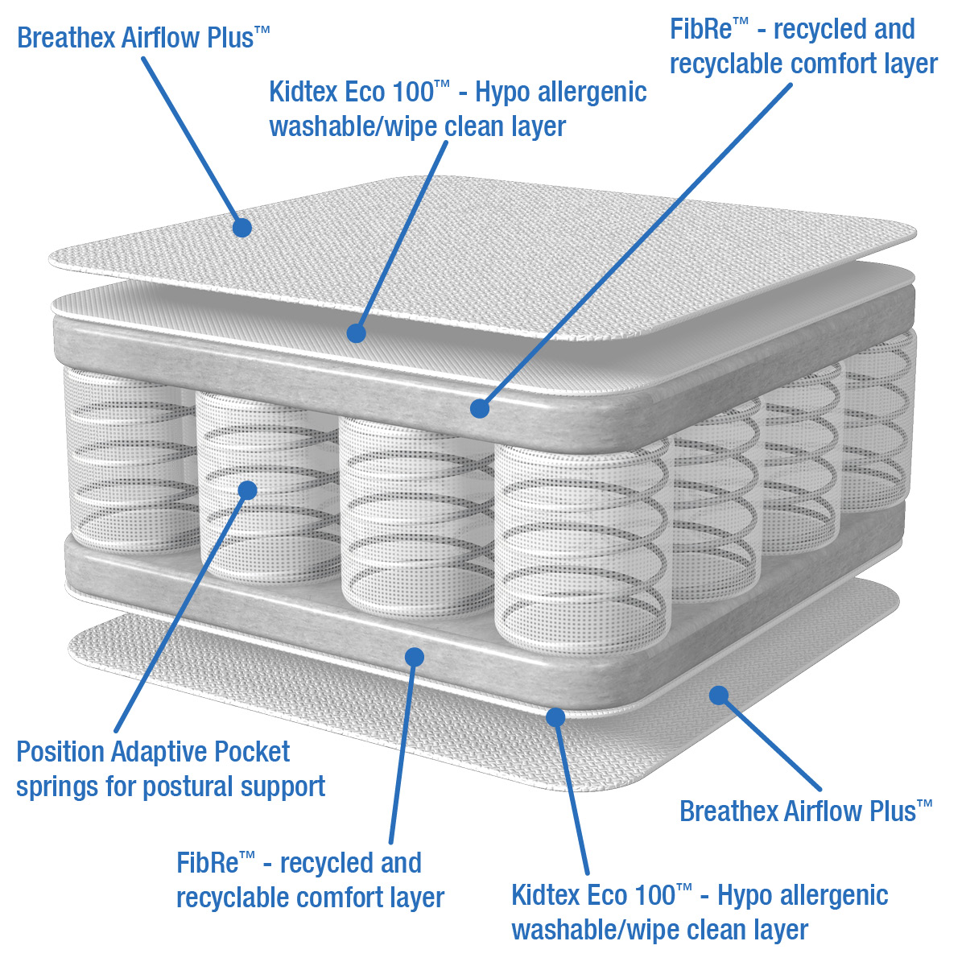
Closeout Mattress – 3D Breathex Airflow Mattress Cover
DEALS….DEALS….DEALS
New Item Code | Item | Desc/Dims | Pack Size
Closeout
NEW BBLKP600 | SUPERIOR Pocket Spring Cot Bed Mattress (M&P Cover) | 140x70x10 | 2
The factory used to manufacture for M&P and still has covers available (3D Breathex Airflow Plus)
A highly competitive price for a superior mattress – get it while you can !!
A superior quality Pocket Spring mattress offering ultimate comfort, support and breathability for all climates.
The fully reversible mattress features a unique 3D Breathex Airflow Plus hypo-allergenic removable and washable cover on both sleeping surfaces, that promotes air circulation to help prevent overheating and maximise breathability for the sleeping child.
The inner cover features a Kidtex Non Woven wipe clean layer made from vapour permeable yet water repellent fabric, helping to protect the comfortable spring core…perfect when potty training or when your child has a little accident.
The springs used in this Pocket Spring mattress are within individually sewn, self contained micro-pockets which adapt to your child’s precise shape and are completely wrapped in a FibReTM comfort layer. Pocketed springs are often the choice for the older child, providing optimum postural support and the pocketed interior is durable and long lasting.
The correct choice of mattress will provide a healthier and safer sleeping environment; provide a better nights sleep for your child, and peace of mind for you, the parent.
The outer cover can be easily removed for washing at 60 degrees C in accordance with the care label, killing dust-mites, a common cause of allergies
Suitable from birth to approx. 5 years
This product is fully tested and complies with the relevant UK safety regulations - BS EN 16890, BS 1877-10, BS 7177 and EN 71.

Slide 26
PVC Changing Mat Range
This quality wipe-clean changing mat is made from supportive foam padding with a Phthalate free PVC cover. It’s a comfortable place to change your baby and is a safe addition to any nursery.
This product is fully tested and complies with the relevant UK safety regulations - EN 71.
Fits most changing tables.
Item code | Item | Desc/Dims | Pack Size
PVC Changing Mats - Medium
BEBEMAT42 | Beige Polka Dot Change Mat Meduim | 70x40x3.5 | 10
BEBEMAT105 | Grey Stars Change Mat Medium | 70x40x3.5 | 10
BEBEMAT104 | Pink Button Change Mat Medium | 70x40x3.5 | 10
BEBEMAT125 | Blue Button Change Mat Medium | 70x40x3.5 | 10
BEBEMAT34 | Blue Gingham Change Mat Medium | 70x40x3.5 | 10
BEBEMAT35 | Pink Gingham Change Mat Medium | 70x40x3.5 | 10
BEBEMAT112 | Pink Pastel Hearts Change Mat Medium | 70x40x3.5 | 10
BEBEMAT113 | Blue Pastel Stars Change Mat Medium | 70x40x3.5 | 10
BEBEMAT36 | G Goes Free Change Mat Medium | 70x40x3.5 | 10
BEBEMAT37 | Rising Stars Change Mat Medium | 70x40x3.5 | 10
BEBEMAT38 | Duck ‘n’ Bearz Change Mat Medium | 70x40x3.5 | 10
BEBEMAT39 | Pads ‘n’ Paws Change Mat Medium | 70x40x3.5 | 10
BEBEMAT40 | Over The Moon (G) Change Mat Medium | 70x40x3.5 | 10
BEBEMAT41 | Over The Moon (P) Change Mat Medium | 70x40x3.5 | 10
BEBEMAT43 | Blowin Bubbles Change Mat Medium | 70x40x3.5 | 10
BEBEMAT44 | Jollie Olliphant Change Mat Medium | 70x40x3.5 | 10
BEBEMAT45 | Big World (P) Change Mat Medium | 70x40x3.5 | 10
BEBEMAT46 | Big World (B) Change Mat Medium | 70x40x3.5 | 10
BEBEMAT47 | Bamboo Baby Change Mat Medium | 70x40x3.5 | 10
BEBEMAT48 | Peak A Boo Bear Change Mat Medium | 70x40x3.5 | 10
PVC Changing Mats - Large
BEBEMAT62 | Strawberry Bloom Change Mat Large | 75x45x4 | 5
BEBEMAT99 | Navy Star Change Mat Large | 75x45x4 | 5
BEBEMAT001 | Grey Stars Change Mat Large | 75x45x4 | 5
BEBEMAT77 | Play Time Change Mat Large | 75x45x4 | 5

Slide 27

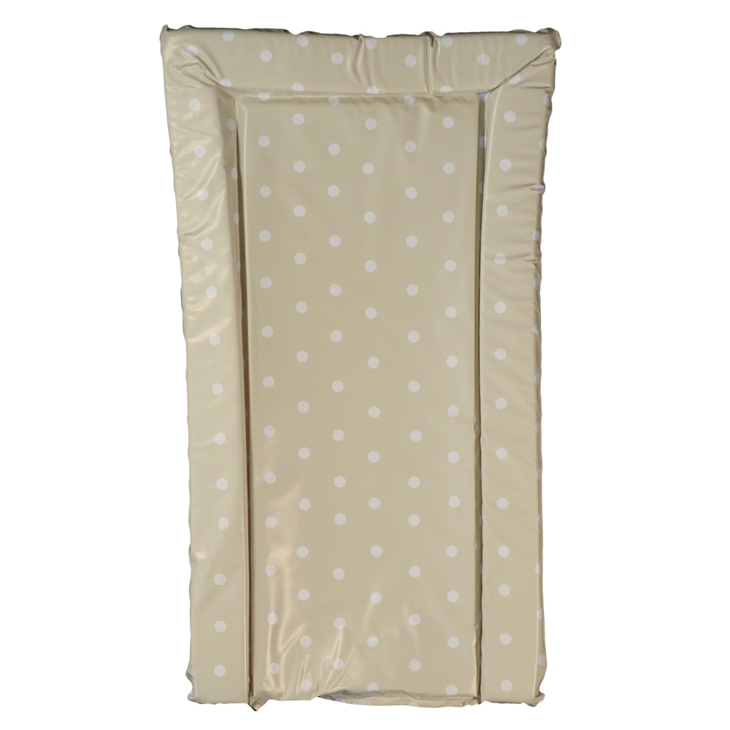
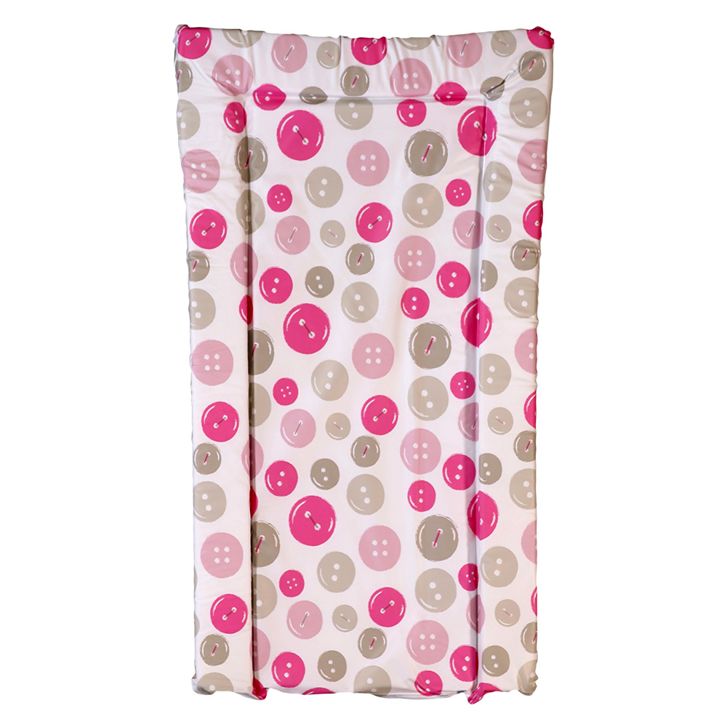
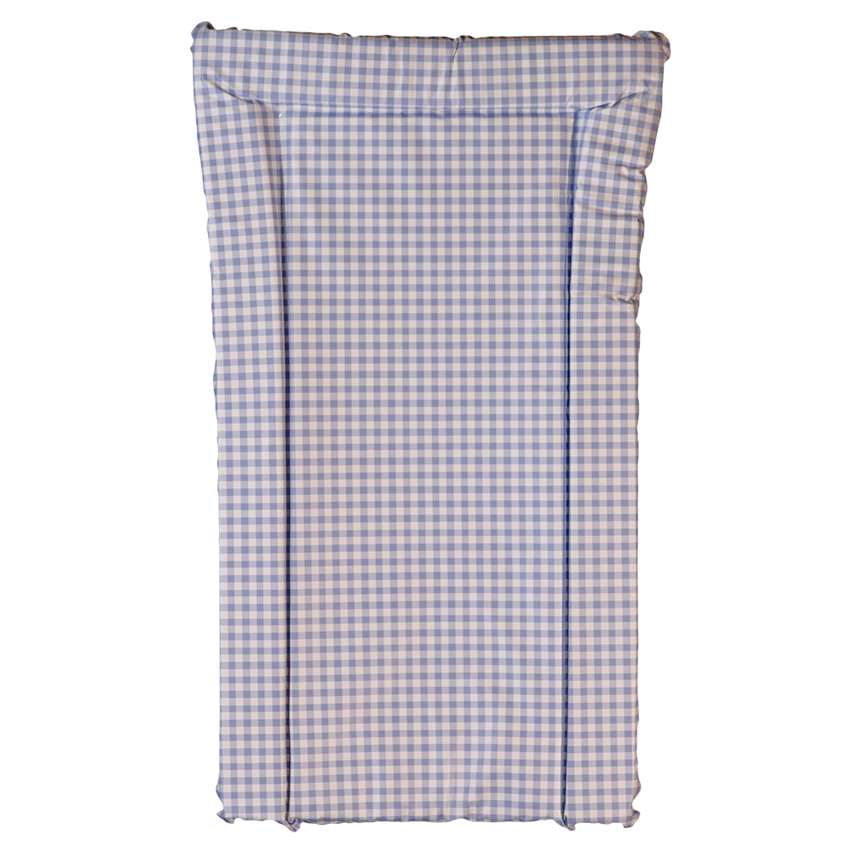
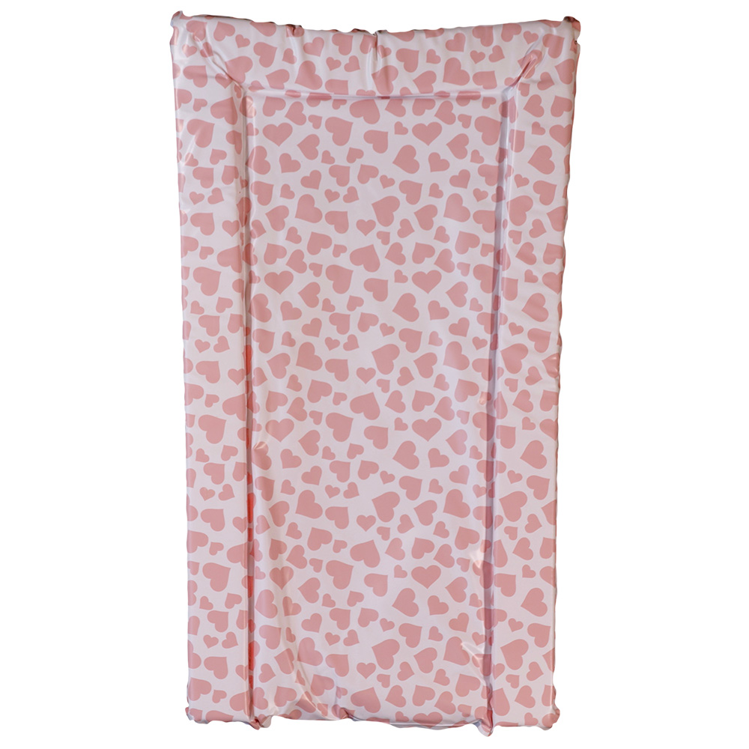
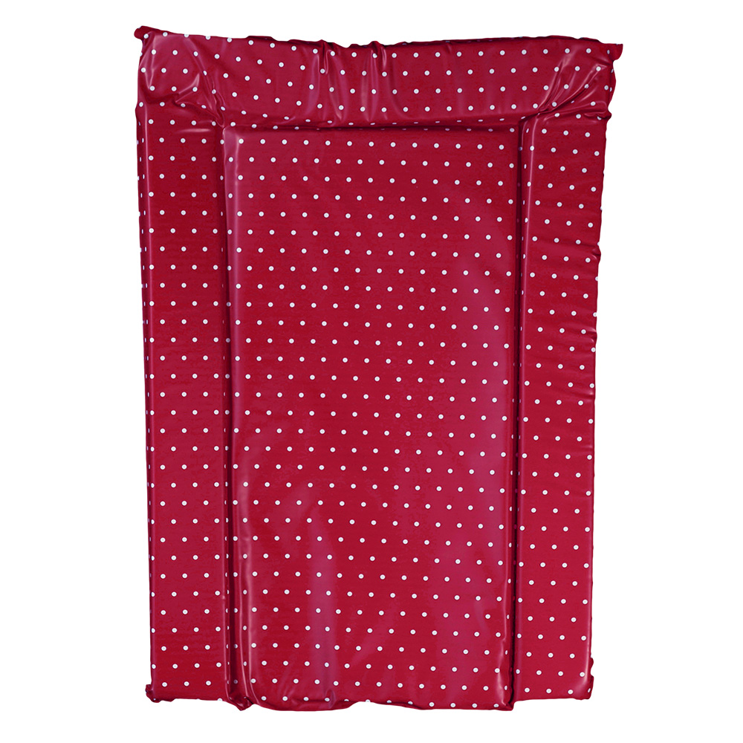
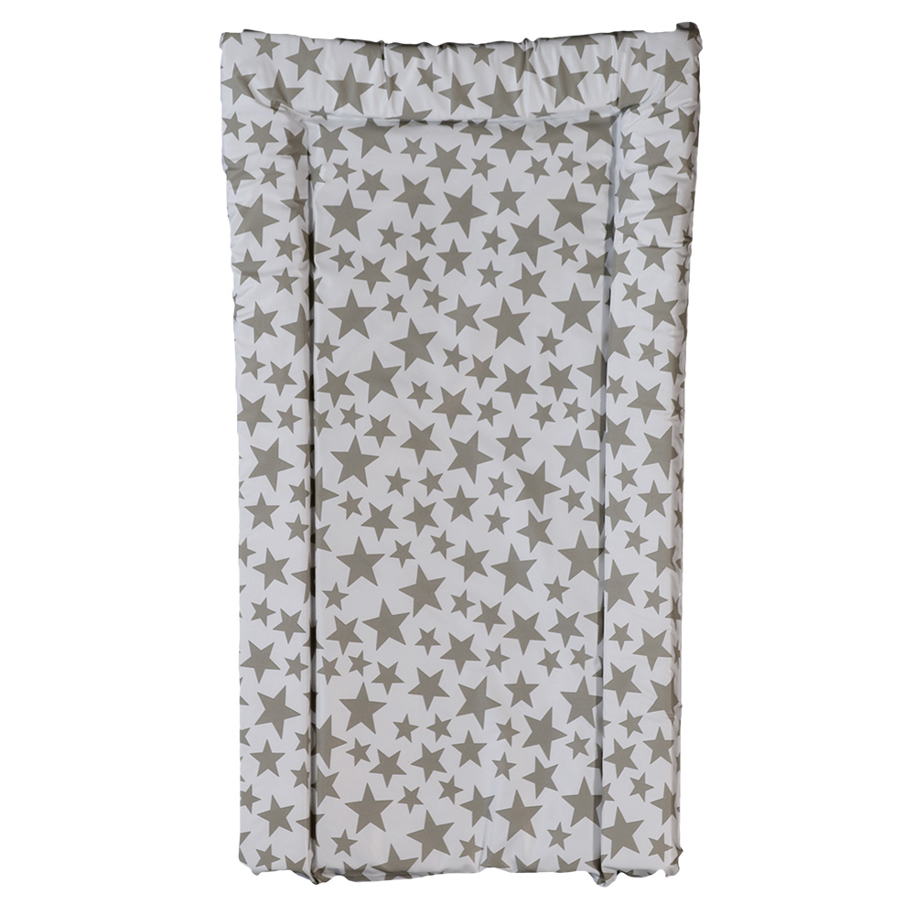
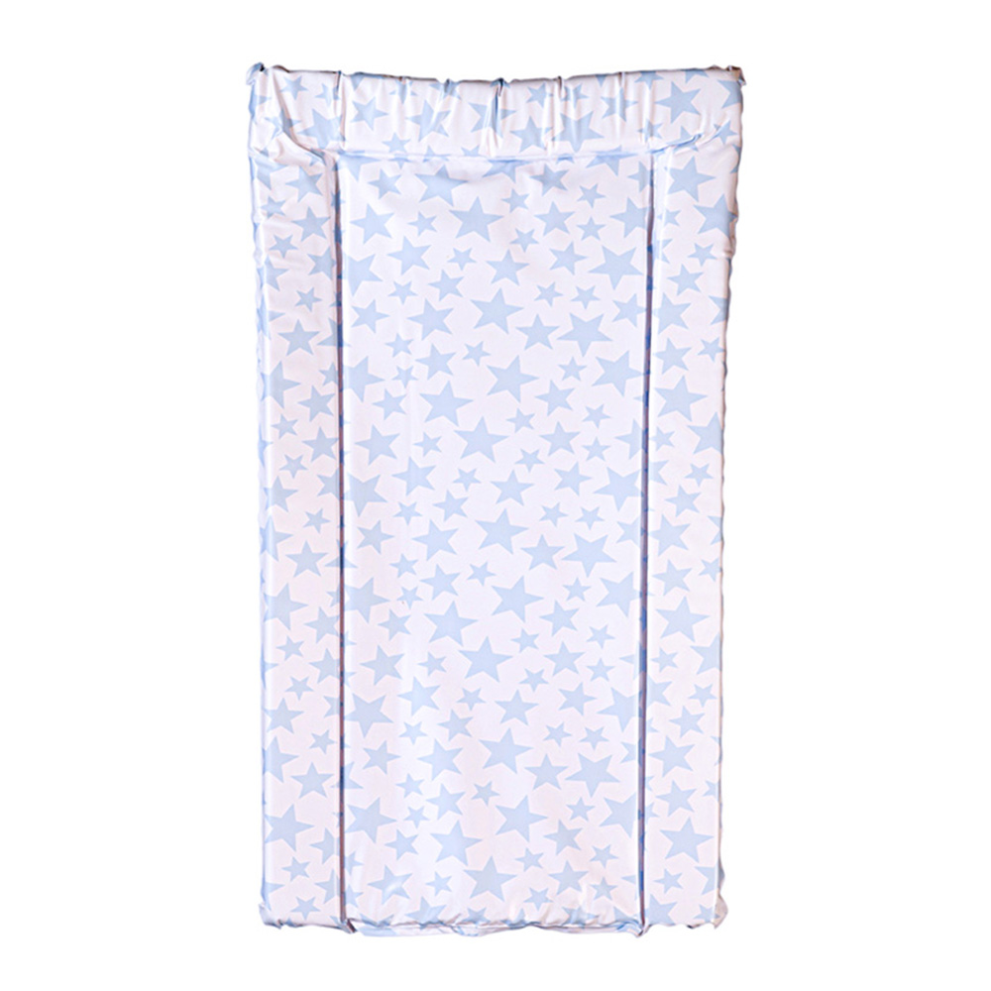
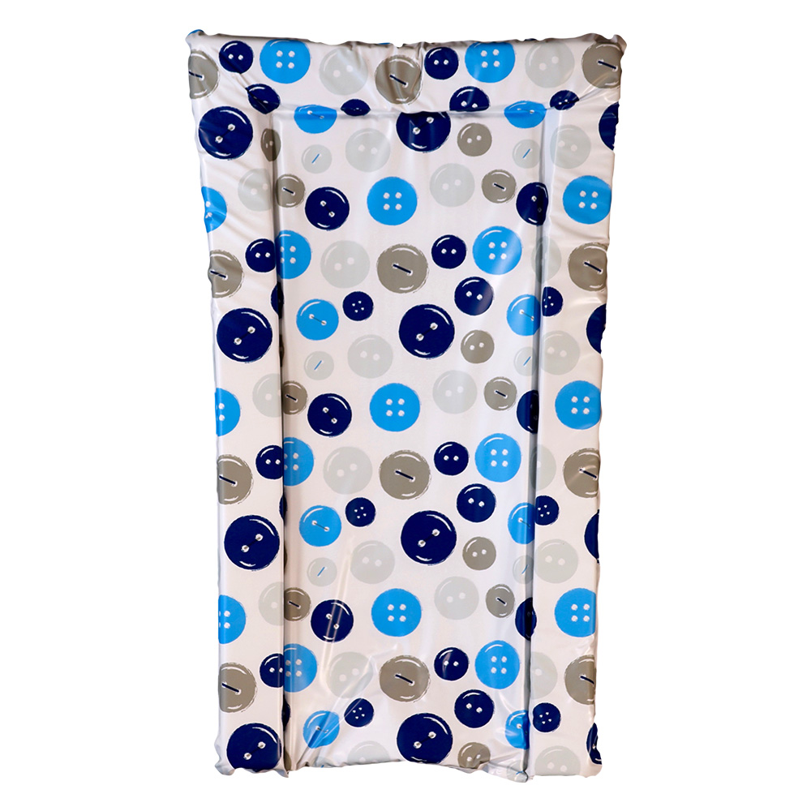
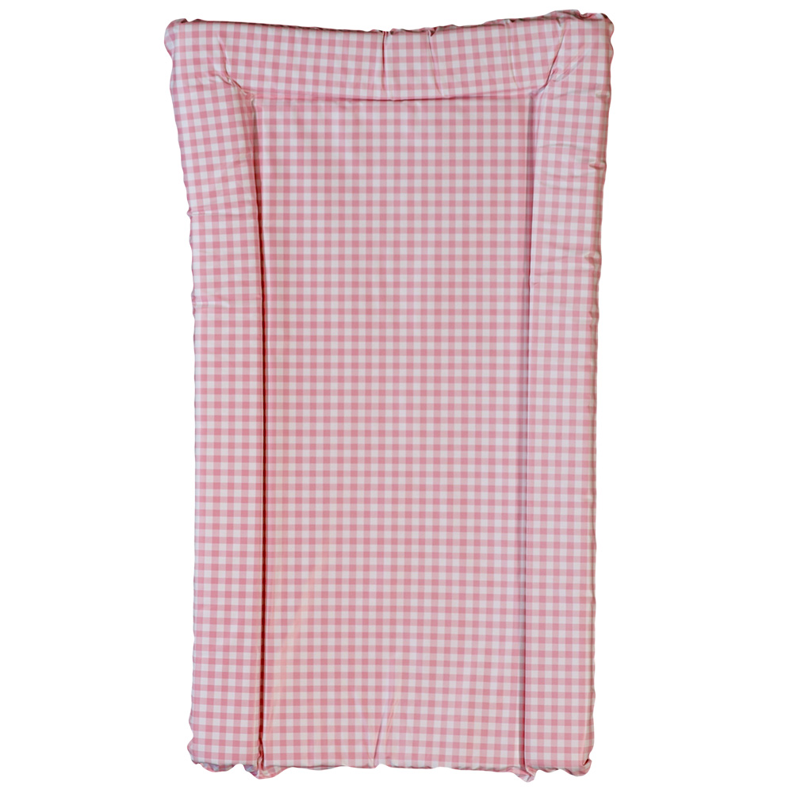
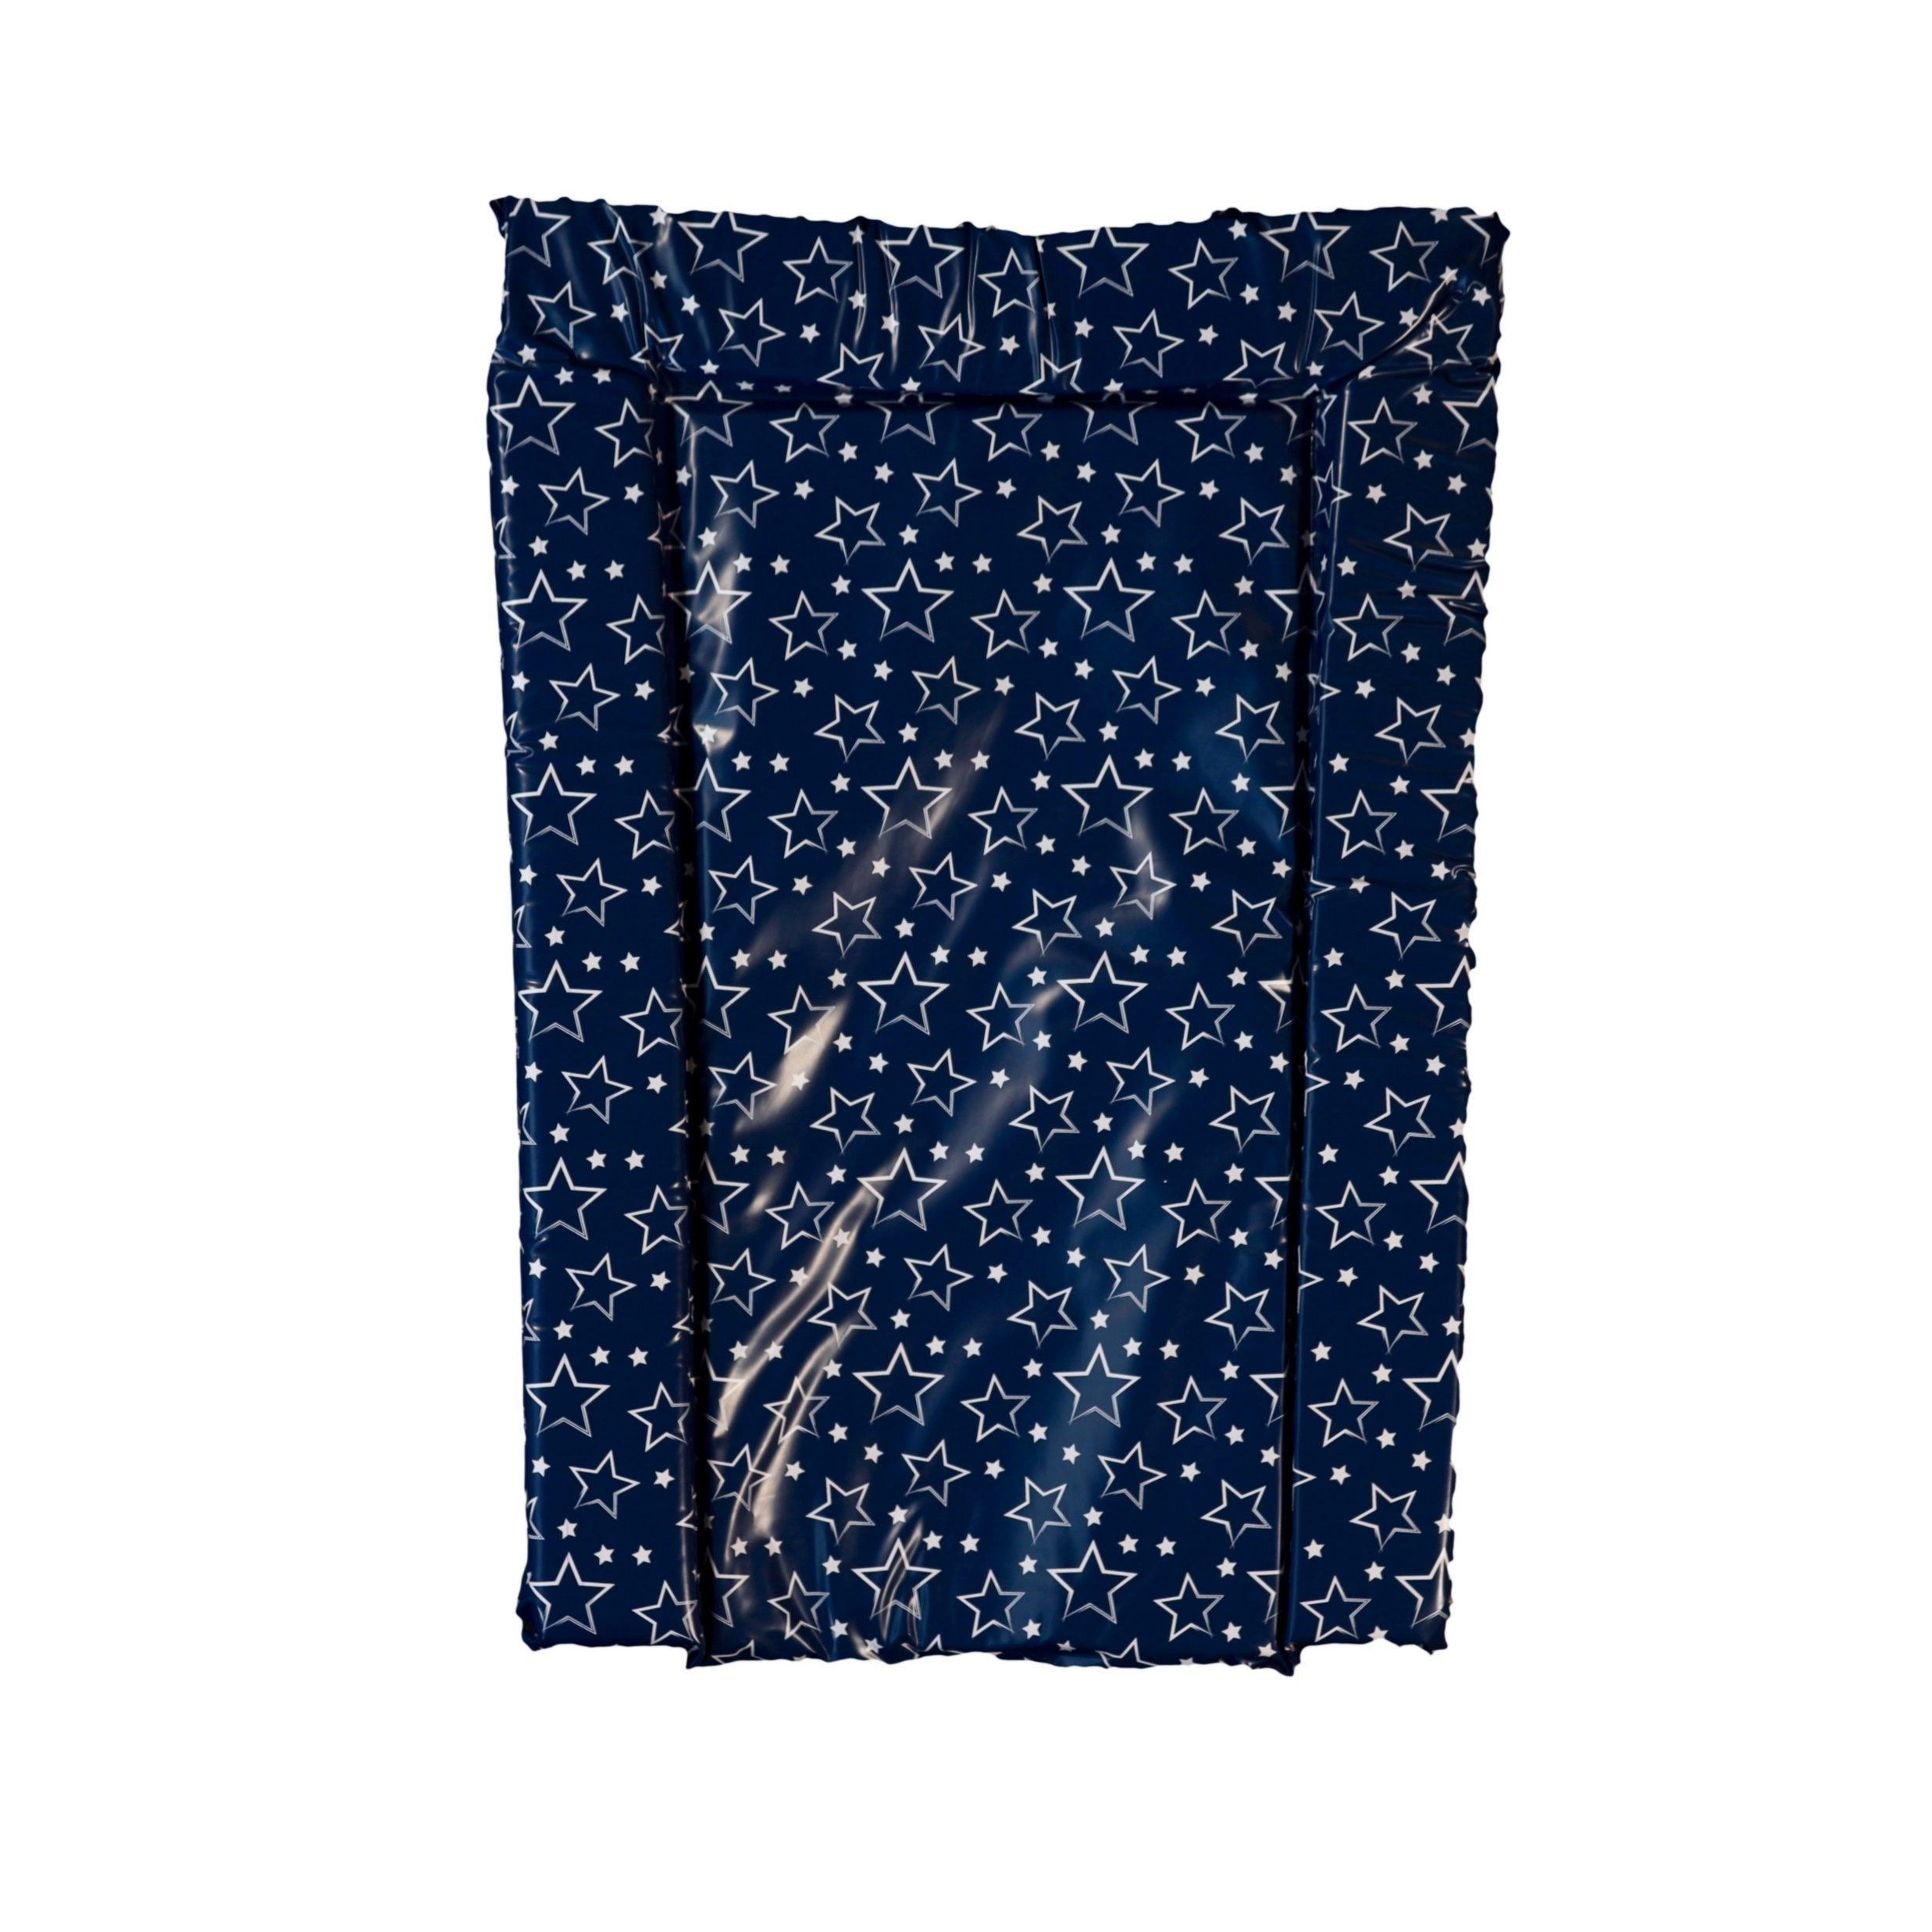
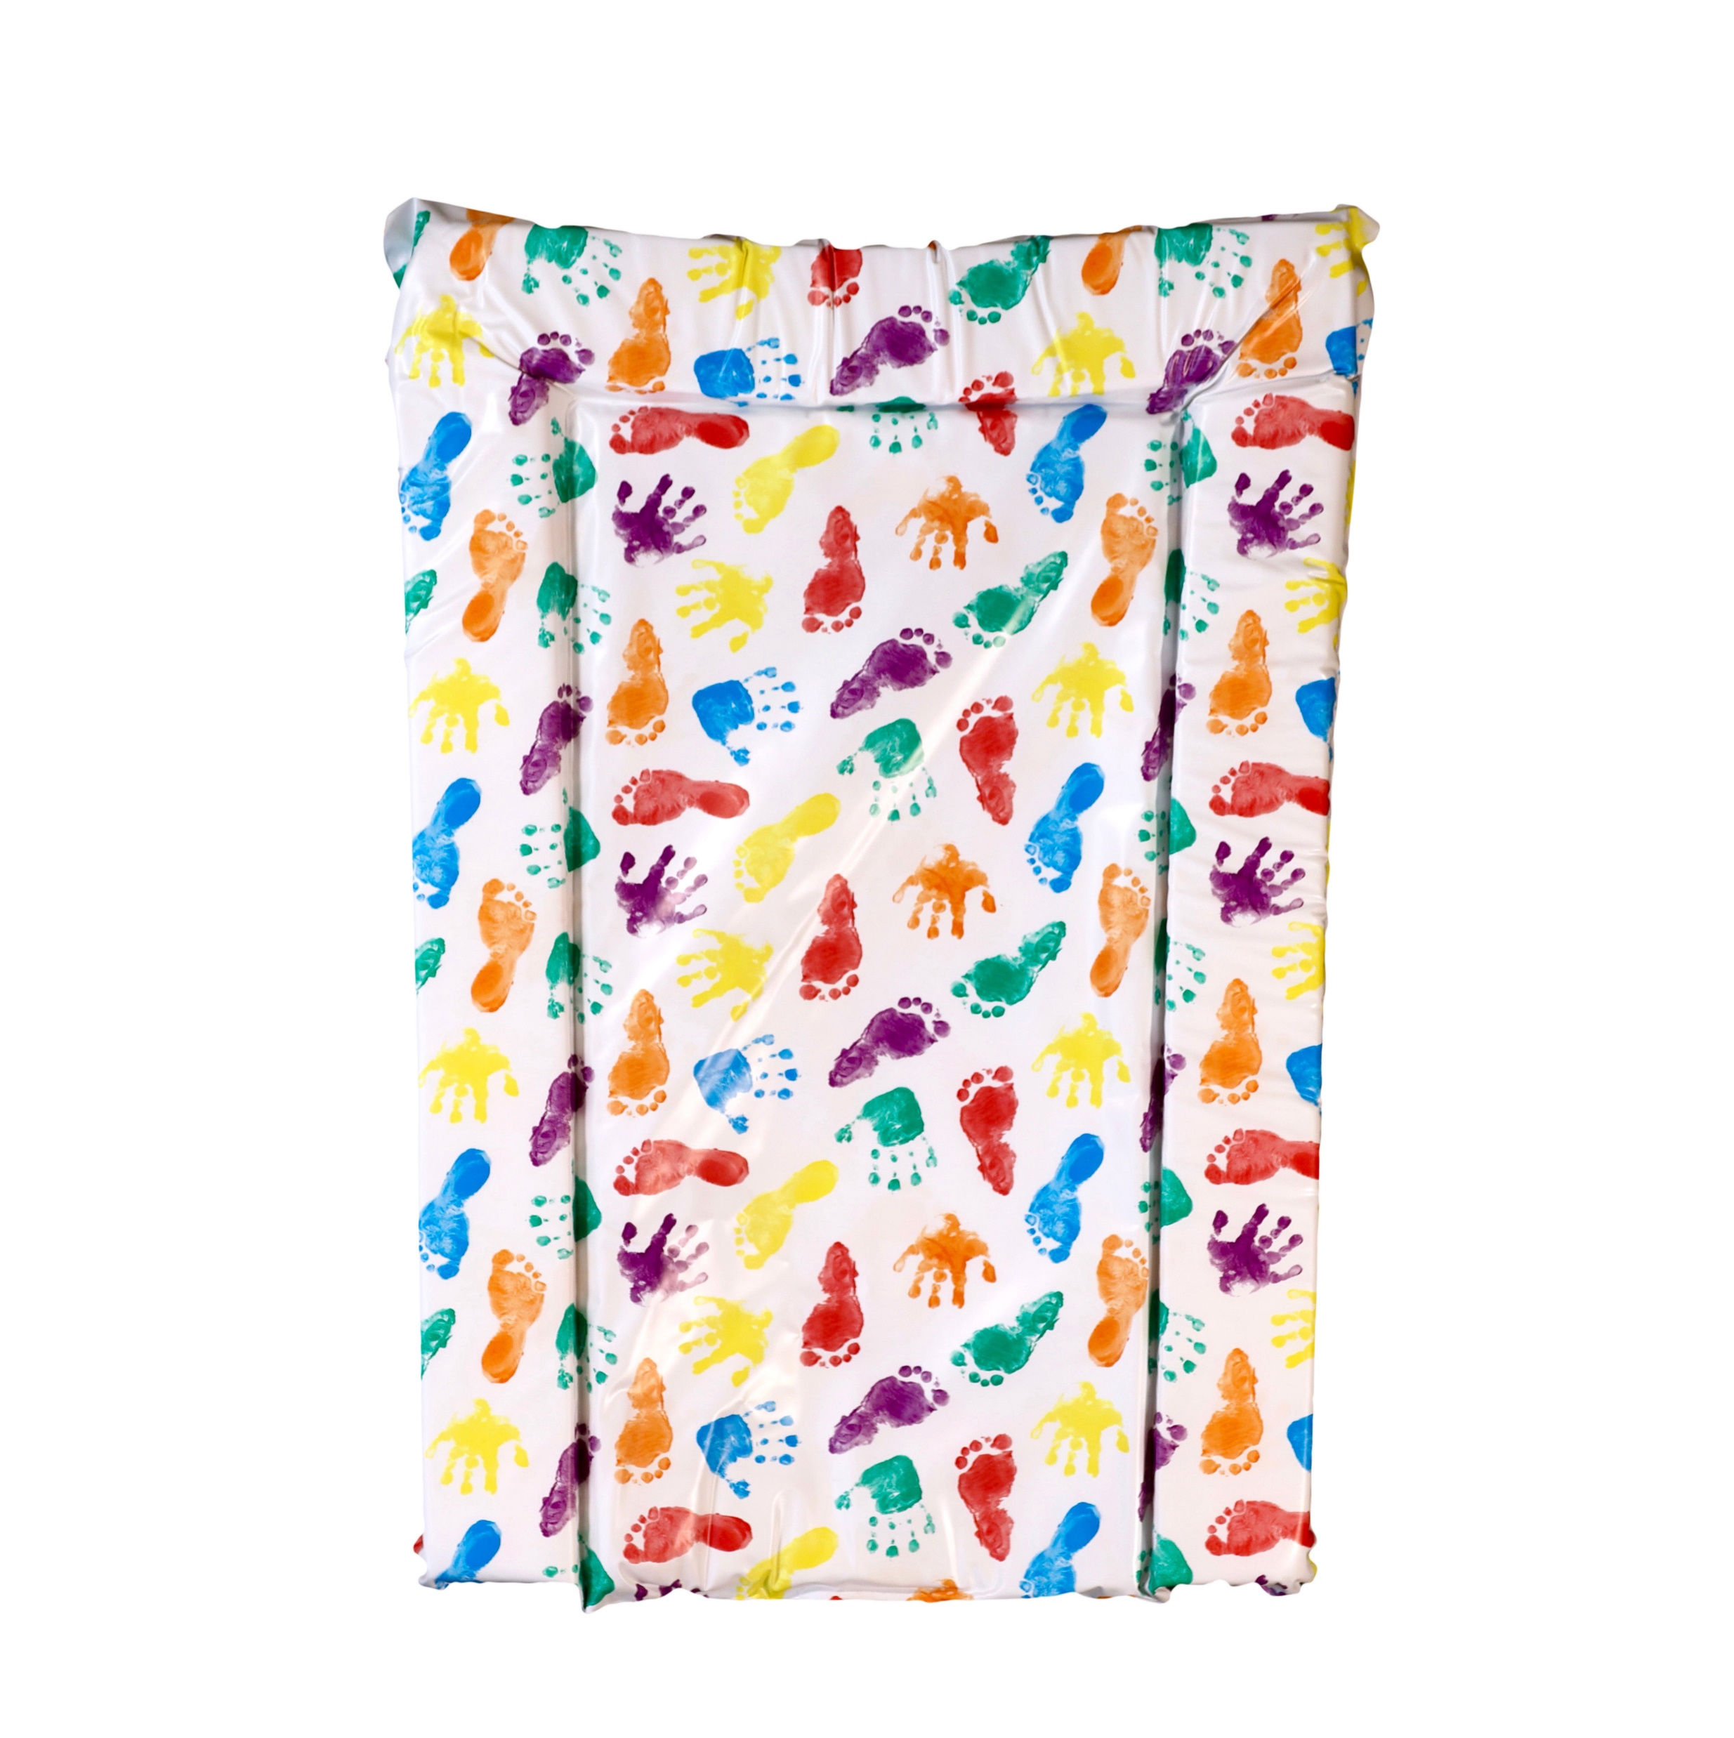

PVC Changing Mat Range
This quality wipe-clean changing mat is made from supportive foam padding with a Phthalate free PVC cover. It’s a comfortable place to change your baby and is a safe addition to any nursery.
This product is fully tested and complies with the relevant UK safety regulations - EN 71.
Fits most changing tables.
opyright From Product UK Ltd
All rights reserved
42
104
34
112
113
62
001
105
125
35
99
77
We have introduced a new collection of designs for changing mats. Please see the following pages for designs….

Slide 28
Supersoft Microfibre ‘Washable & Tumble Dry’ Changing Mat Range
This comfortable changing mat is made from a warm-feel Supersoft textured fabric that is easily cleaned and eco friendly. Its waterproof soft textile surface is stain resistant and non allergenic.
Item code | Item | Desc/Dims | Pack Size
NEW Changing Mats - Supersoft Microfibre Washable
BBMAT002 | White Microfibre Change Mat Meduim | 70x40x3.5 | 10
BBMAT003 | White Microfibre Quilted Change Mat Medium | 70x40x3.5 | 10
BBMAT006 | G Goes Free Change Mat Medium | 70x40x3.5 | 10
BBMAT007 | Rising Stars Change Mat Medium | 70x40x3.5 | 10
BBMAT008 | Duck ‘n’ Bearz Change Mat Medium | 70x40x3.5 | 10
BBMAT009 | Pads ‘n’ Paws Change Mat Medium | 70x40x3.5 | 10
BBMAT010 | Over The Moon (G) Change Mat Medium | 70x40x3.5 | 10
BBMAT011 | Over The Moon (P) Change Mat Medium | 70x40x3.5 | 10
BBMAT012 | Blowin Bubbles Change Mat Medium | 70x40x3.5 | 10
BBMAT013 | Jollie Olliphant Change Mat Medium | 70x40x3.5 | 10
BBMAT014 | Big World (P) Change Mat Medium | 70x40x3.5 | 10
BBMAT015 | Big World (B) Change Mat Medium | 70x40x3.5 | 10
BBMAT016 | Bamboo Baby Change Mat Medium | 70x40x3.5 | 10
BBMAT017 | Peak A Boo Bear Change Mat Medium | 70x40x3.5 | 10
BBMAT004 | White Microfibre Change Mat Large | 75x45x4 | 5
BBMAT005 | White Microfibre Quilted Change Mat Large | 75x45x4 | 5
BBMAT018 | G Goes Free Change Mat Large | 75x45x4 | 5
BBMAT019 | Rising Stars Change Mat Large | 75x45x4 | 5
BBMAT020 | Duck ‘n’ Bearz Change Mat Large | 75x45x4 | 5
BBMAT021 | Pads ‘n’ Paws Change Mat Large | 75x45x4 | 5
BBMAT022 | Over The Moon (G) Change Mat Large | 75x45x4 | 5
BBMAT023 | Over The Moon (P) Change Mat Large | 75x45x4 | 5
BBMAT024 | Blowin Bubbles Change Mat Large | 75x45x4 | 5
BBMAT025 | Jollie Olliphant Change Mat Large | 75x45x4 | 5
BBMAT026 | Big World (P) Change Mat Large | 75x45x4 | 5
BBMAT027 | Big World (B) Change Mat Large | 75x45x4 | 5
BBMAT028 | Bamboo Baby Change Mat Large | 75x45x4 | 5
BBMAT029 | Peak A Boo Bear Change Mat Large | 75x45x4 | 5

Slide 29
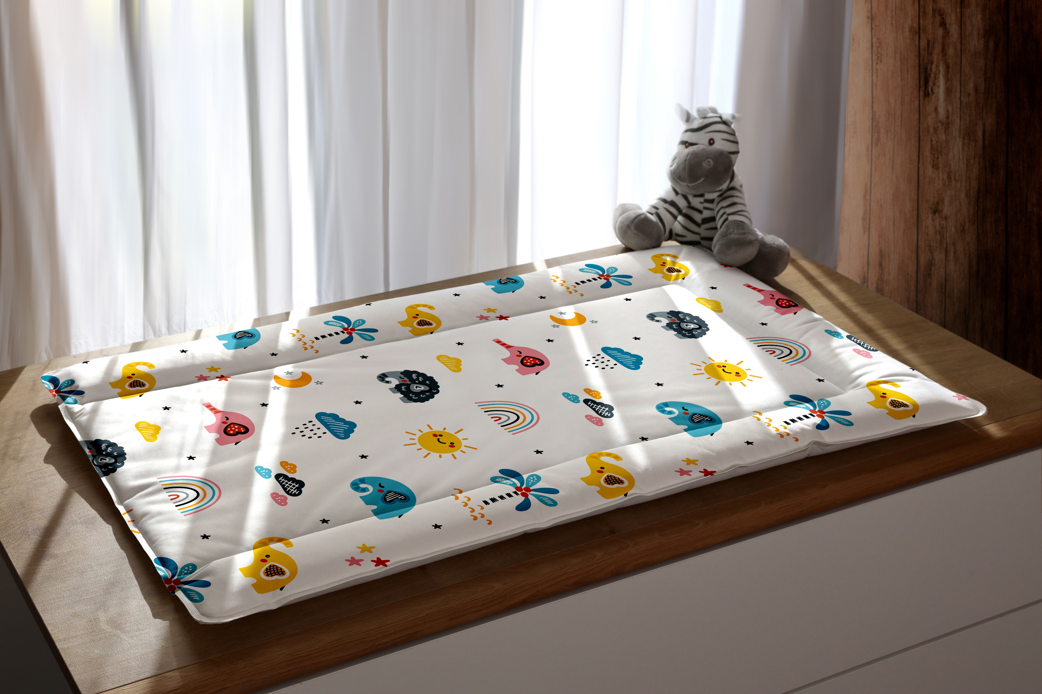
Supersoft Microfibre ‘Washable & Tumble Dry’ Changing Mat Range
This comfortable changing mat is made from a warm-feel Supersoft textured fabric that is easily cleaned and eco friendly. Its waterproof soft textile surface is stain resistant and non allergenic.
It can be washed at 30 degrees and also tumble dried on a cool setting
Made from part-recycled and recyclable materials
PVC and plasticizer-free
Plain, Quilted or Printed design
Low energy consumption ultrasonic manufacturing process with sealed hygienic edges
Can be wiped clean or machine ‘cool’ washed at 30 degrees in accordance with the care label
Can be tumble dried on a ‘cool’ setting in accordance with the care label
Designed for use at home or easily rolled for use on the move
For use with newborns to toddlers
Fits most size changing tables
This product is fully tested and complies with the relevant UK safety regulations - EN 71.

Slide 30
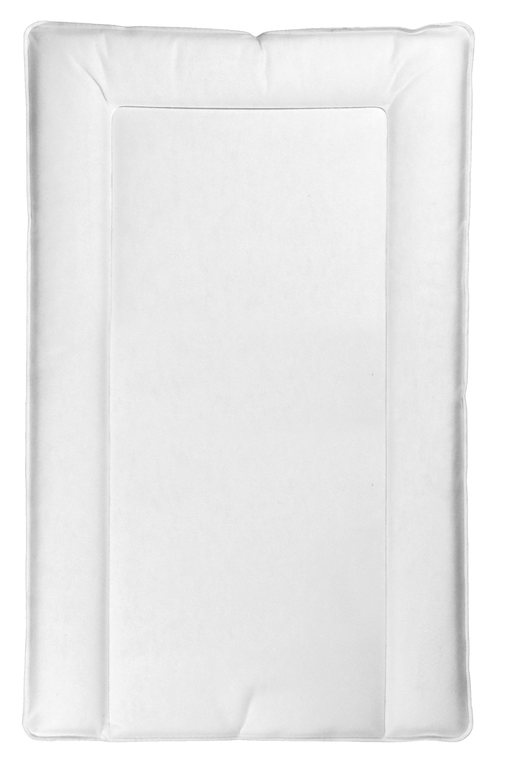
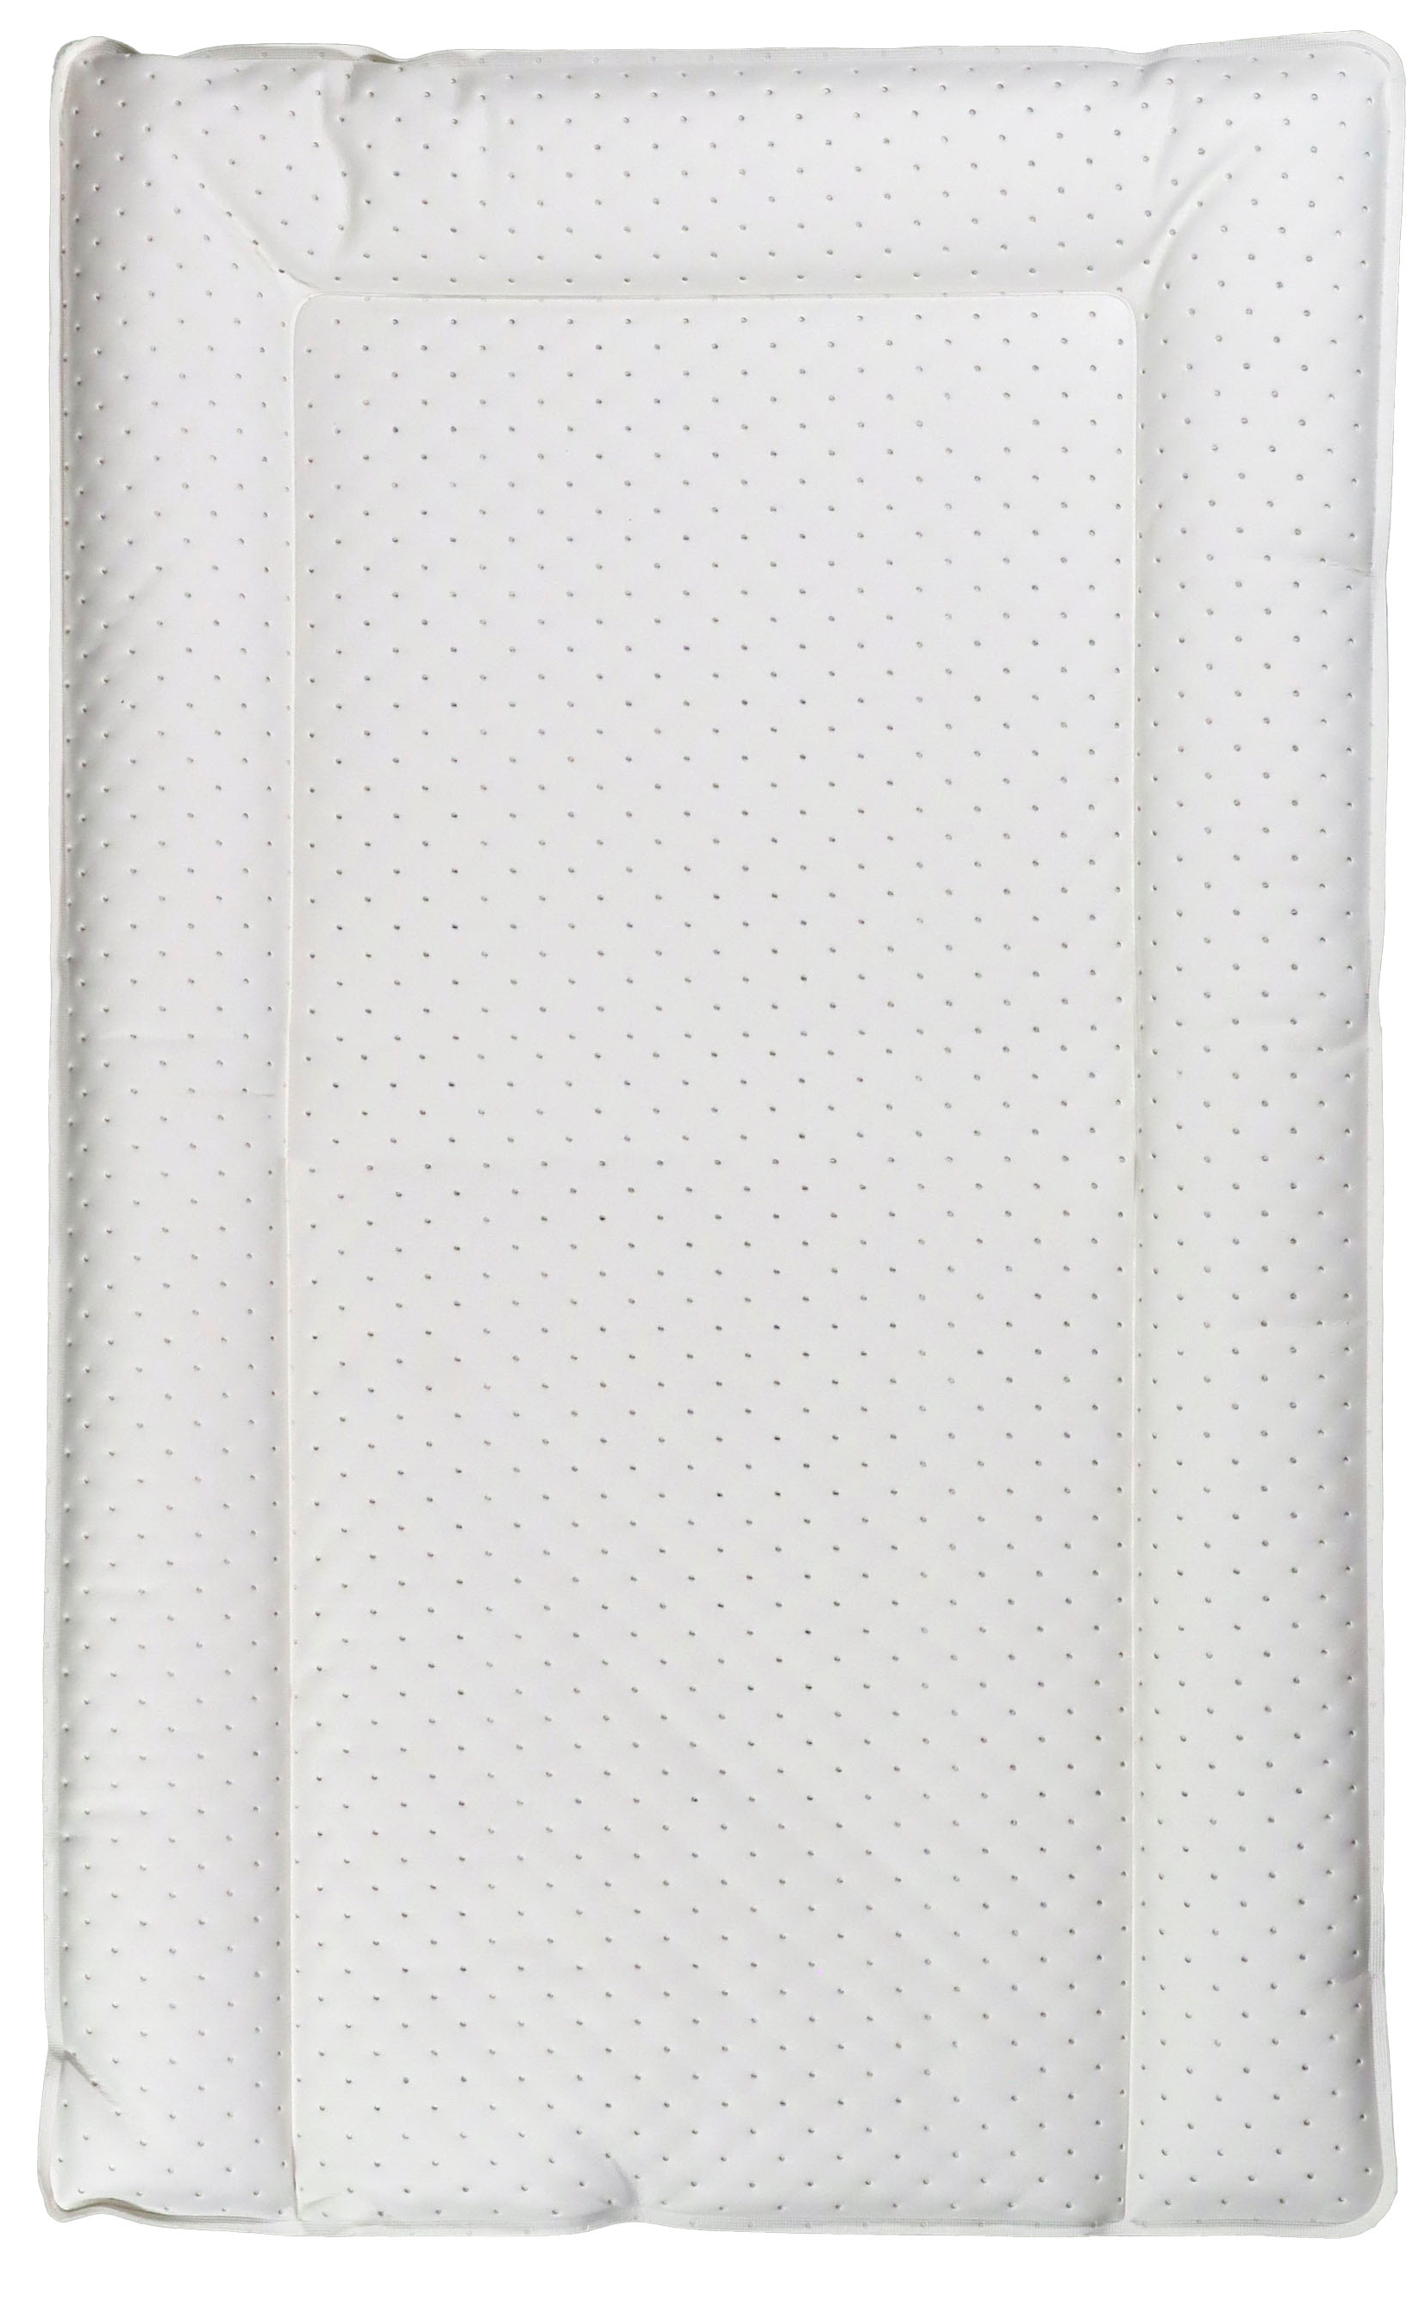
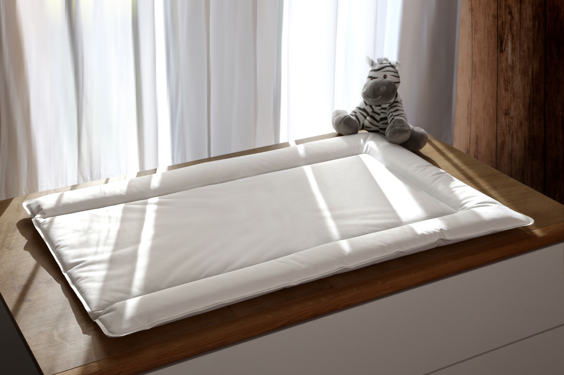
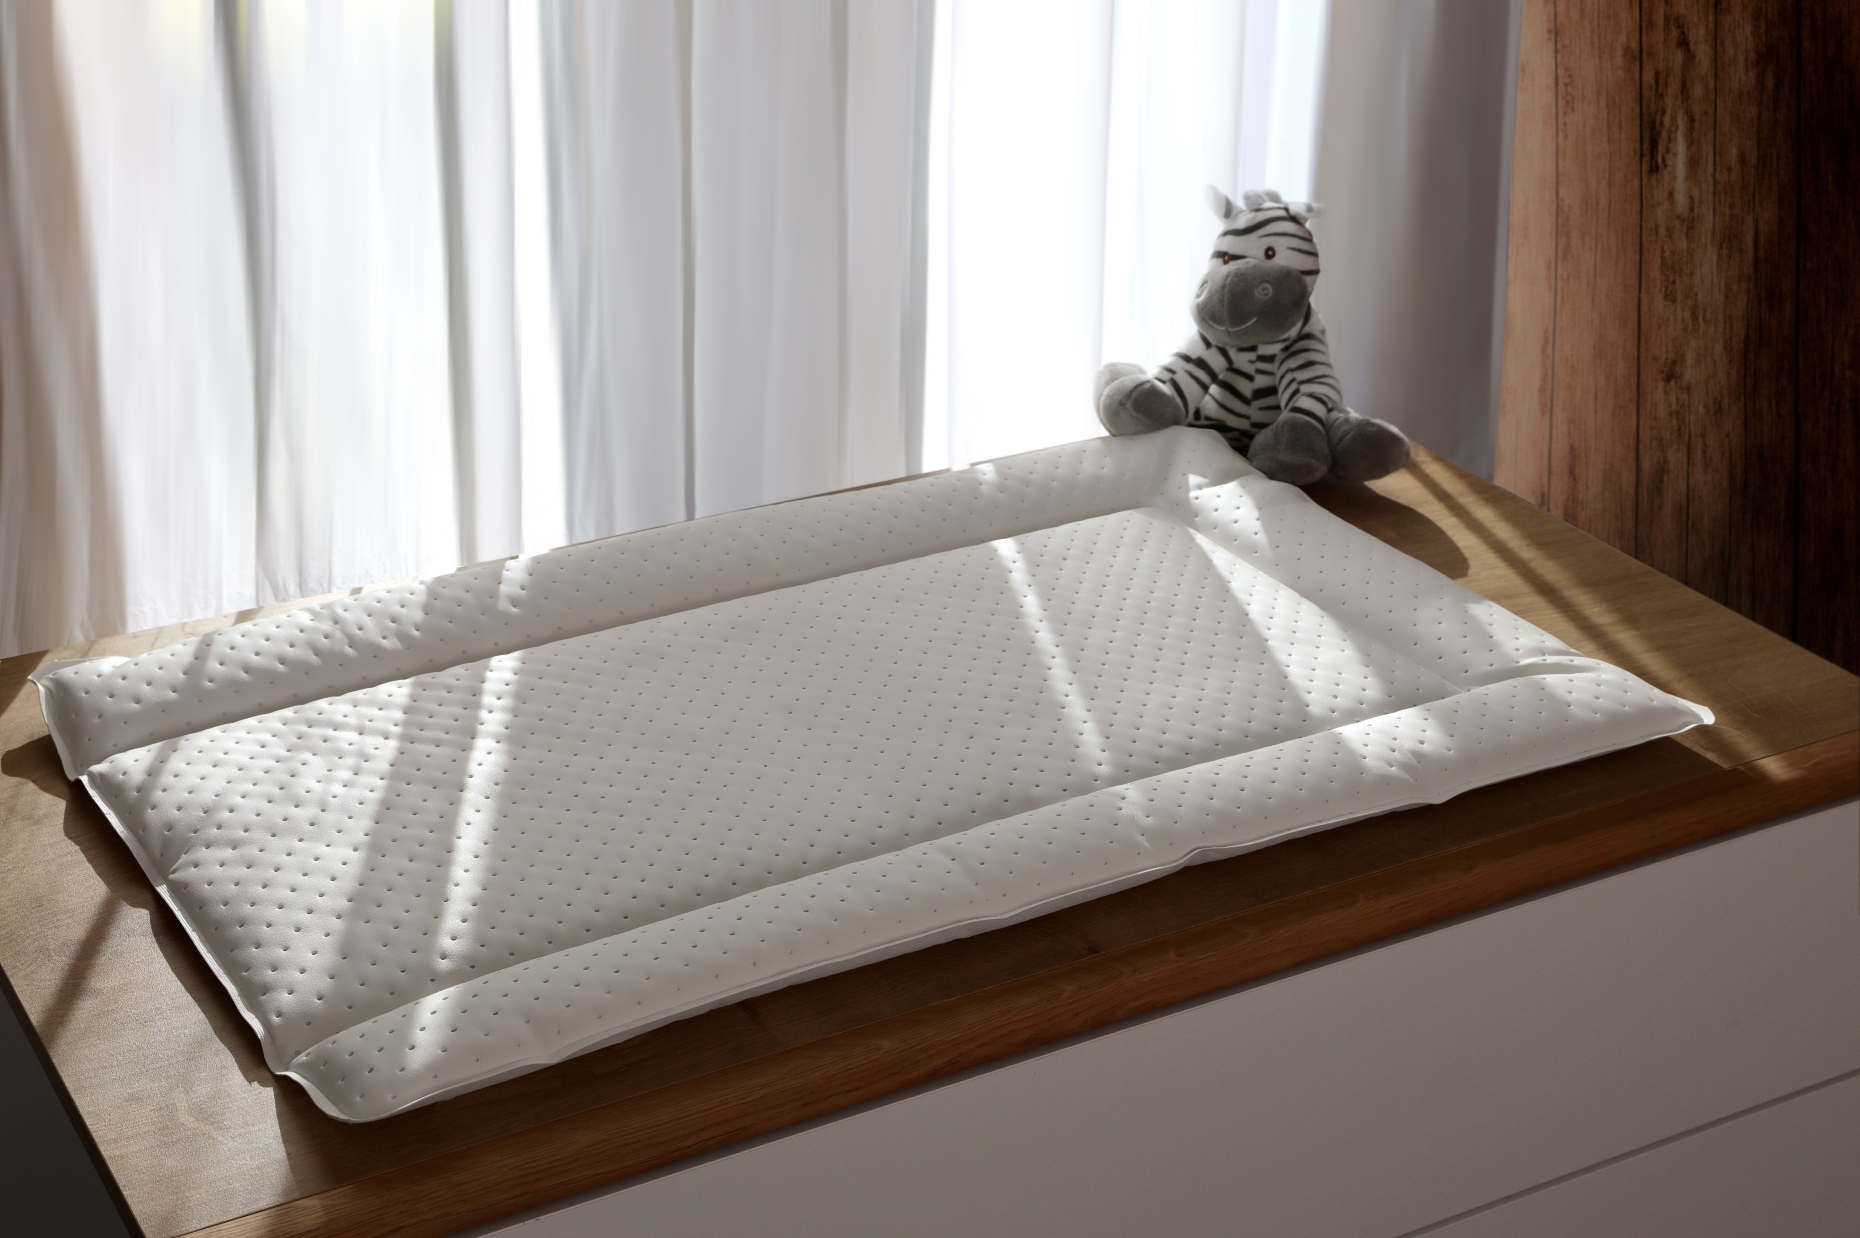
Changing Mats – New Design Collection
Please see below the new collection for changing mats which will be available on the PVC Medium, Microfibre Medium and Microfibre Large ranges (PVC large – on request only)
opyright From Product UK Ltd
All rights reserved
Bebeluca
Bebeluca
Plain White
Plain White With Quilting
SRP £7.00
SRP £9.00

Slide 31
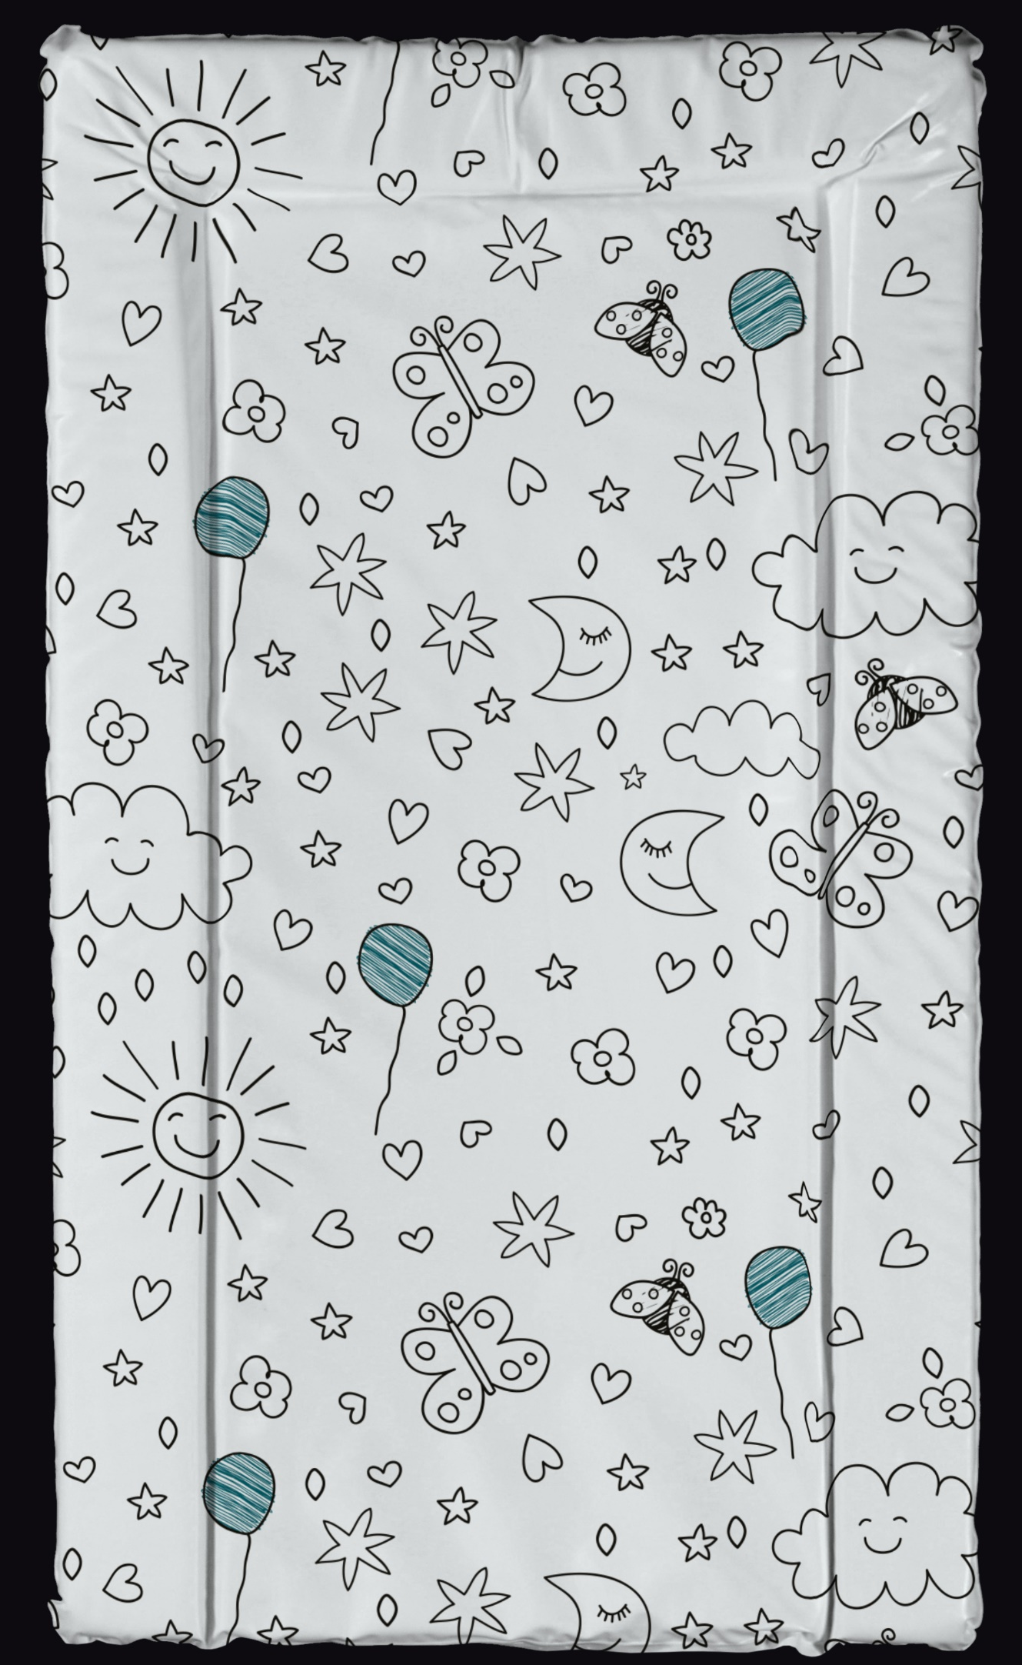
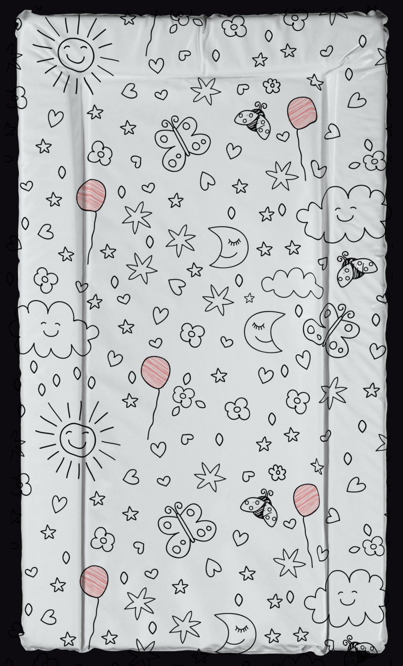
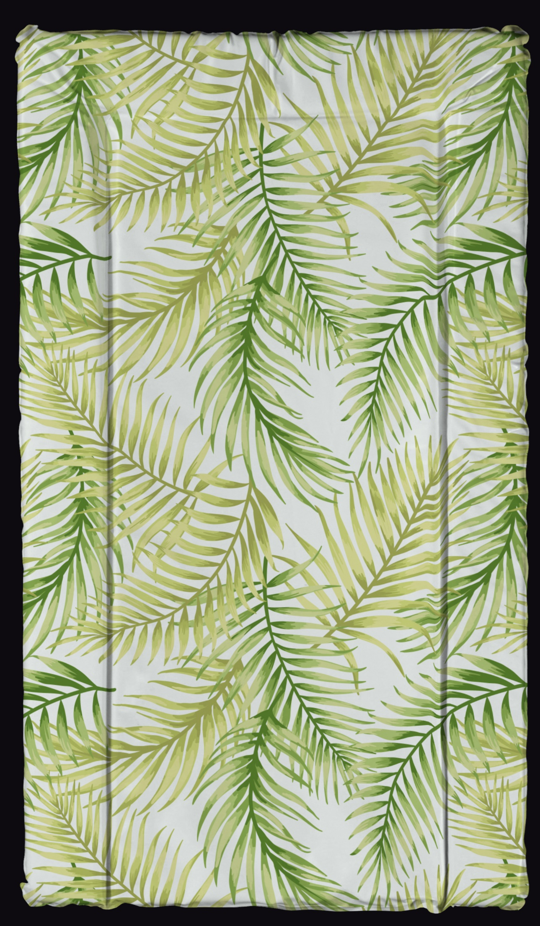
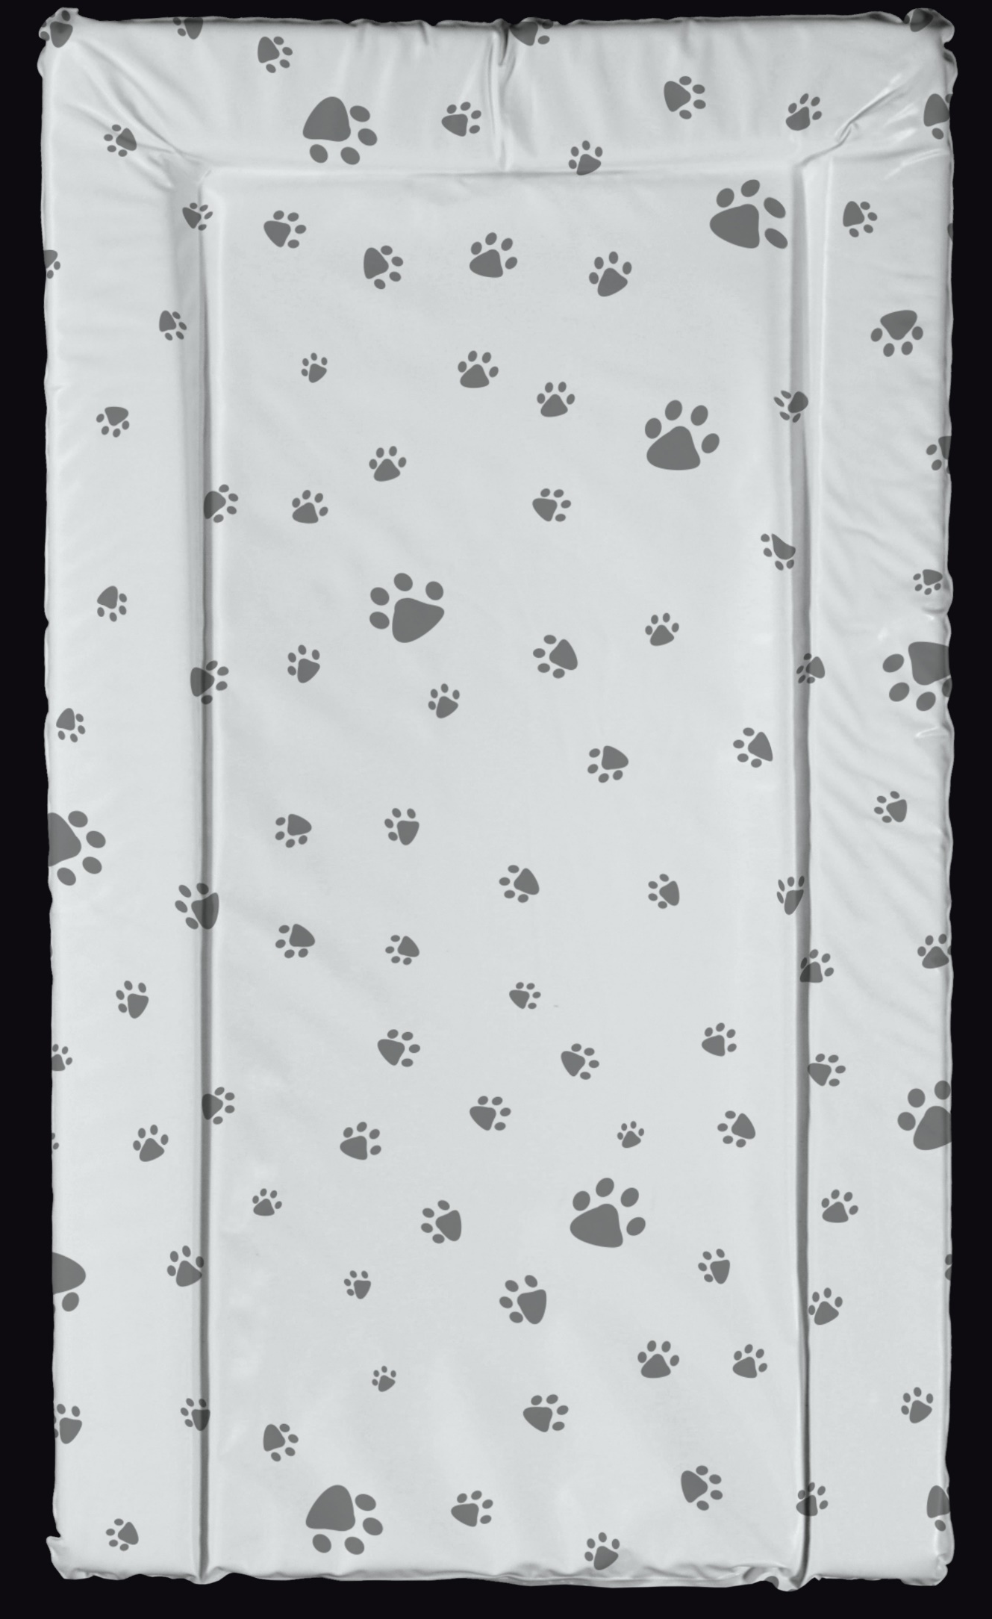
Changing Mats – New Design Collection
Please see below the new collection for changing mats which will be available on the PVC Medium, Microfibre Medium and Microfibre Large ranges (PVC large – on request only)
opyright From Product UK Ltd
All rights reserved
Bebeluca
Bebeluca
Bebeluca
Bebeluca
Big World (B)
Big World (P)
Pads ‘n’ Paws
Bamboo Baby

Slide 32
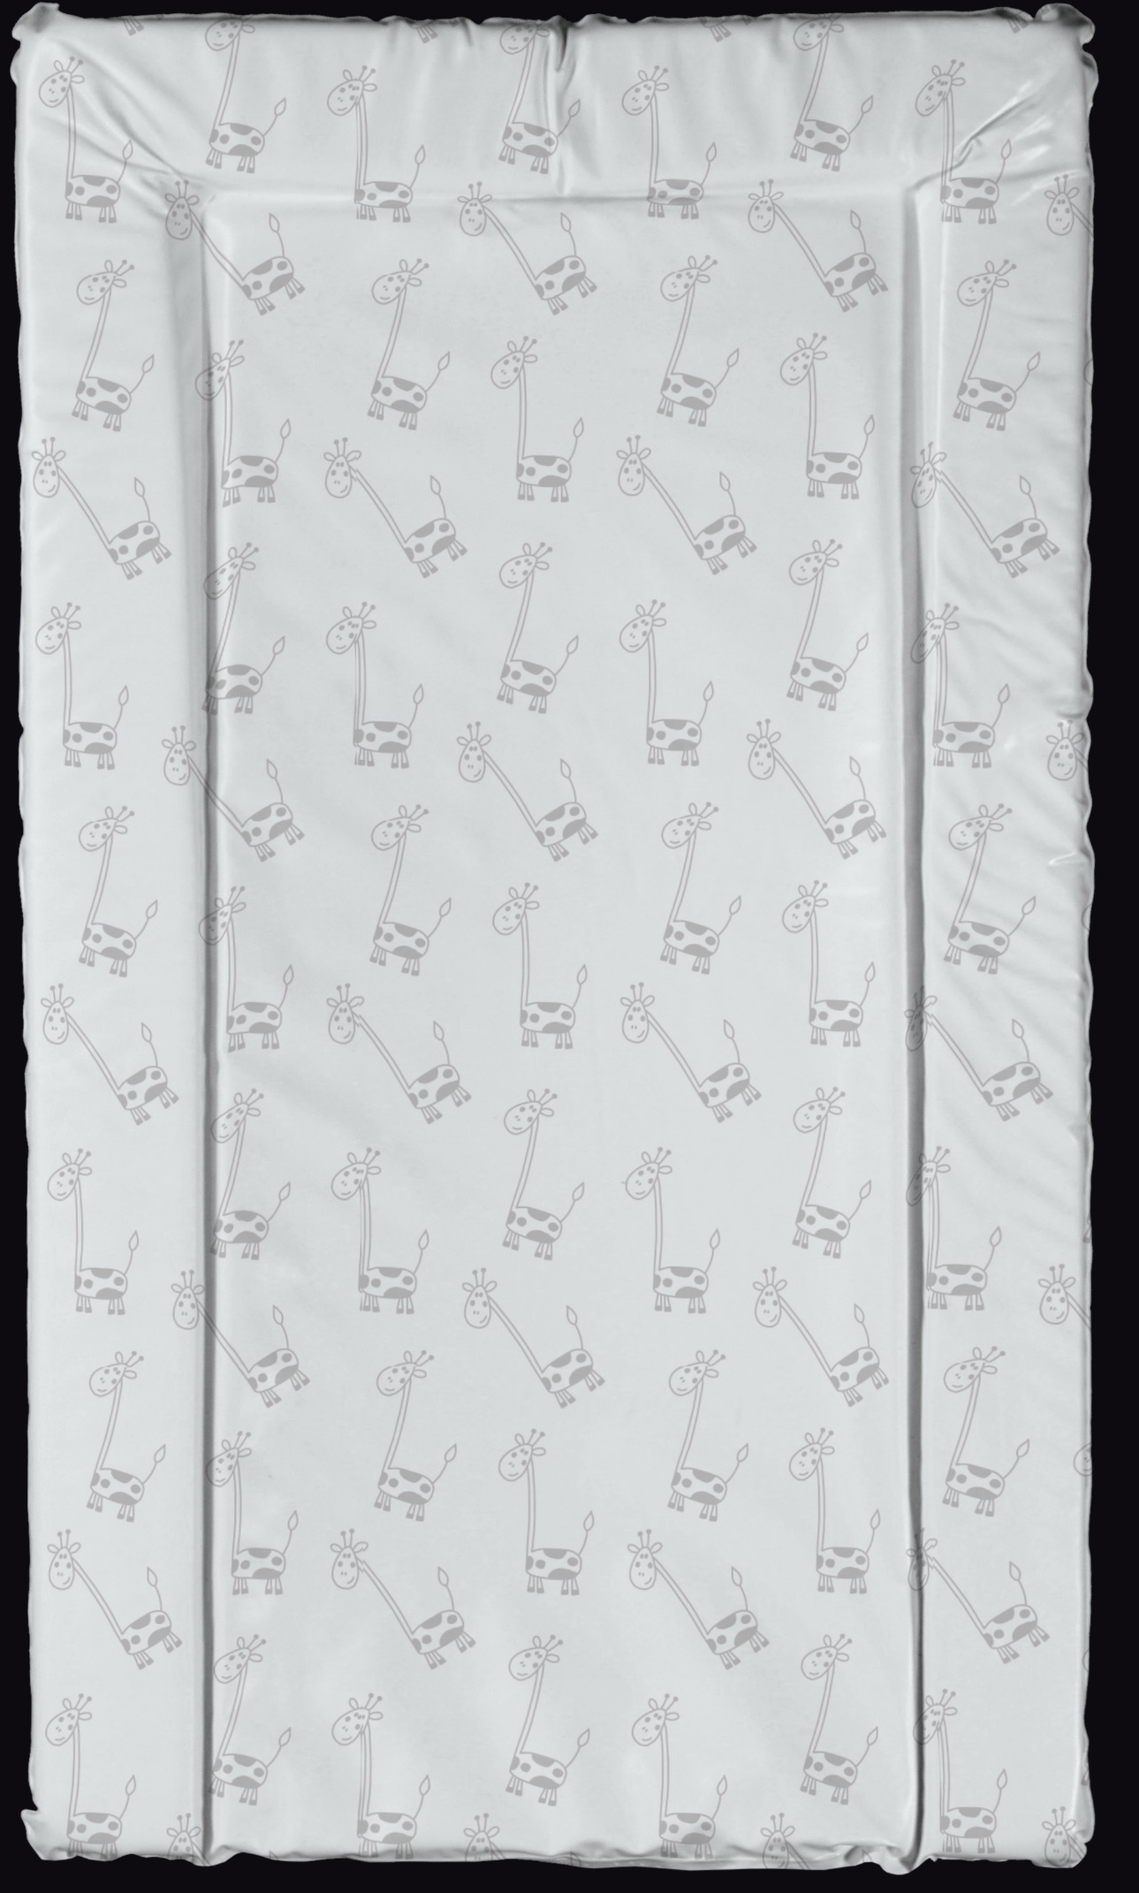
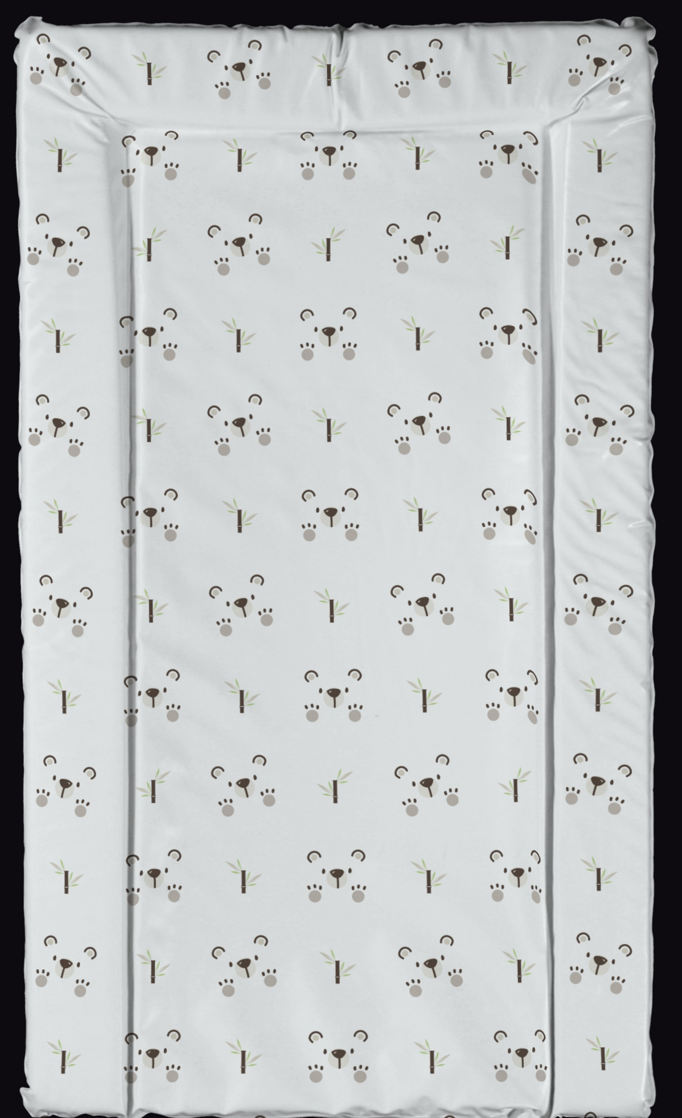
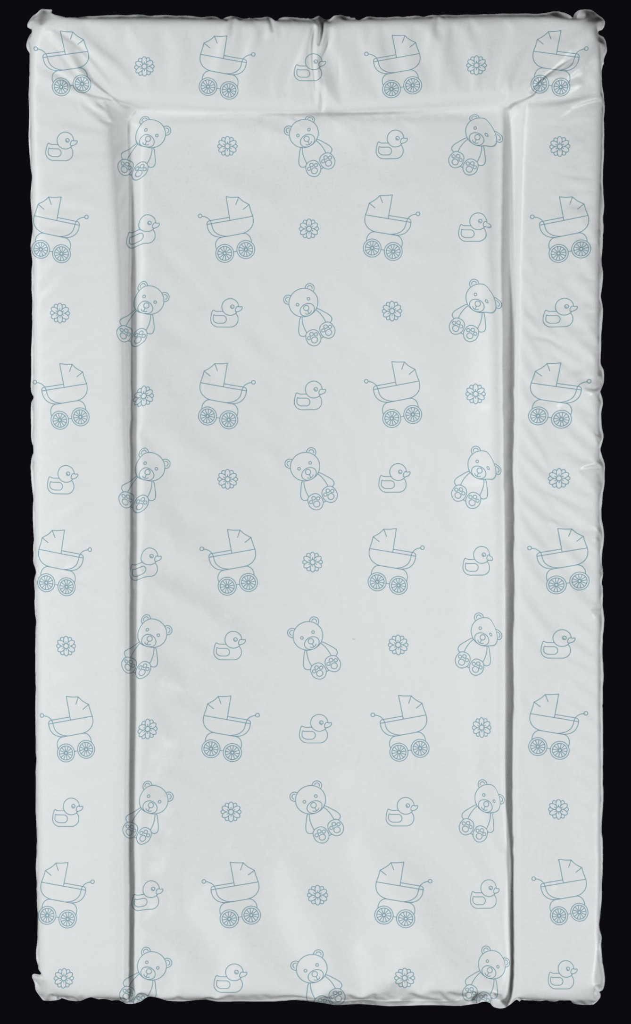
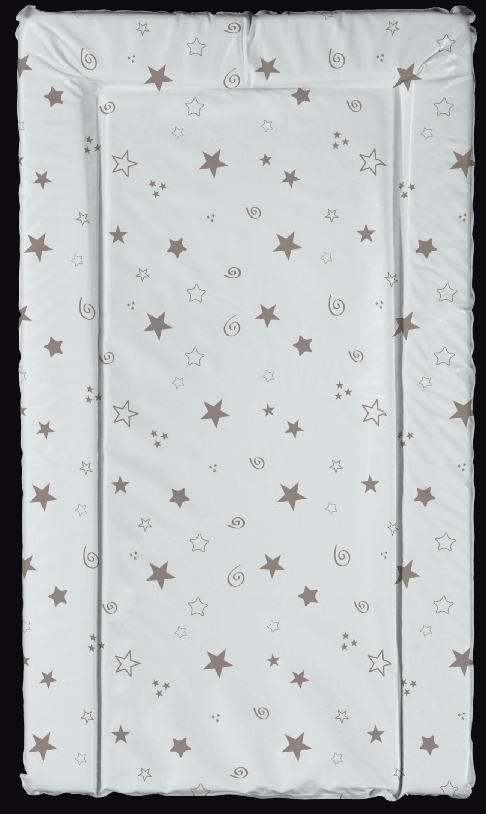
Changing Mats – New Design Collection
Please see below the new collection for changing mats which will be available on the PVC Medium, Microfibre Medium and Microfibre Large ranges (PVC large – on request only)
opyright From Product UK Ltd
All rights reserved
Bebeluca
Bebeluca
Bebeluca
Bebeluca
G Goes Free
Peak A Boo Bear
Duck ‘n’ Bearz
Rising Stars

Slide 33
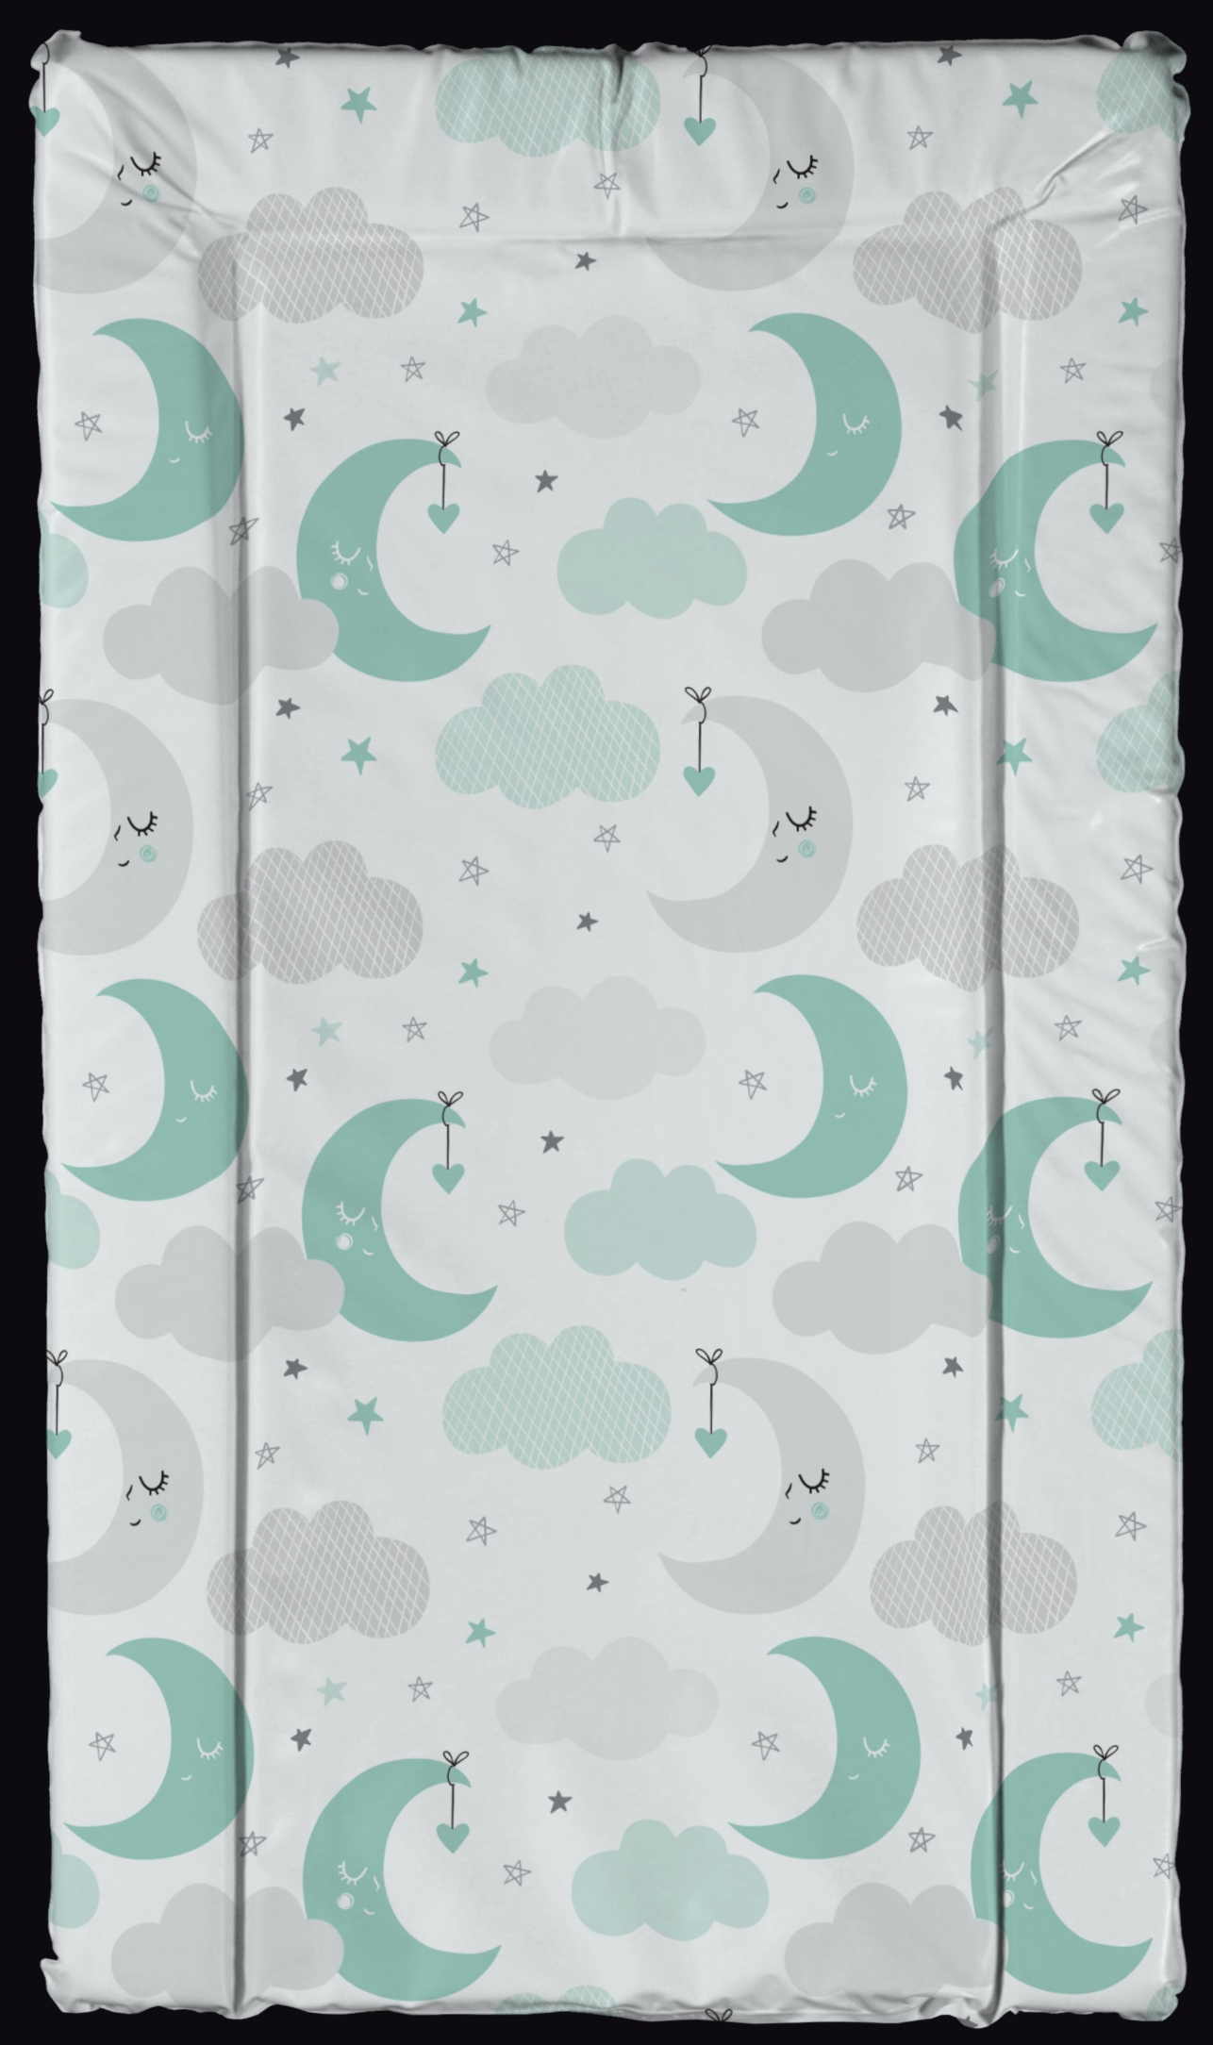
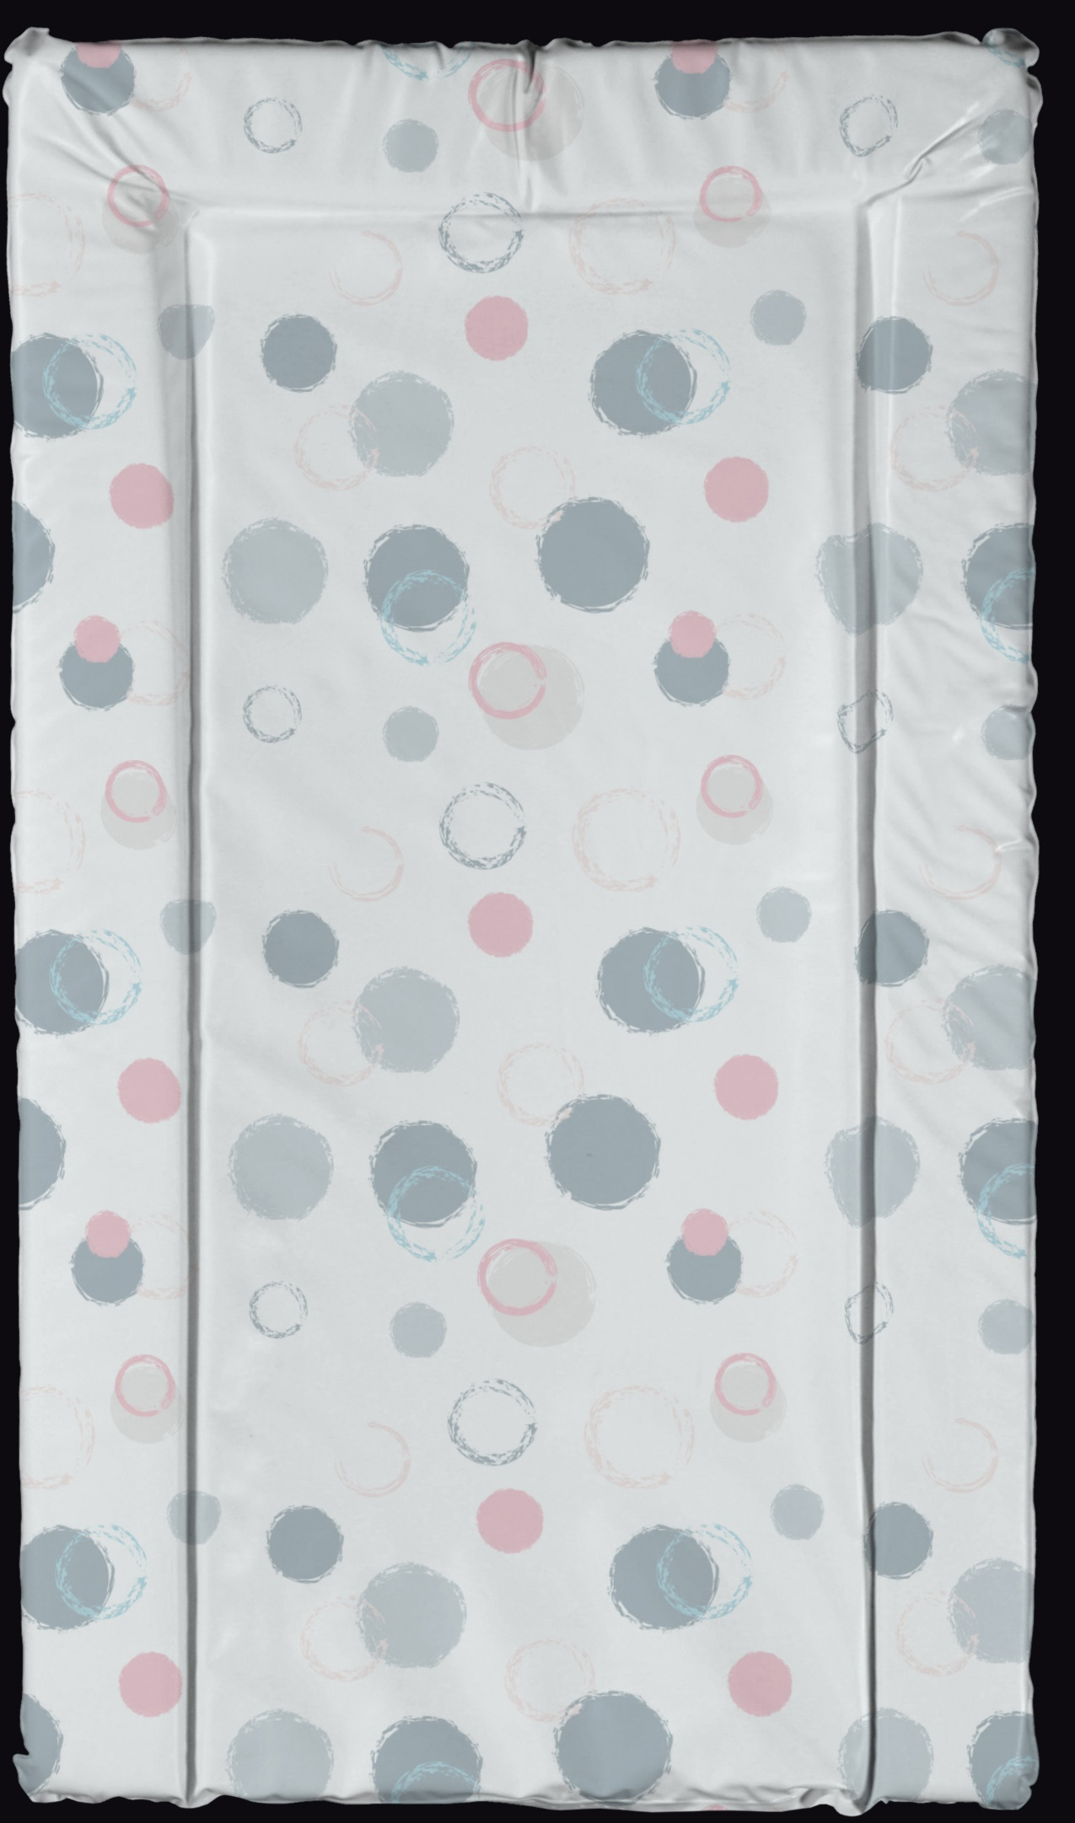
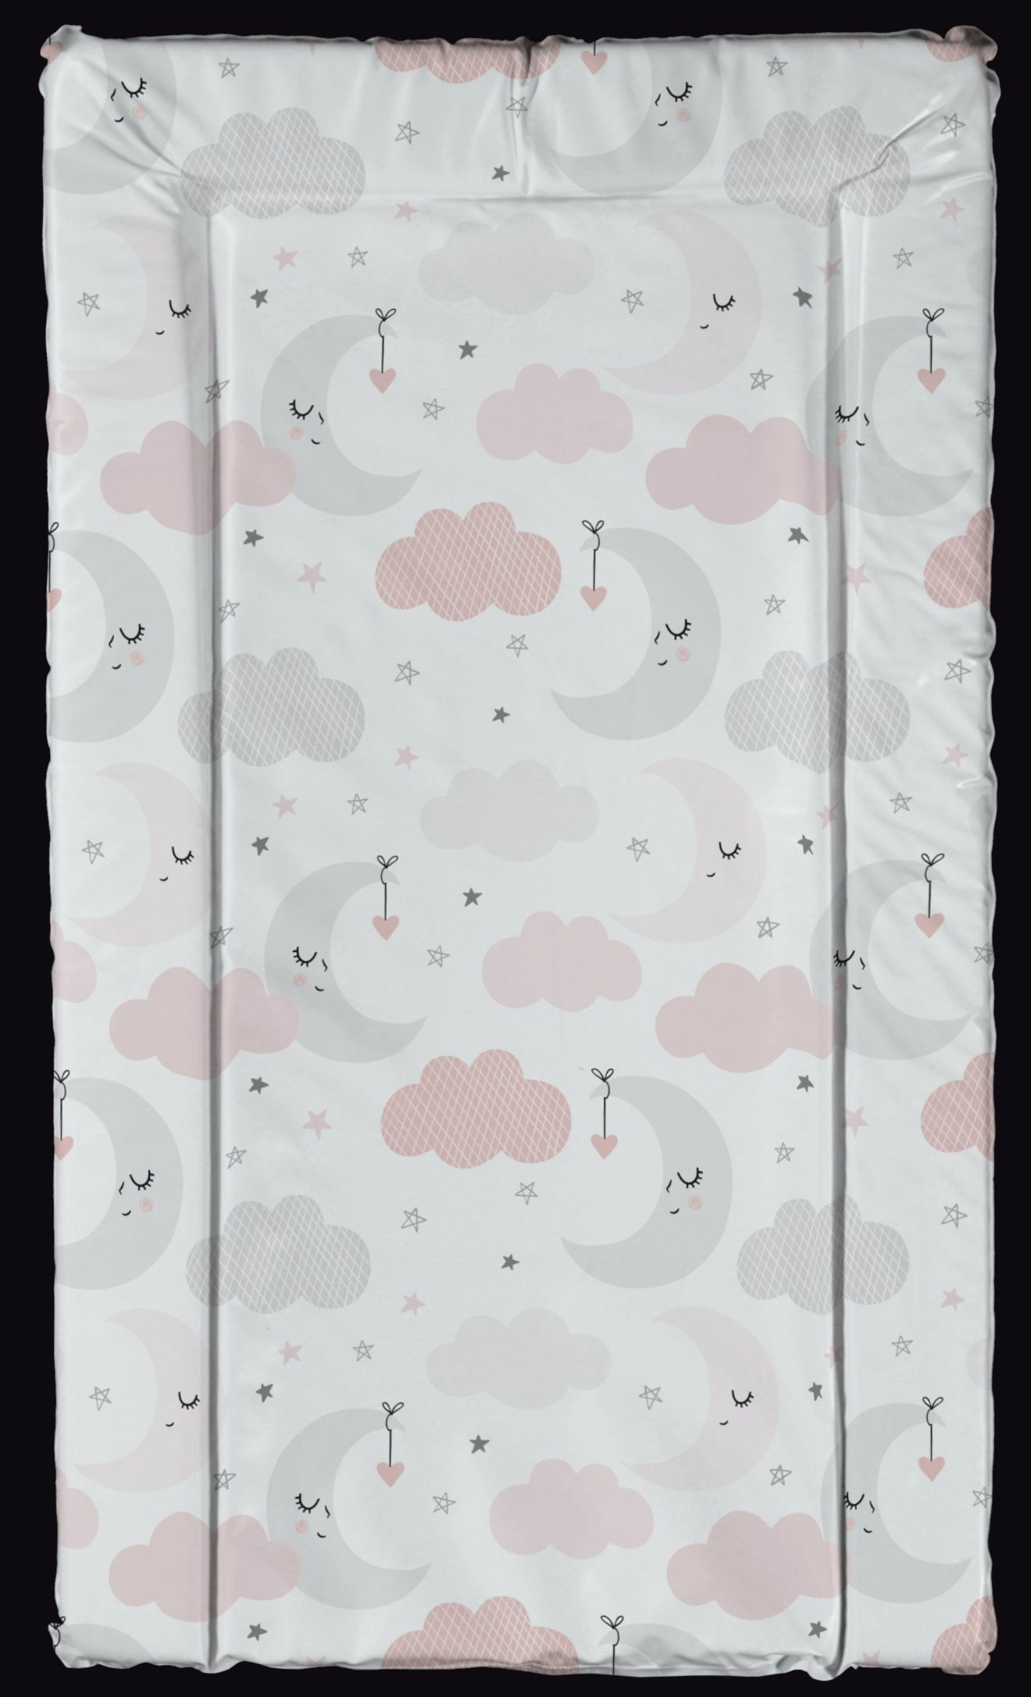
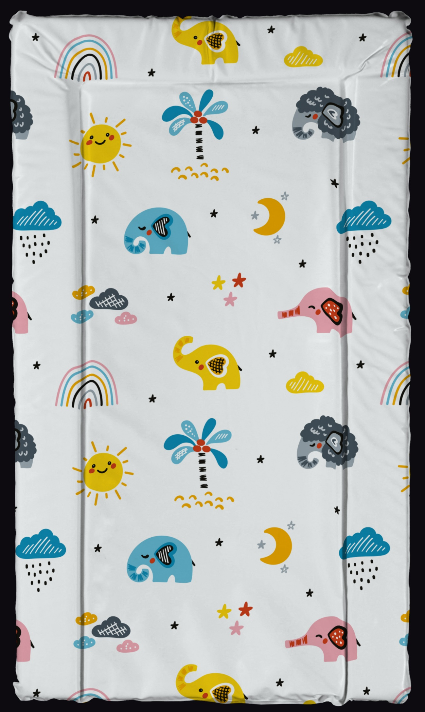
Changing Mats – New Design Collection
Please see below the new collection for changing mats which will be available on the PVC Medium, Microfibre Medium and Microfibre Large ranges (PVC large – on request only)
opyright From Product UK Ltd
All rights reserved
Bebeluca
Bebeluca
Bebeluca
Bebeluca
Over The Moon (G)
Blowin Bubbles
Over The Moon (P)
Jollie Olliphant

Slide 34
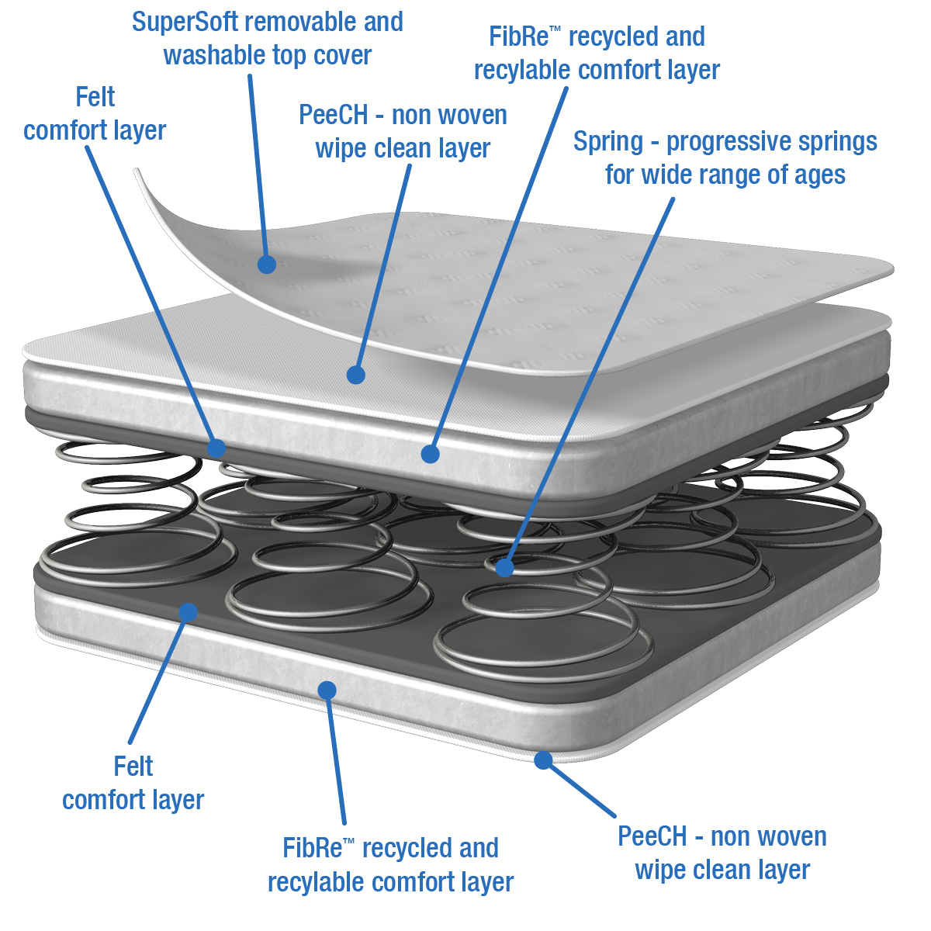
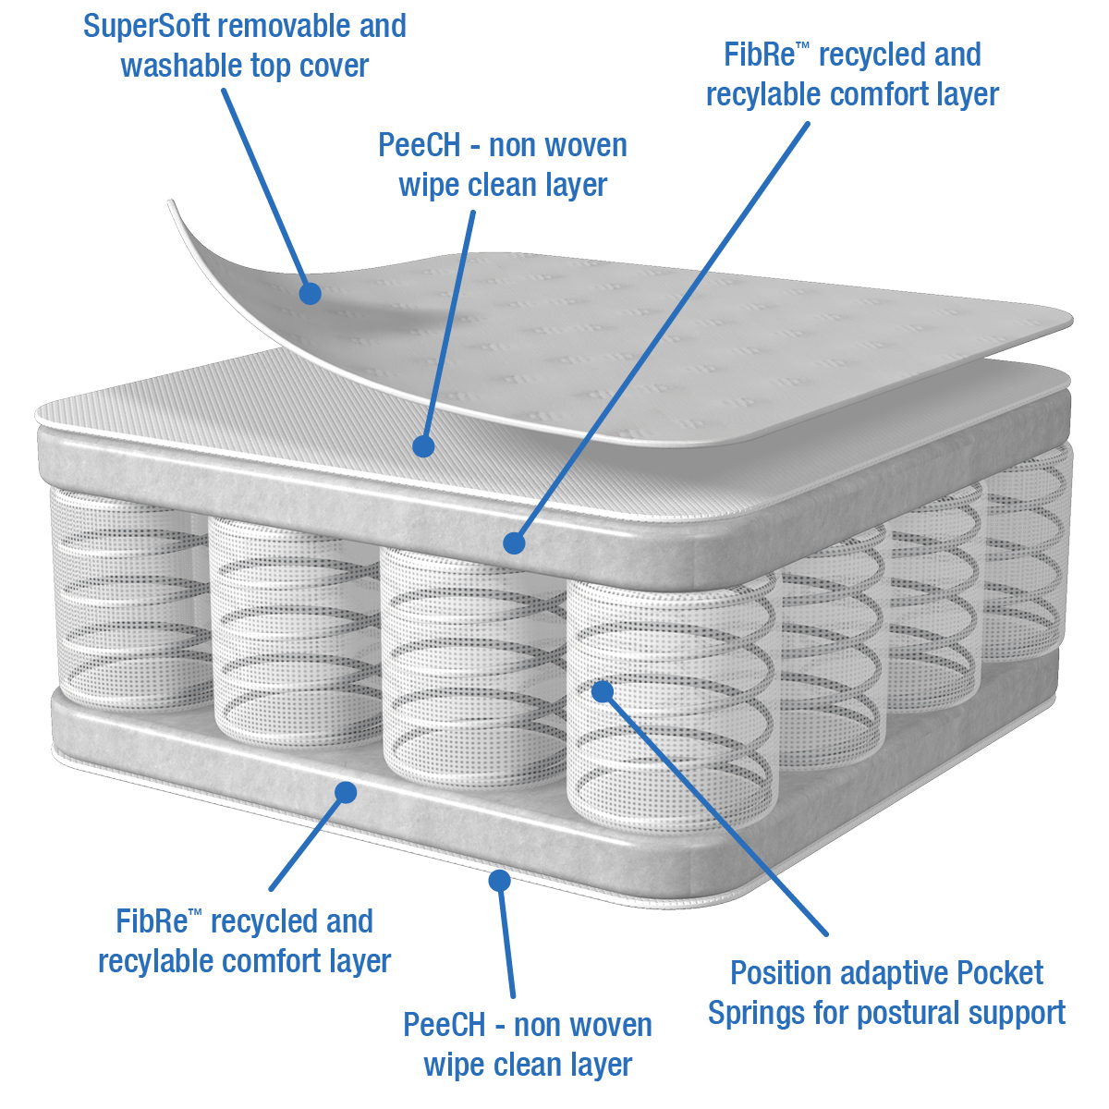
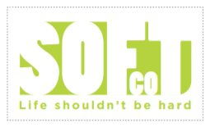
3ft Single Training Mattress - My First Big Bed
A premium Spring 3ft single Junior/Bunk Bed mattress, offering superior comfort, hygiene and support for your child, with a special training feature that gives you peace of mind should a night time accident happen. As your baby grows into an older child, this mattress provides the perfect next step up from a cot/cotbed to their first ‘big bed’.
Item code | Item | Desc/Dims | Pack Size
3ft Training Mats - My First Big Bed
BBLK402 | 3ft Single Spring Junior/Bunk Bed Mattress with special training feature featuring a removable and washable top cover | 190x90x15 | 1
BBLK602 | 3ft Single Pocket Spring Junior/Bunk Bed Mattress with special training feature featuring a removable and washable top cover | 190x90x15 | 1
The SuperSoftTM quilted mattress cover helps to regulate temperature whilst maintaining comfort and posture, and features a removable, washable micropore cover which enhances breathability and air circulation.
Once the top cover is unzipped and removed, a unique special waterproof inner top layer is revealed which completely protects the mattress core from “little accidents“ and other allergens. This ‘training’ layer can be easily sponged/wiped clean with a mild detergent and air dried.
The soft quilted fabric envelopes and orthopaedic core with a fully linked double cone spring base that is cocooned in our eco-friendly FiBreTM and felt comfort layer. Double cones springs add further support and durability to a mattress and are often the best choice for the older child, tailoring postural support for your growing child. (Pocket Spring option also available)
The correct choice of junior mattress will provide a healthier and more hygienic sleeping environment, and provide a better night’s sleep for your child, and peace of mind for you.
The outer top cover can be easily removed for washing at 60 degrees C in accordance with the care label, killing dust-mites, a common cause of allergies
Also available with Viroblock^{R} treatment which helps provide the ultimate protection from known viruses, bacteria and fungal spores and inactivates all coronaviruses (inc Sars COV2/ COVID19), thus maintaining the mattress cover’s hygiene at all times.
Suitable from 3 – 11 years
    This product is fully tested and complies with the relevant UK safety regulations - BS 7177:2008 + A1:2011 ; EN71

